Slide 1
Connective Tissue
1

Slide 2
General Features
COMPOSED OF VARIABLE AMOUNTS OF CELLS, FIBRES AND GROUND SUBSTANCE
ORIGINATES FROM MESENCHYME.
VARIABLE REGENERATIVE POWER
HIGHLY VASCULAR

Slide 3
Functions of Connective Tissue
SUPPORT
.
STORAGE
DEFENSE AND PROTECTION
MEDIUM FOR EXCHANGE

Slide 4
Connective Tissue Cells
Transient cells
Fixed cells
4

Slide 5
 |  |  |  | Fibroblasts
 |  |  |  | Adipose cells
 | Fixed cells: |  |  | Pericytes
 |  |  |  | Mast cells
 |  |  |  | Macrophages | 5

Slide 6
Plasma cells
White blood cells (Neutrophils, Eosinophils, Basophils, Lymphocytes, Monocytes)
Transient cells:
Macrophages
6

Slide 7
Fibroblast
7

Slide 8
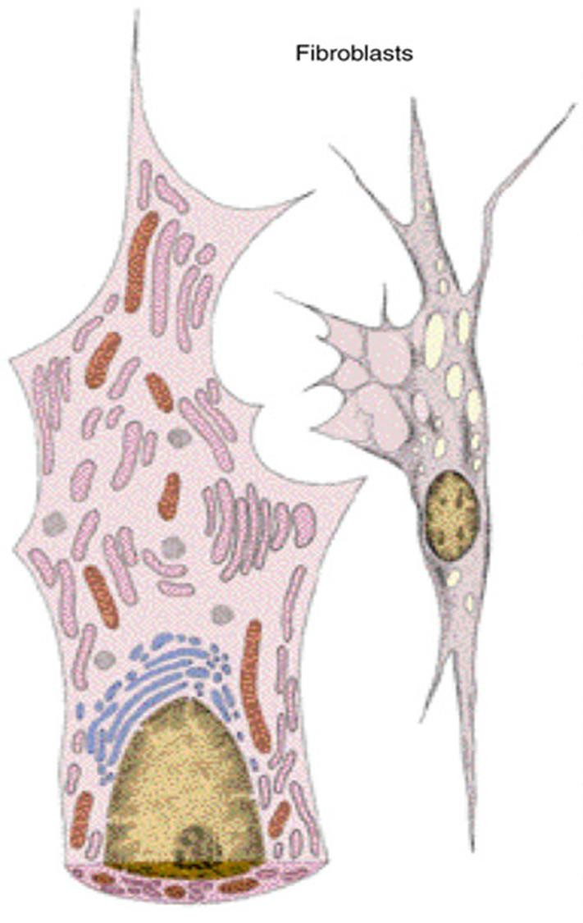
The most numerous cells of connective tissue.
Occur in active and inactive forms (fibrocyte).
Originate from undifferentiated mesenchymal cells.
Capable of some movement.
Rarely undergo division.
FGF may influence cell growth and differentiation.
8

Slide 9
Active fibroblasts
Closely associated with collagen bundles.
Elongated, fusiform, and have many processes.
Cytoplasm is pale and difficult to be differentiated from near by tissue.
Nucleus is large, dark stained and granular.
E.M: prominent Golgi, mitochondria, rER, actin and myosin.
9

Slide 10
10

Slide 11
Inactive Fibroblast (Fibrocyte)
Smaller and ovoid with acidophylic cytoplasm.
The nucleus is smaller and darker. Few processes.
E.M: few rER and many ribosomes.
When stimulated, it may revert to fibroblast.
11

Slide 12
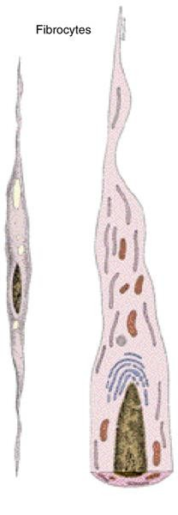
12

Slide 13
Myofibroblast
Has features of both smooth muscles and fibroblasts.
Their contraction is responsible for wound contraction.
13

Slide 14
Mast Cell
14

Slide 15
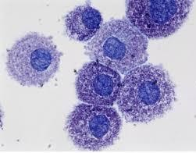
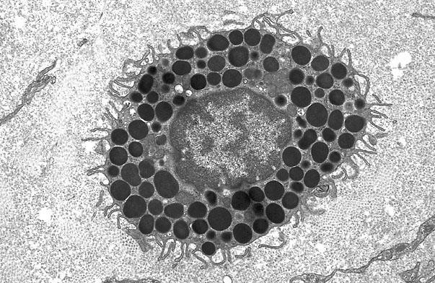
Large cell ~ 20-30 m.
Derived from precursors in the bone marrow. Nucleus: central ovoid.
Cytoplasm highly granular, metachromatic. Grnules contain:
Heparin
Histamin
Leukotriens
Eosinophil chemotactic factor.
Neutrophil chemotactic factor.
Platelet activating factor.
Bradykinin.
Thromboxane A₂
15

Slide 16
Plasma Cell
Derived from B lymphocytes following exposure to an antigen.
Present at portal of entry of organisms and sites of chronic inflammation.
Life span ~ 2-4 weeks.
Large ovoid cells ~ 20 μm. Nucleus: eccentric with clusters
of heterochromatin⭢ cart-wheel
or clock-face nucleus.
16

Slide 17
Cytoplasm:
Intensely basophilic.
Well developed supranuclear Golgi apparatus (- ve image).
Well developed rER.
Functions: secretion of specific antibodies.
17

Slide 18
Derived from monocyte.
Large cells ~15-30 μm.
Surface shows many projections.
Nucleus: eccentric, ovoid, dark, and
indented (kidney-shaped).
Cytoplasm: basophilic, well developed
Golgi, prominent rER, many lysosomes.
They are part of the MPS.
18

Slide 19
Derived from undifferentiated mesenchymal cell.
Surrounded by its own basal lamina.
Commonly seen in the walls of capillaries and venules.
They may differentiate into other cells.
19

Slide 20
Extracellular Matrix
Extracellular Matrix = ground substance + fibres.
Resists compression and stretching forces.
The water content allows rapid exchange of metabolites.
20

Slide 21
Ground Substance
21

Slide 22
Ground Substance
Composed of:
Glycosaminoglycans:
Sulfated: keratan sulfate, chondroitin sulfate, dermatan sulfate and heparin.
Non-sulfated: hylauronic acid
Proteoglycans:Responsible for the gel state of the extracellular matrix.
Adhesive glycoproteins: laminin, chondronectin, osteonectin and fibronectin.
22

Slide 23
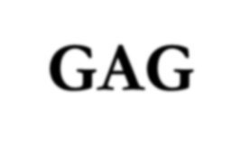
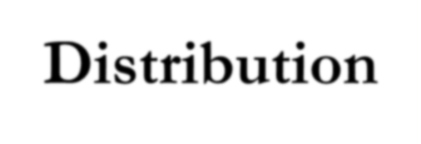
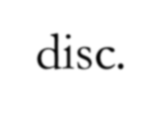
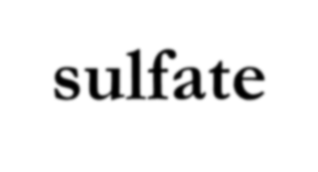
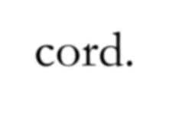
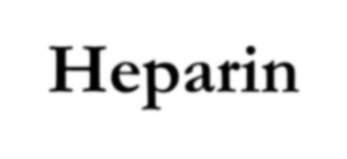
GAG Hyaluronic acid | Distribution Most connective tissue, cartilage, dermis, synovial fluid.
Keratan sulfate | Cartilage, cornea, intervertebral disc.
Heparan sulfate | Blood vessels, lung, basal lamina
Chondroitin 4-sulfate | Cartilage, bone, blood vessels
Chondroitin 6-sulfate | Cartilage, blood vessels, umbilical cord.
Dermatan sulfate | Skin, heart valves, blood vessels
Heparin | Mast cell granules, basophils, liver ₂₃ lung, skin.

Slide 24
Functions of Proteoglycans
Resistance of compression.
Retardation of movement of microorganisms. Act as a filter.
Possess binding sites for growth factors.

Slide 25
Connective Tissue Fibres
Collagen
Elastic
Reticular

Slide 26
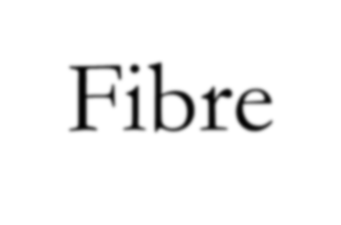
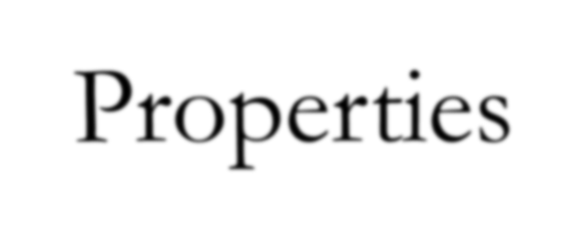
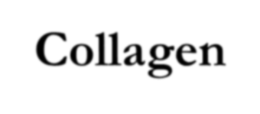
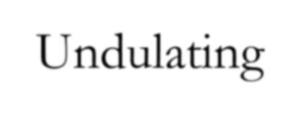
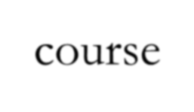
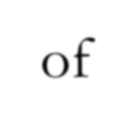
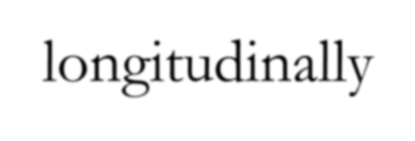
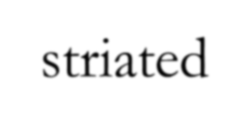
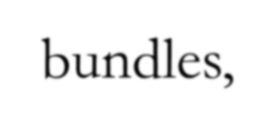
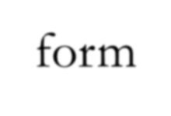
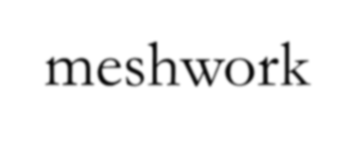
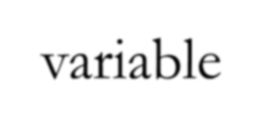
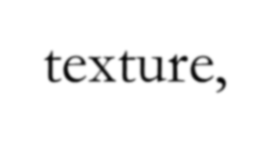
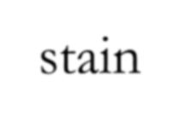
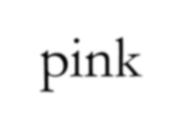
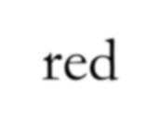
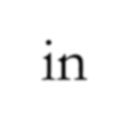
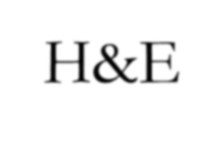
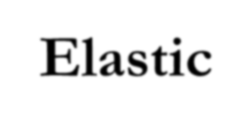
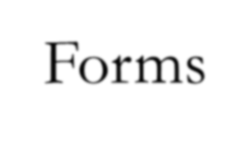
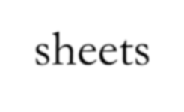
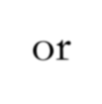
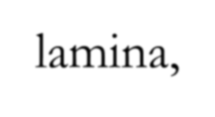
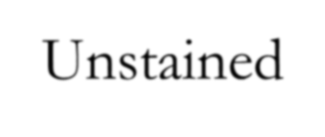
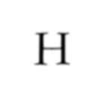
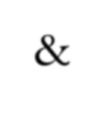
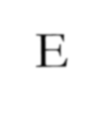
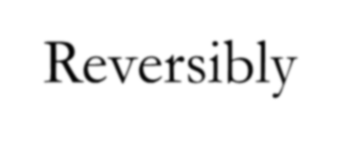
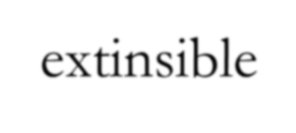
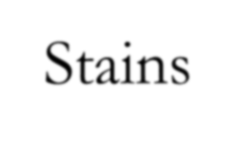
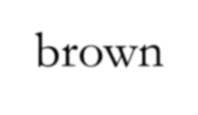
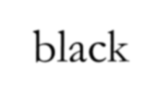
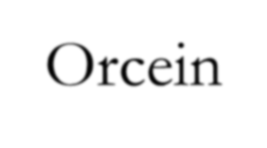
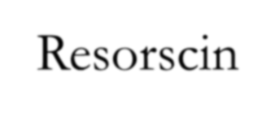
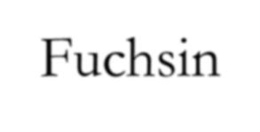
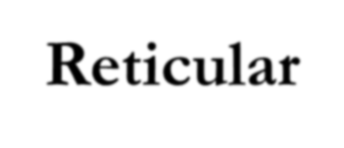
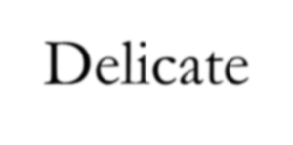
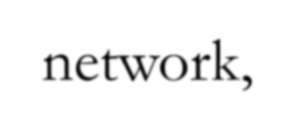
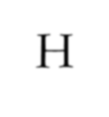
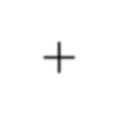
 | Fibre | Properties
 | Collagen | Undulating course of longitudinally striated bundles, form meshwork of variable texture, stain pink-red in H&E. Nonextensible.
 | Elastic | Forms sheets or lamina, Unstained in H & E. Reversibly extinsible. Stains brown-black in Orcein or Resorscin Fuchsin.
 | Reticular | Delicate network, Unstained in H & E. Reversibly extinsible. PAS +ve, stains black in AgNO₃ (Argyrophilic).

Slide 27
Collagen Fibers
Gives the extracellular matrix strength to resist tensile forces.
Formed of protein collagen (20% of all proteins of the body).
H & E: long, wavy pink bundles.
E.M: cross banding at 67 nm.
Fibres are formed of aggregation of fibrils. Fibrils are formed of tropocollagen.
Tropocollagen is formed of 3 helical
polypeptide chains.
27

Slide 30
α-chains possess 1000 amino acids.
Every 3rd amino acid is glycine.
Other amino acids: proline, hydroxyproline, hydroxylysine.
The sequence of aminoacids determines the type of collagen.
There are 16 types of collagen.

Slide 31
II
Basal lamina
31

Slide 32
Intracellular
* Transcription (Nucleus).
Translation (rER).
Hydroxylation (rER).
Glycosylation (rER & Golgi).
Formation of the triple helix.
Secretion of procollagen (trans Golgi network and microtubules).
*** Vit. C is essential
EXTRA CELLULAR
Cleavage and assembly

Slide 34
Clinical Notes:
Progressive Systemic Sclerosis Keloid
Vitamin C deficiency (Scurvy)

Slide 35
ELASTIC FIBERS
Oxytalan: found in the zonule of the eye and upper dermis.
Not elastic, highly resistant to pulling forces.
Elaunin: found in deep dermis around sweat glands
Elastic:
Elasticity is due to elastin.
Elastin = glycine + proline + lysine.
Stability is due to microfibrils (resistant to boiling).
Digested by pancreatic enzyme elastase
Composed of:

Slide 37
RETICULAR FIBRES
Consist mainly type III collagen.
Short, thin and branching. Give PAS +ve reaction.
Stain with Silver Nitrate (Argyrophylic).
Found mainly in RES organs, endometrium and around blood vessels.

Slide 38
Edema
الوذمة

Slide 39
Edema = increase in the intercellular fluid
Arterial:
Venous:
Lymphatic:
Causes:

Slide 42
Classification of Connective Tissue
•
•
•
•
•
•
•
•
•
•
•
•
•
•

