Slide 1
Abdomin

Slide 2
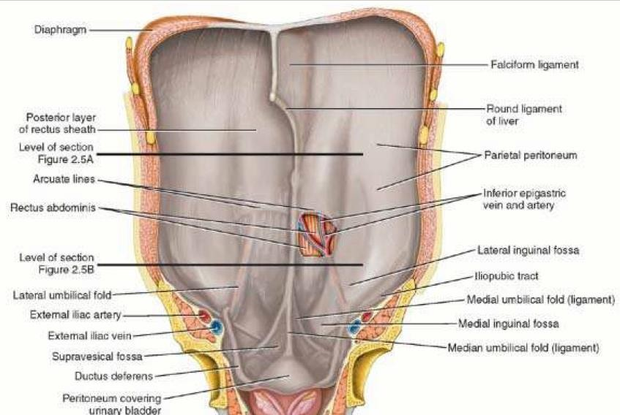
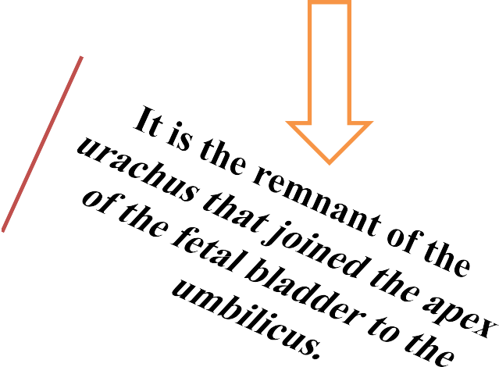
Internal Surface of Anterolateral Abdominal Wall
The infraumbilical part of this surface of the wall exhibits several peritoneal folds
Five umbilical peritoneal folds two on each side and one in the median plane—pass toward the umbilicus
The median umbilical fold, extending from the apex of the urinary bladder to the umbilicus, covers the median umbilical ligament
note: you are looking at internal Surface of Anterolateral Abdominal Wall

Slide 3
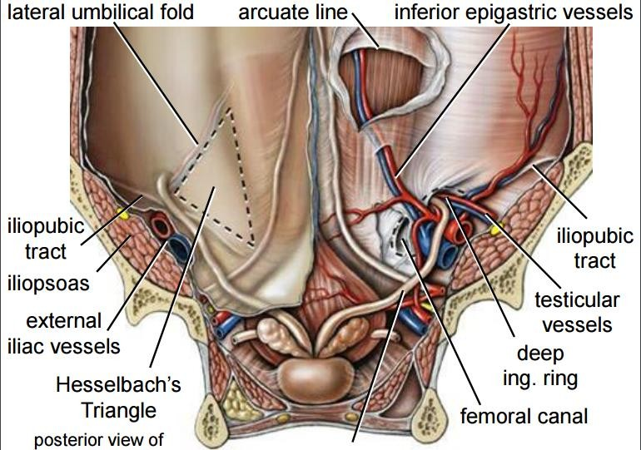
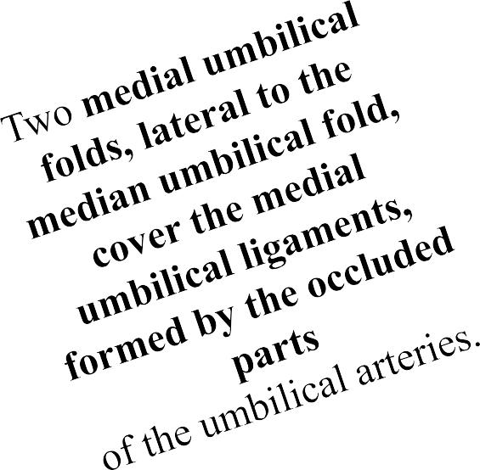
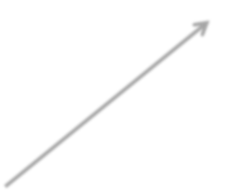
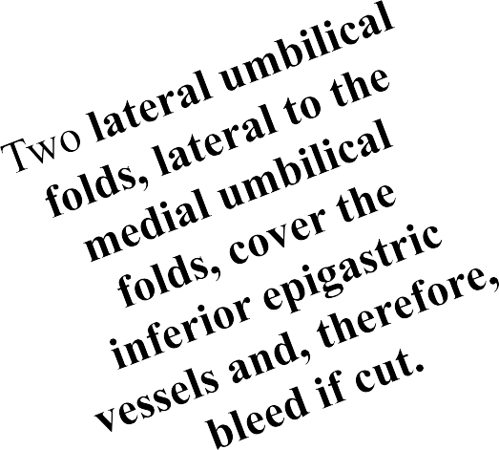

Slide 4
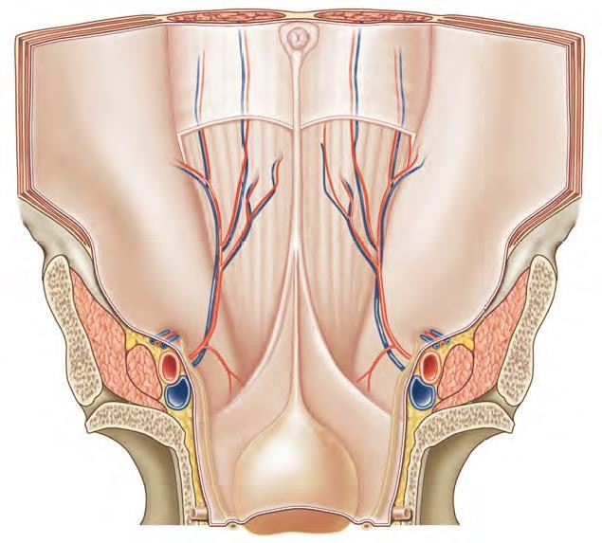
The depressions lateral to the umbilical folds are peritoneal fossae
1-Supravesical fossae between the median and the medial umbilical folds, formed as the peritoneum reflects from the anterior abdominal wall
onto the bladder. The level of the supravesical fossae rises and falls with filling and emptying of the bladder

Slide 5
Medial inguinal fossae between the medial and the lateral umbilical folds, areas also commonly called inguinal t riangles (Hesselbach
triangles). These are potential sites for direct inguinal hernias.

Slide 6
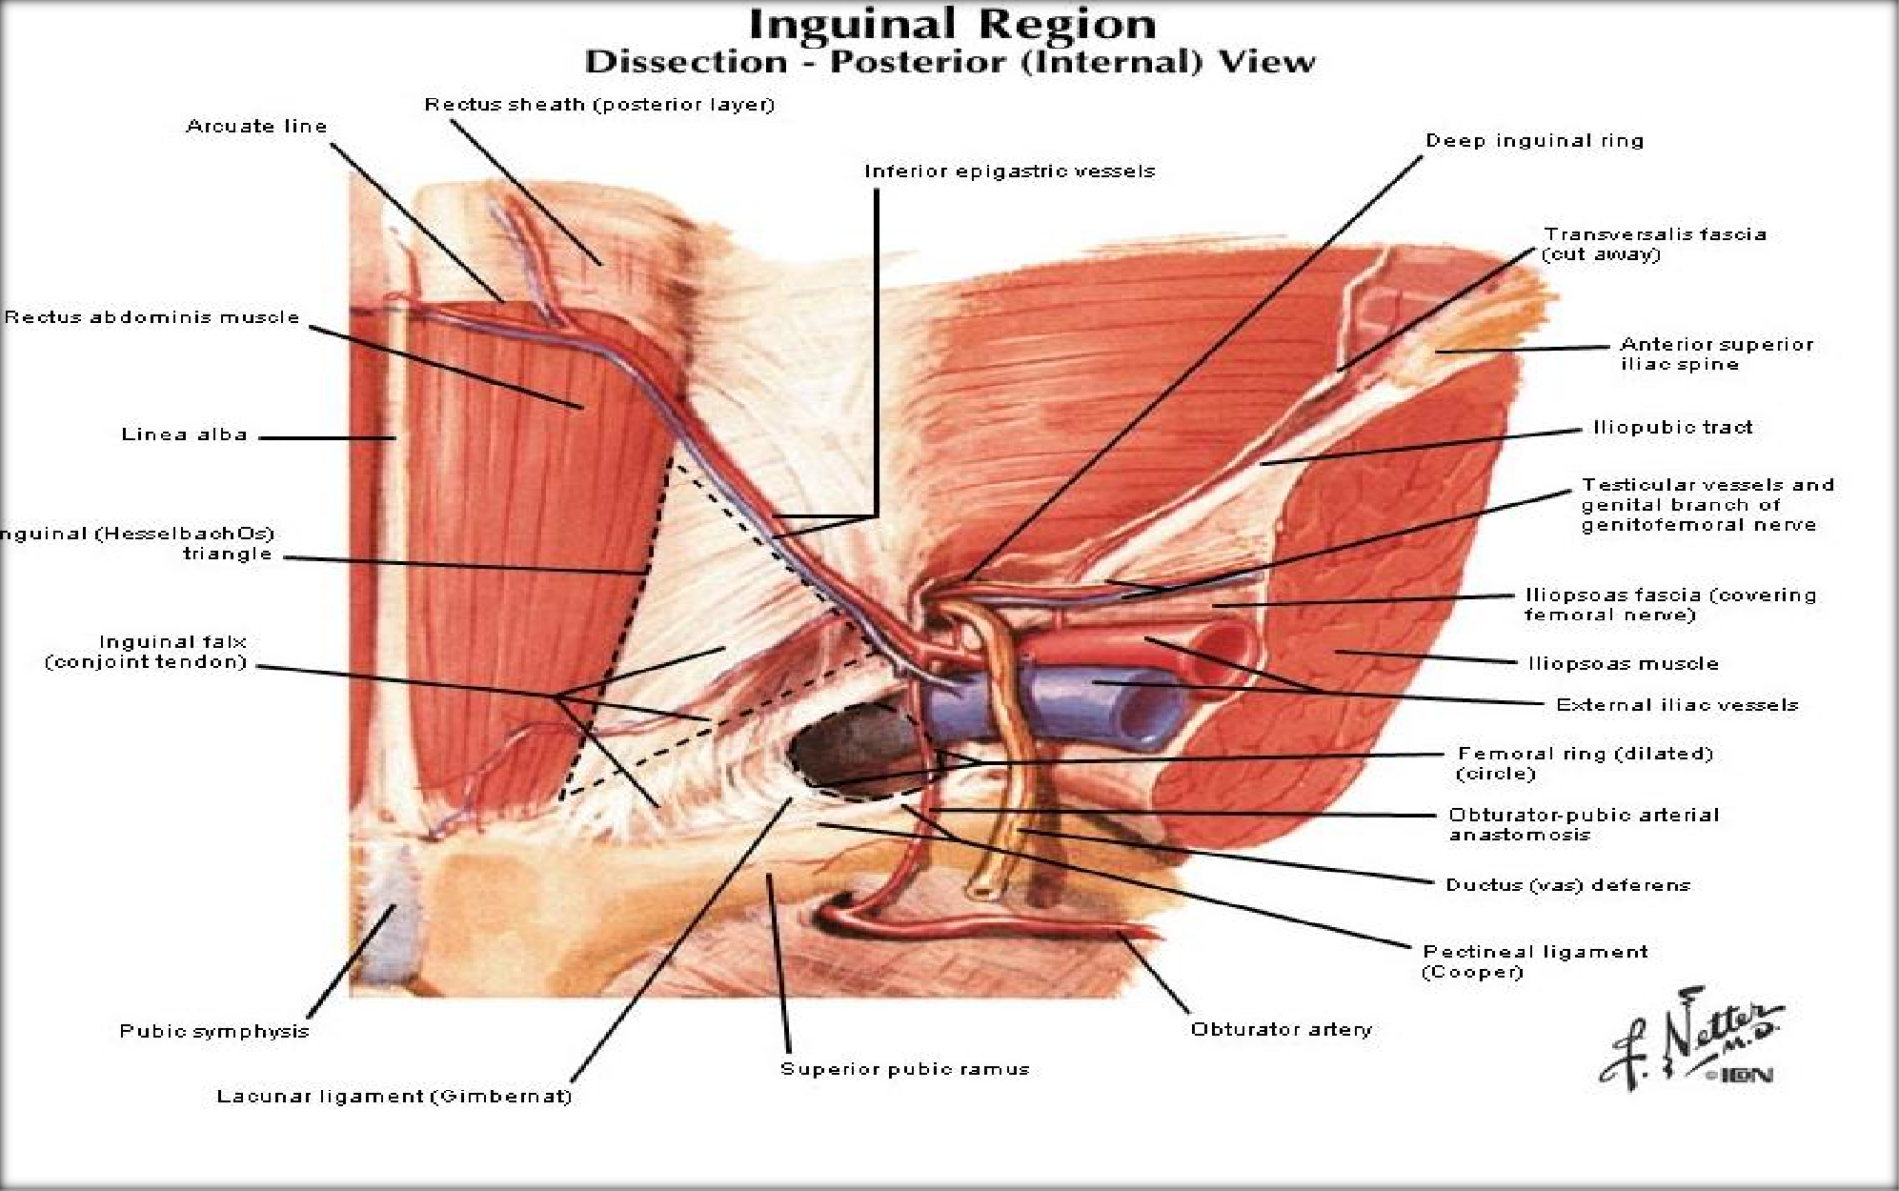
Lateral inguinal fossae, lateral to the lateral umbilical folds; these include the deep inguinal rings and are potential sites for the most common type of inguinal hernia, the indirect inguinal hernia.

Slide 7
Anteriorly:the inguinal ligament
The boundaries of the femoral canal (ring) are:
Medially: the sharp free edge of the pectineal part of the inguinal ligament,termed the lacunar ligament (Gimbernat’s ligament)
Posteriorly — the pectineal ligament
(of Astley Cooper), which is the
laterally—the femoral vein
thickened periosteum along the pectineal border of the superior pubic
ramus and which continues medially with the pectineal part of the inguinal
ligament.
Dr.Amjad shatarat

Slide 8
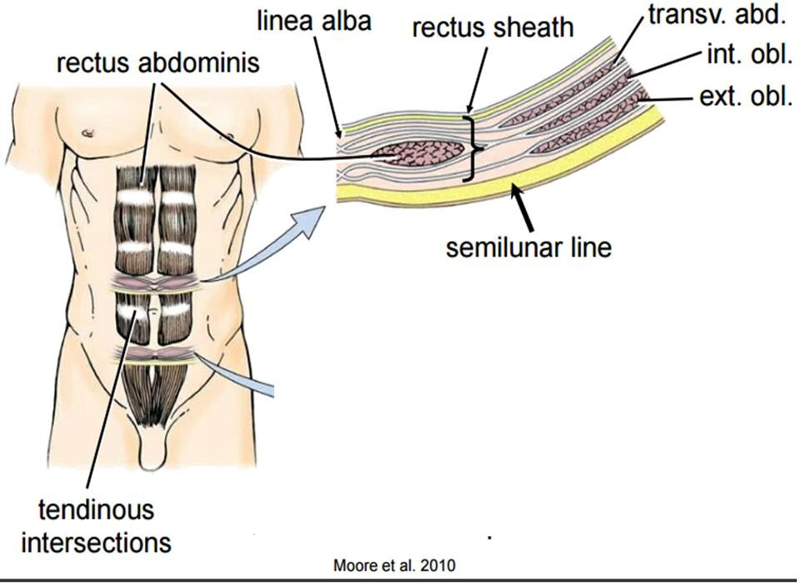
Transverse section superior to umbilicus
The anterior layer of the rectus sheath is formed by:
The external oblique aponeurosis The anterior lamina of the internal oblique aponeurosis
The posterior layer of the rectus sheath is formed by:
The posterior lamina of the internal
oblique aponeurosis The transversus abdominis
aponeurosis

Slide 9
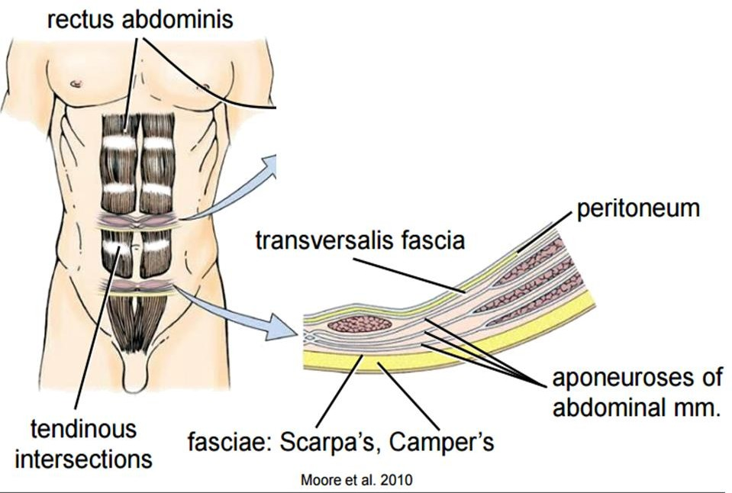
Transverse section inferior to umbilicus
The anterior layer of the rectus sheath is formed by:
The aponeuroses of all three muscles,
the external internal oblique
the transversus abdominis
The posterior layer of the rectus
sheath is formed by:
only the transversalis fascia

Slide 10
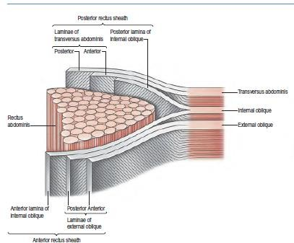

Slide 11
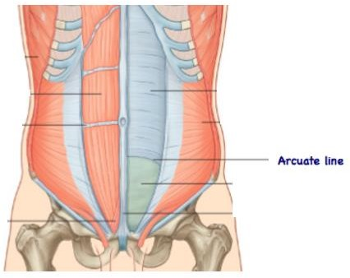
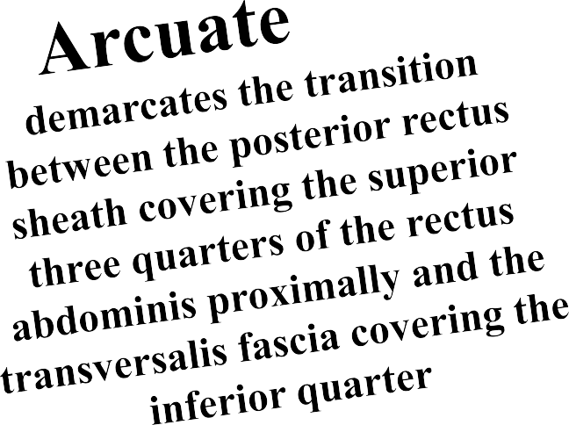

Slide 12
The contents of the rectus sheath
1-The rectus abdominis 2-Pyramidalis muscles
3-The anastomosing superior inferior
Epigastric arteries and veins 4-The lymphatic vessels
5-The distal portions of the anterior rami of Spinal nerves T7-T12, which supply the muscle and overlying skin

Slide 13
Nerves of Anterolateral Abdominal Wall
The skin and muscles of the anterolateral abdominal wall are supplied mainly by the
1-Thoraco-abdominal nerves: the anterior rami of the inferior six thoracic spinal nerves (T7-T11)
2-Subcostal nerve: large anterior ramus of spinal nerve T12
3-Iliohypogastric and ilio-inguinal nerves: terminal branches of the anterior ramus of spinal nerve L1.
Each nerve has muscular branches
and anterior and lateral cutaneous branches.

Slide 14
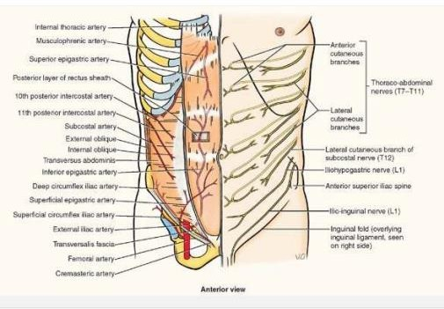
Spinal nerves T7-T9 supply the skin superior to the umbilicus
T10 innervates the
skin around the
umbilicus
Spinal nerve T11, plus the cutaneous branches of the subcostal (T12), iliohypogastric, and ilio-inguinal (L1) nerves: supply the skin inferior to the umbilicus.

Slide 15
Blood supply of the anterolateral abdominal wall
Superior Epigastric Vessels
Branches Of The Musculophrenic Vessels From The Internal Thoracic
Vessels.
Inferior Epigastric
Deep Circumflex Iliac Vessels From The External Iliac Vessels. Superficial Circumflex Iliac And Superficial Epigastric Vessels From The Femoral Artery And Great Saphenous Vein.
Posterior Intercostal Vessels In The 11th Intercostal Space And Anterior Branches Of Subcostal Vessel

Slide 16
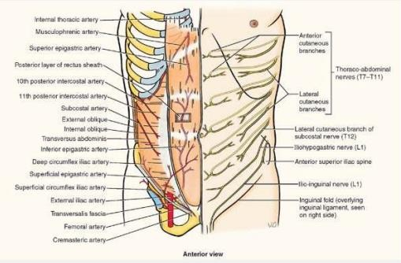
The superior epigastric artery, the direct continuation of the internal thoracic artery, enters the rectus sheath superiorly through its posterior layer supplies the upper part of the rectus abdominis, and anastomoses with the inferior epigastric artery.
The inferior epigastric artery arises from the external iliac artery just superior to the inguinal ligament. It runs superiorly in the transversalis fascia to enter the rectus sheath inferior to the arcuate line. Its branches enter the lower rectus abdominis and anastomose with those of the superior epigastric artery.

Slide 17
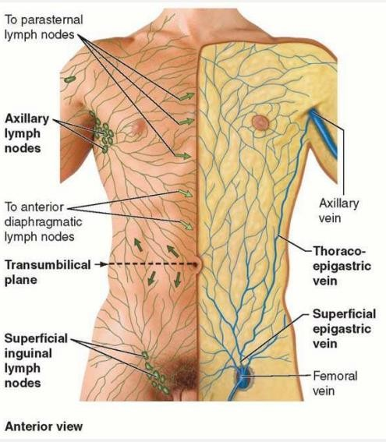
The superficial lymphatic vessels accompany the subcutaneous veins;
Those superior to the umbilicus drain mainly to the axillary lymph nodes,
Those inferior to it drain to the superficial inguinal lymph nodes
The deep lymphatic vessels accompany the deep veins and drain to the external iliac, common iliac, and lumbar (caval and aortic) lymph nodes

Slide 18
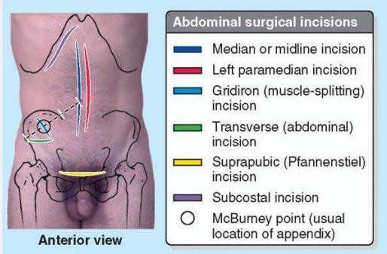

Slide 19
Instead of transecting muscles, causing irreversible necrosis (death) of
muscle fibers, the surgeon splits them between their fibers.
The rectus abdominis is an exception and can be transected because its muscle fibers are short and its nerves entering the lateral part of the rectus sheath can be located and preserved.

Slide 20
Umbilical Hernia

Slide 21
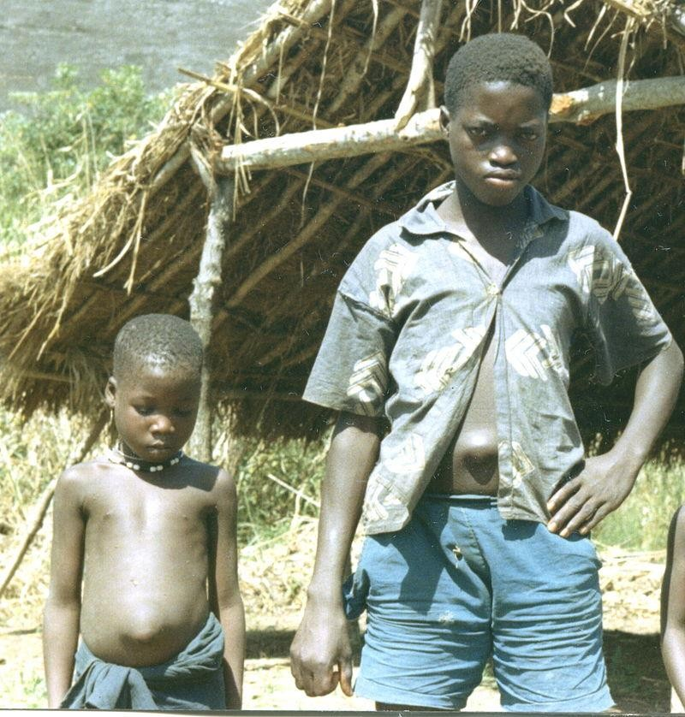
(I)Umbilical hernia
There are three varieties of umbilical hernia.
A-Congenital herniation: 1- a defect is present from birth.
Usually simply the result of failure of closure of the umbilicus after retraction of the umbilical gut loop.

Slide 22
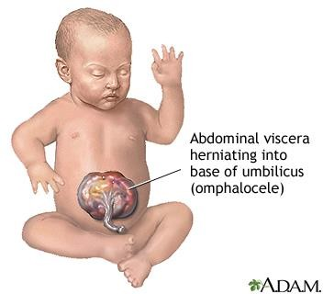
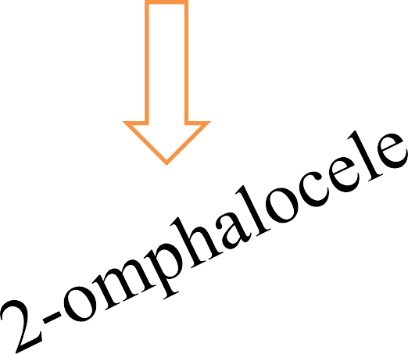
Less commonly, the gut loop does not retract
and remains, in
part, outside the abdominal cavity
Notice that 1 and 2 are present from birth

Slide 23
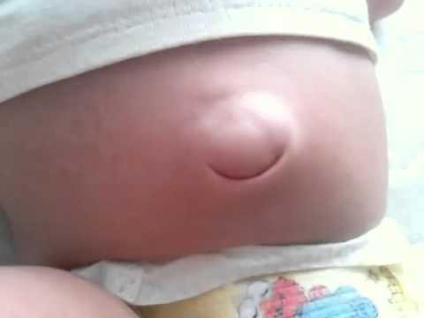
B-An infantile umbilical hernia
is
caused by stretching of the umbilical scar tissue, associated with increased intra-abdominal pressure.
The infant at time of birth has normal umbilicus, however, after that with increased intra-abdominal pressure the hernia may occur.

Slide 24
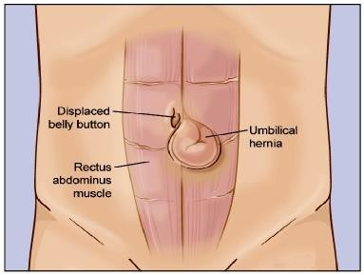
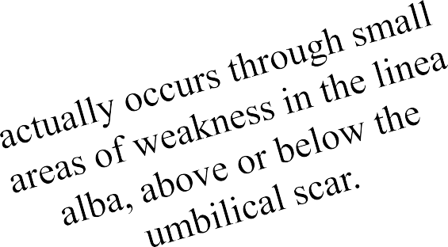
C-An acquired umbilical or paraumbilical hernia

Slide 26
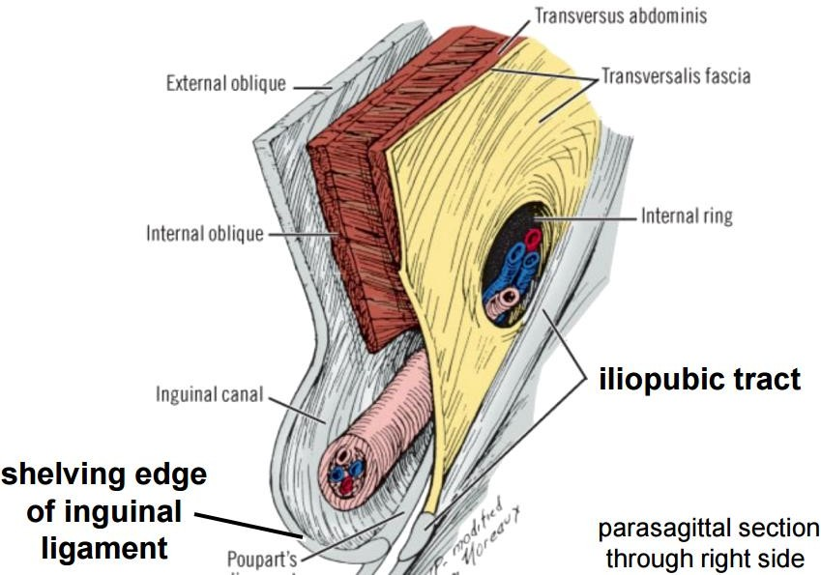
Inguinal canal
The inguinal canal is a natural hiatus in the tissues of the anterior
abdominal wall.
Its size and form vary with age, and although it is present in both sexes it is most well developed in the male.
The canal is an oblique
tunnel, with deep and superficial openings or rings.
It contains the
Spermatic cord in males
The round ligament of the uterus in females The ilioinguinal nerve in both sexes.

Slide 27
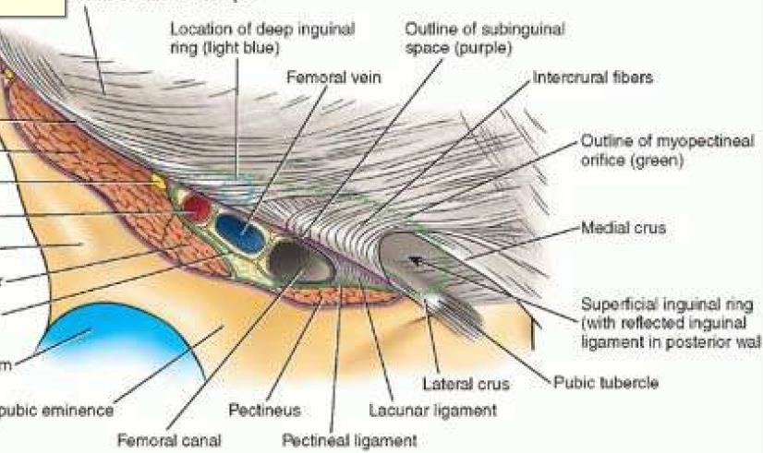
Superficial inguinal ring
The superficial inguinal ring is a hiatus in the aponeurosis of external oblique, just above and lateral to the crest of the pubis.
The ring is actually triangular
The ring is smaller in the female.
The base lies along the crest of the pubis
The medial crus is thin. The fibres attach to the front of the symphysis pubis and interlace with fibres from the opposite side.
its sides are the crura of the opening in the aponeurosis. .
The lateral crus is the stronger and is reinforced by fibres of the inguinal ligament inserted into the pubic tubercle
In the male, the lateral crus is curved to form a groove, in which the spermatic cord rests

Slide 28
Deep inguinal ring The deep inguinal ring is situated in the transversalis fascia, midway
between the anterior superior iliac spine and the symphysis pubis

Slide 29
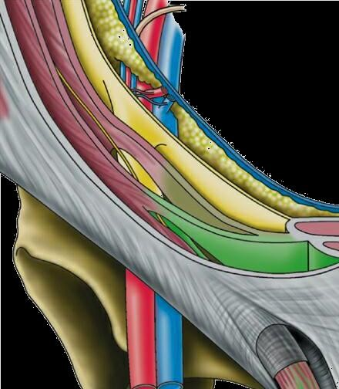
The inguinal canal has two walls (anterior and posterior), a roof, and a floor
Roof: formed laterally by transversalis fascia, centrally by the musculo-aponeurotic arches of internal oblique and transversus abdominis muscles, and medially by the medial crus of the external oblique aponeurosis.
Posterior wall:
formed by transversalis fascia;
The medial part of the posterior wall of the canal is reinforced by merging of the pubic attachments of the internal oblique and transversus abdominis aponeuroses into a
common tendon—the inguinal falx
(conjoint tendon).
Anterior wall: formed by external oblique aponeurosis throughout the length of the canal;
the anterior wall of the lateral part of the canal is
reinforced by fibers of internal oblique.

Slide 30
Floor: formed laterally by the iliopubic tract, centrally by the superior surface of the inguinal ligament, and medially by the lacunar ligament.

Slide 31
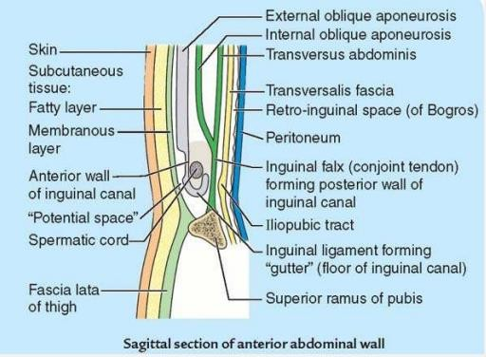
Look at the floor in a sagittal section as the inguinal ligament forms a gutter
Floor

Slide 32
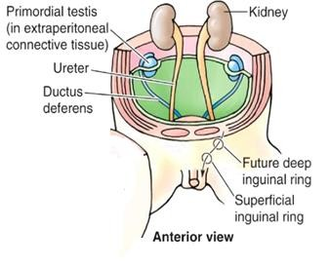

Slide 33
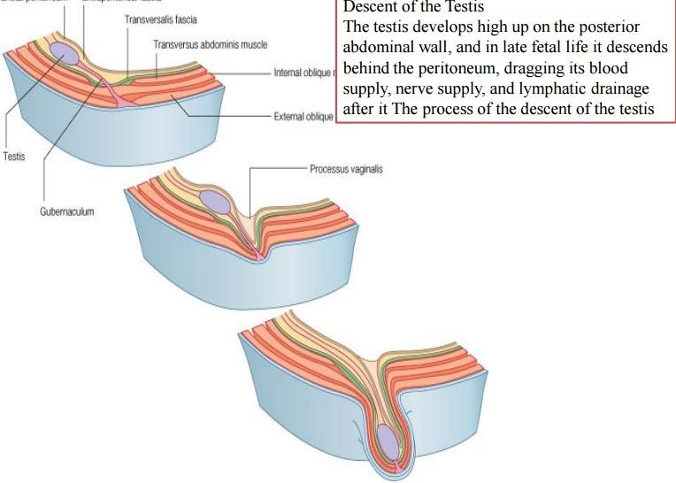

Slide 34
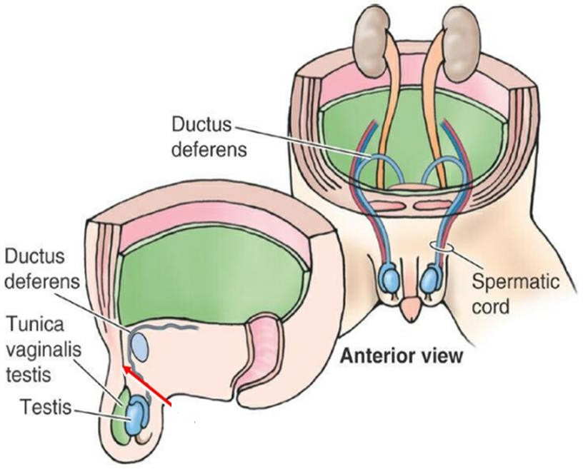

Slide 35
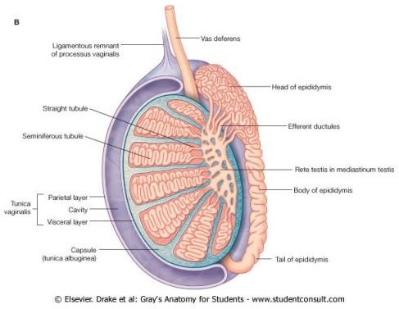
As the testis migrate from the abdomen to the scrotum, it takes with it part of the peritoneum
called
It upper part becomes obliterated before birth
The lower part forms

Slide 37
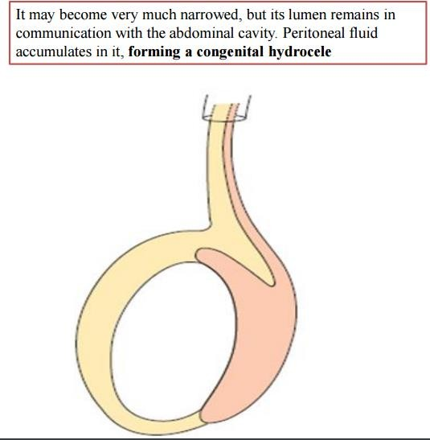
the upper part of the
processus vaginalis

Slide 38
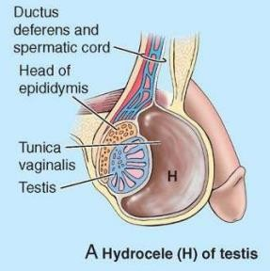

Slide 39
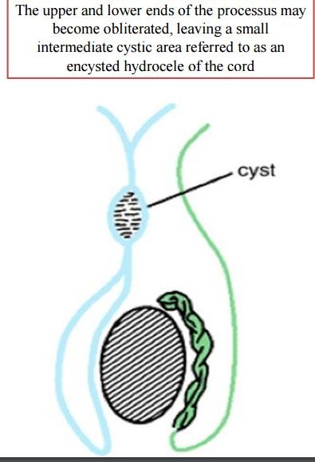

Slide 40
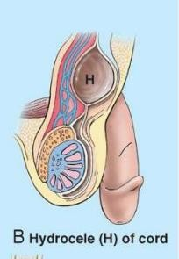

Slide 41
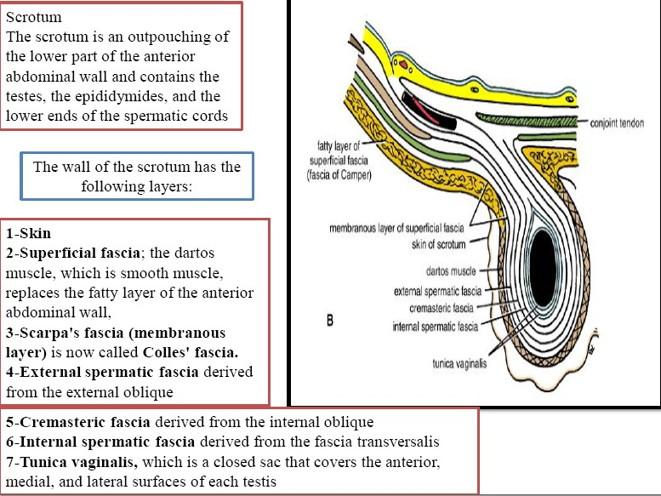

Slide 43
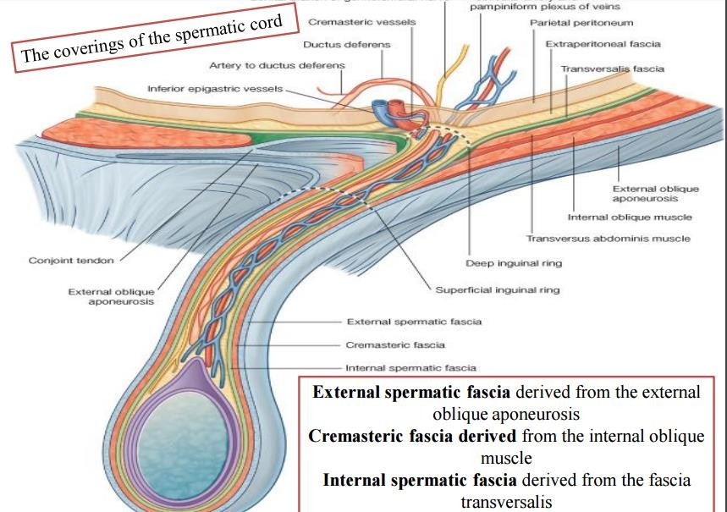

Slide 44
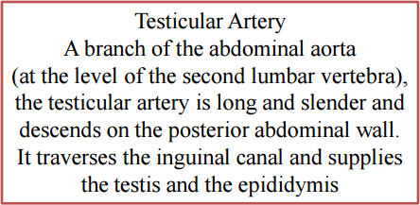

Slide 47
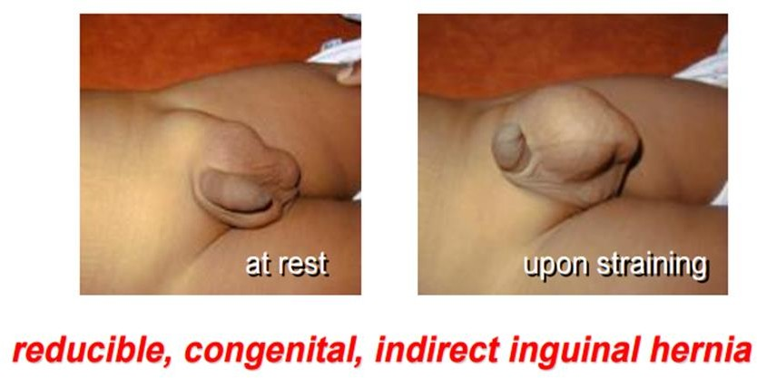

Slide 48
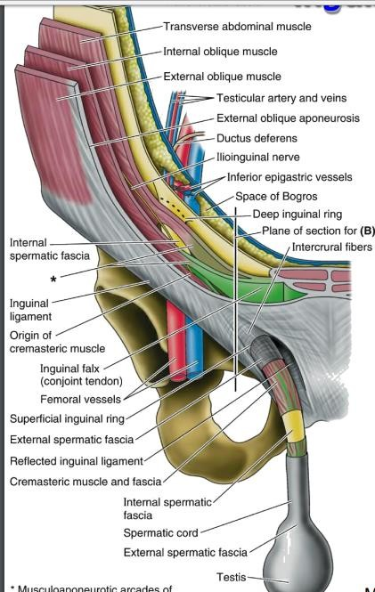

Slide 50
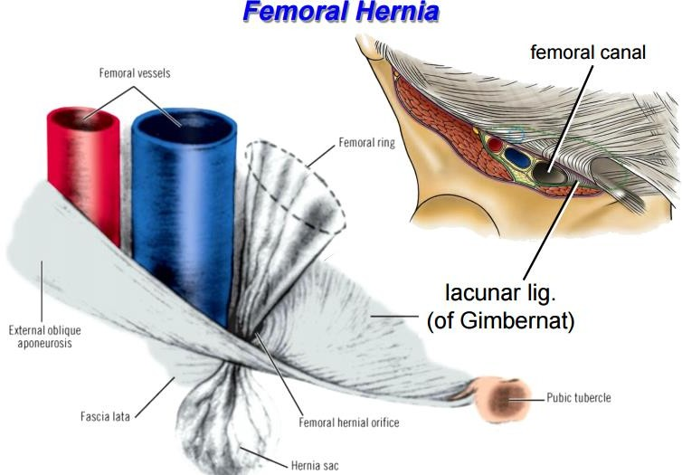

Slide 51
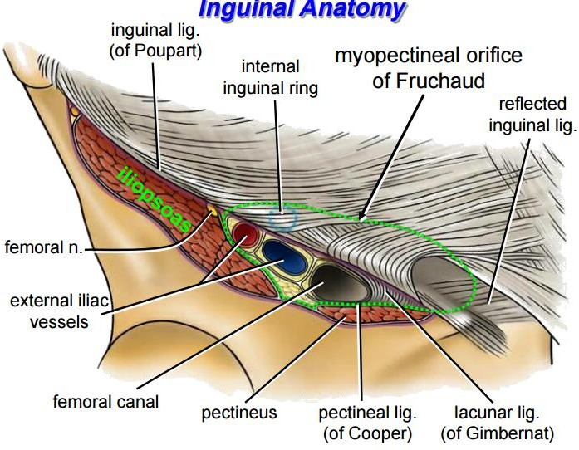

Slide 52
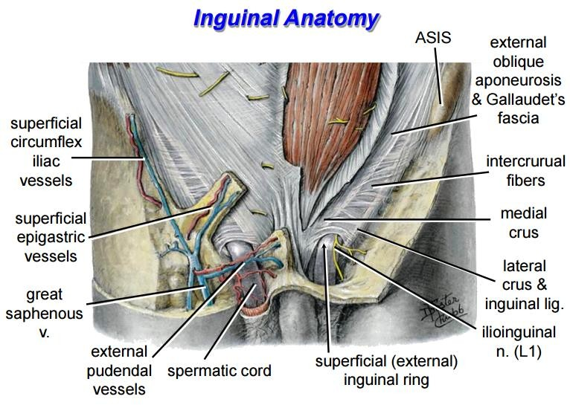

Slide 53
Thank You

