Slide 1
Title

Slide 2
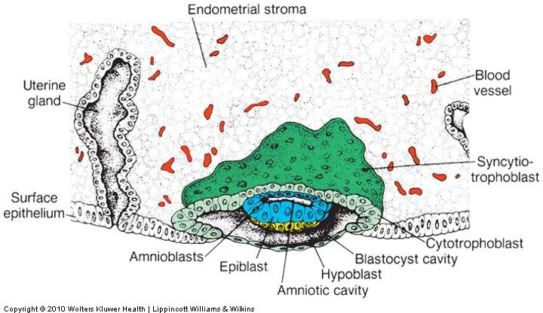
The trophoblast differentiates into two layers:
(1) an inner layer the
CYTOTROPHOBLAST
(2) an outer zone the
SYNCYTIOTROPHOBLAST

Slide 3
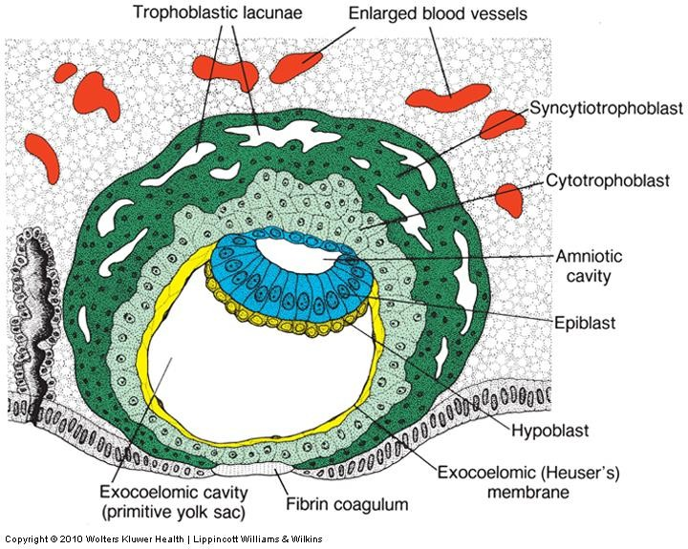
At the trophoblast
vacuoles
appear in the syncytium.
These vacuoles fuse and form large
lacunae
shatarat
This phase of trophoblast development is known as the
LACUNAR STAGE

Slide 4
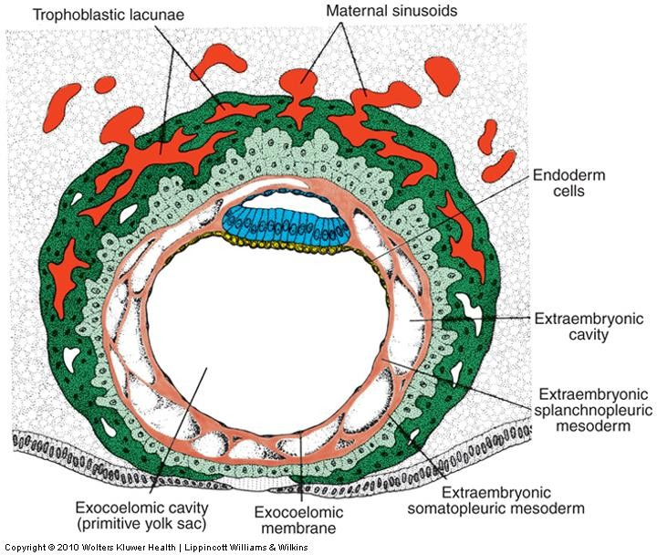
syncytiotrophoblast start to penetrate
The
deeper into the stroma and eroding the maternal capillaries
known as sinusoids.
shatarat
The syncytial lacunae
become continuous with the
sinusoids,
and maternal blood enters
the
lacunar system
Thus establishing the
UTEROPLACENTAL
CIRCULATION

Slide 5
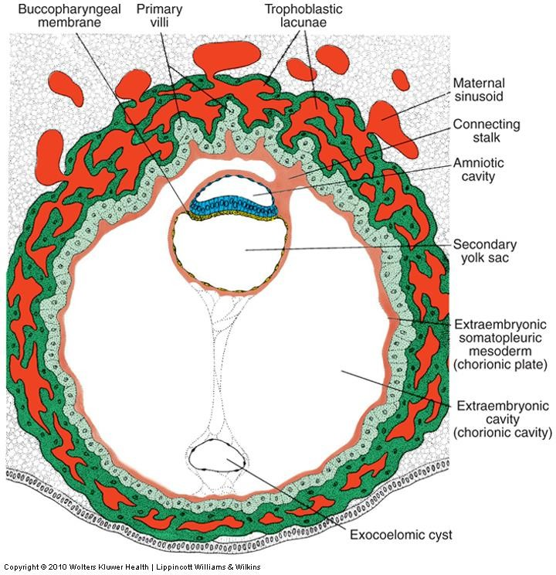
Cells of the cytotrophoblast proliferate
locally and penetrate into the syncytiotrophoblast, forming cellular columns surrounded by syncytium.
Cellular columns with the syncytial covering are known as
PRIMARY VILLI
shatarat

Slide 6
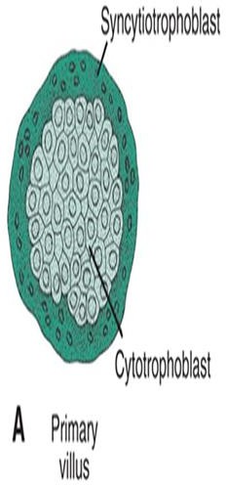
By the beginning of the third week
The trophoblast is
characterized by
primary villi
that consist of a cytotrophoblastic core covered by asyncytial layer
shatarat

Slide 7
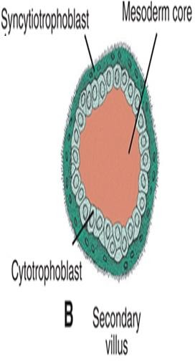
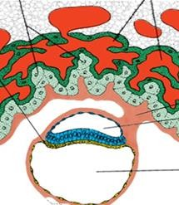
During further development mesodermal cells penetrate the core of primary villi and grow toward the decidua
The newly formed structure is known as
a secondary villus
shatarat

Slide 8
By the end of the third week, mesodermal cells in the core of the villus begin to differentiate into blood cells and small blood vessels
forming the villous capillary system The villus is now known as a
Tertiary villus or
definitive placental villus
shatarat

Slide 9
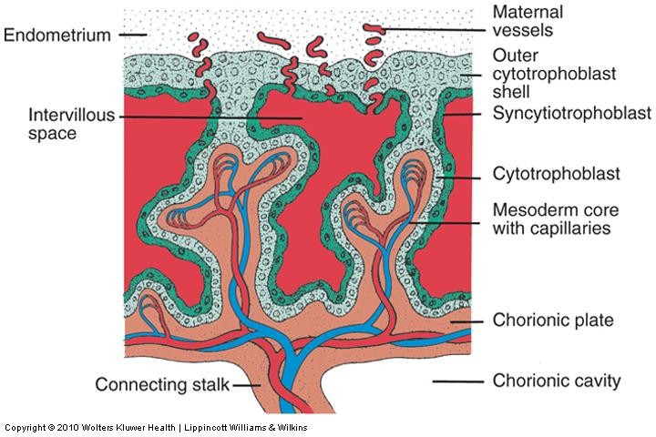
Capillaries in tertiary villi make contact with
capillaries developing in the mesoderm of the chorionic plate and in the connecting stalk
These vessels, in turn, establish contact with the intraembryonic circulatory system, connecting the placenta and the embryo
shatarat

Slide 10
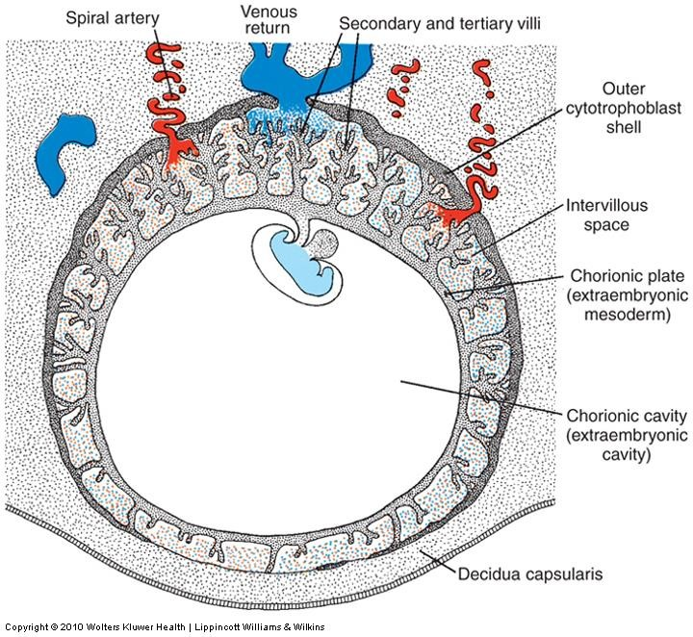
Maternal blood is delivered to the placenta by spiral arteries in the uterus
During the following months, numerous
small extensions grow out from existing stem villi and extend as free villi into the surrounding lacunar or intervillous spaces.
shatarat

Slide 11
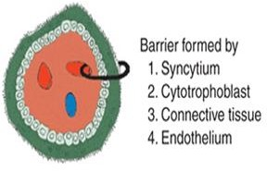
The placental membrane, which separates maternal and fetal blood, is
initially composed of four layers:
the endothelial lining of fetal vessels
the connective tissue in the
villus core
the cytotrophoblastic layer
the syncytium
shatarat

Slide 12
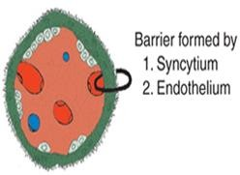
FROM THE FOURTH MONTH ON
The placental membrane thins because the endothelial lining of the vessels comes in intimate contact with the syncytial membrane, greatly increasing the rate of exchange
shatarat
Some times called the placental barrier, the placental membrane is not a true barrier, as many substances pass through it freely

Slide 13
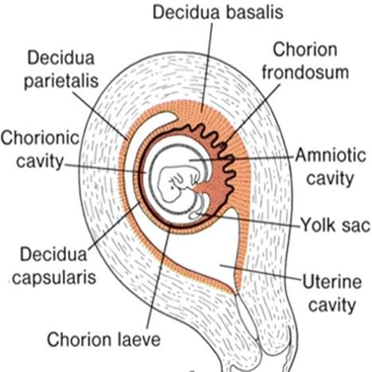
By the beginning of the fourth month, the placenta has two components:
a fetal portion, formed
by the chorion
frondosum
a maternal portion, formed by the decidua
basalis
In the junctional zone, trophoblast and decidual cells
intermingle.
shatarat

Slide 14
PLACENTA
Two component
Maternal
Fetal
is derived from the trophoblast and
extraembryonic mesoderm
CHORION FRONDOSUM
The maternal component is derived from the
Uterine endometriumshatarat
DECIDUA BASALIS
shatarat

Slide 15
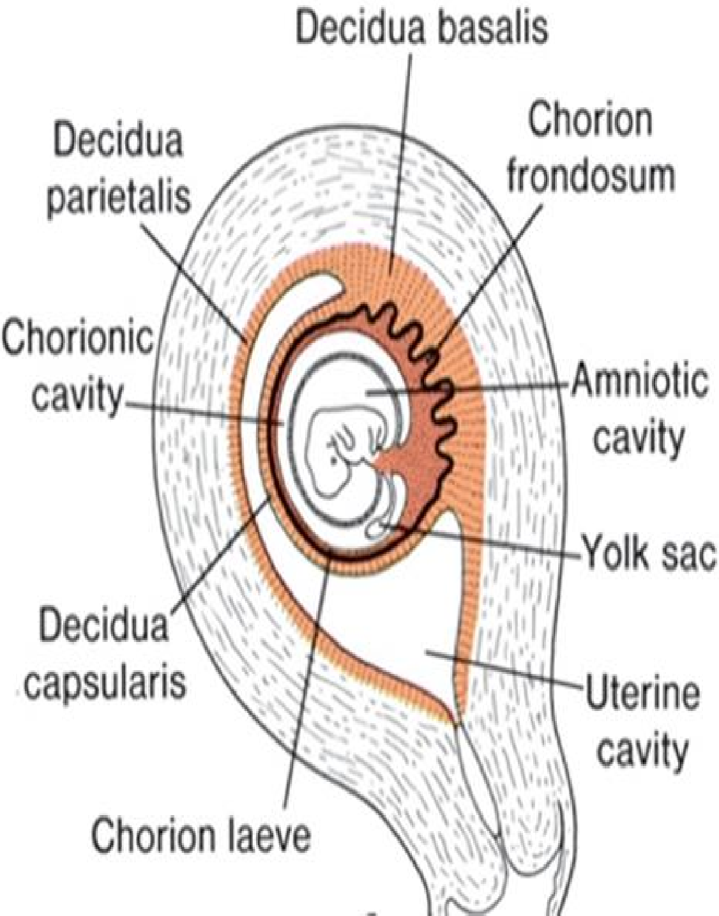
Decidua
Decidua: (is the structure that will separate)
is the endometrium after implantation
Parts:
Decidua basalis：under
the implantation site
Decidua capsularis： between the implantation site and the uterine lumen
Decidua parietalis： remaining endometrium

Slide 16
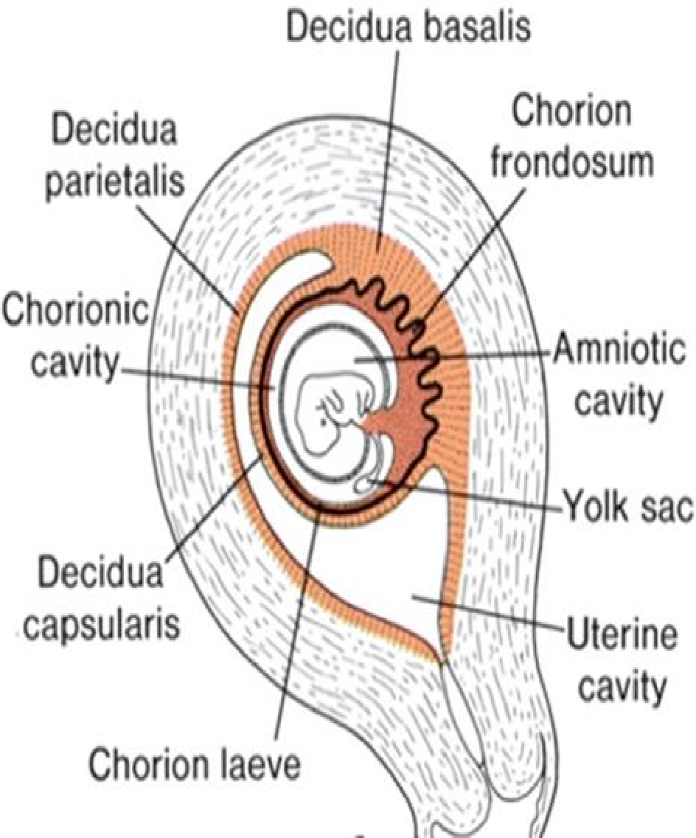
PARTS OF CHORION
1-Chorion laeve： adjacent to
Chorion frondosum
2-Chorion frondosum： adjacent to
Ch
orion laeve
shatarat

Slide 17
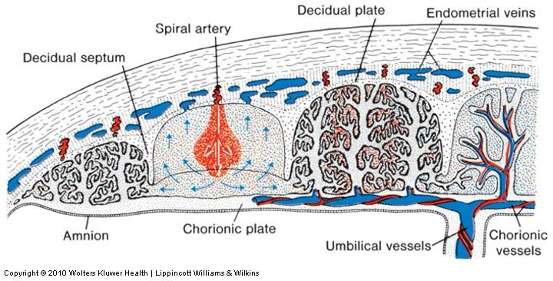
During the fourth and fifth months, the decidua forms a number of decidual septa, which project into intervillous spaces
shatarat

Slide 18
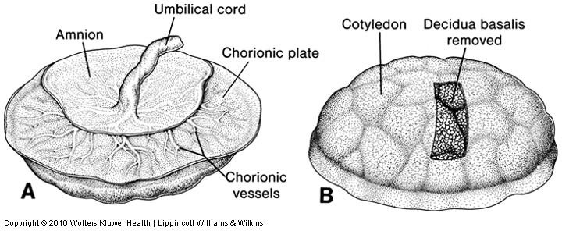
As a result of this septum formation, the placenta is divided into a number of compartments, or
Cotyledons
At full term
the placenta is discoid with a diameter
of 15 to 25 cm
is approximately 3 cm thick, and weighs about 500 to 600 g
approximately 30 minutes after birth of the child, is expelled from the uterine cavity
as the afterbirth.
shatarat

