Slide 1
Joints of the Upper Limb

Slide 2
Shoulder joint
(Glenohumeral joint)(Gleno- humeral joint)
Shoulder joint

Slide 3
Type of the joint: synovial of the ball and socket variety.
Articular surfaces:
Glenoid cavity of the scapula
Head of the humerus
The glenoid cavity is deepened and widened by the presence
of cartilage around it margins known as labrum glenoidale.
The head of the humerus is more than half a sphere and it is 3- 4 times larger than the glenoid cavity.

Slide 4
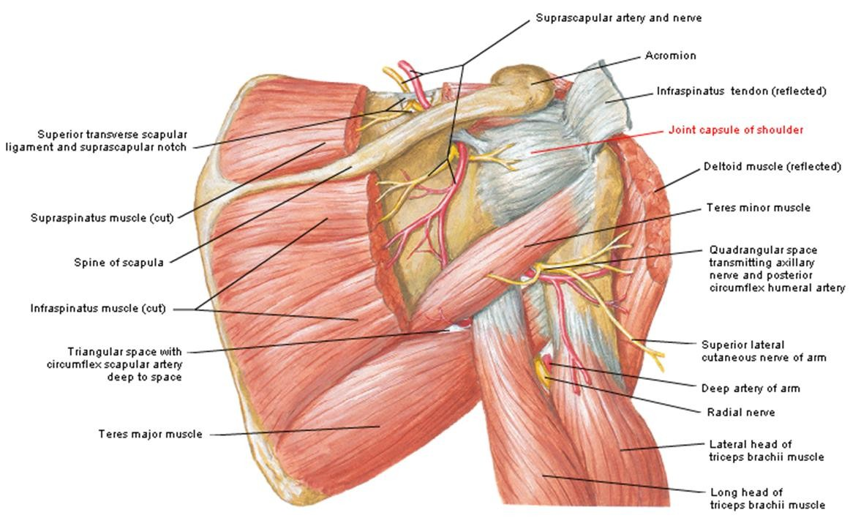

Slide 5
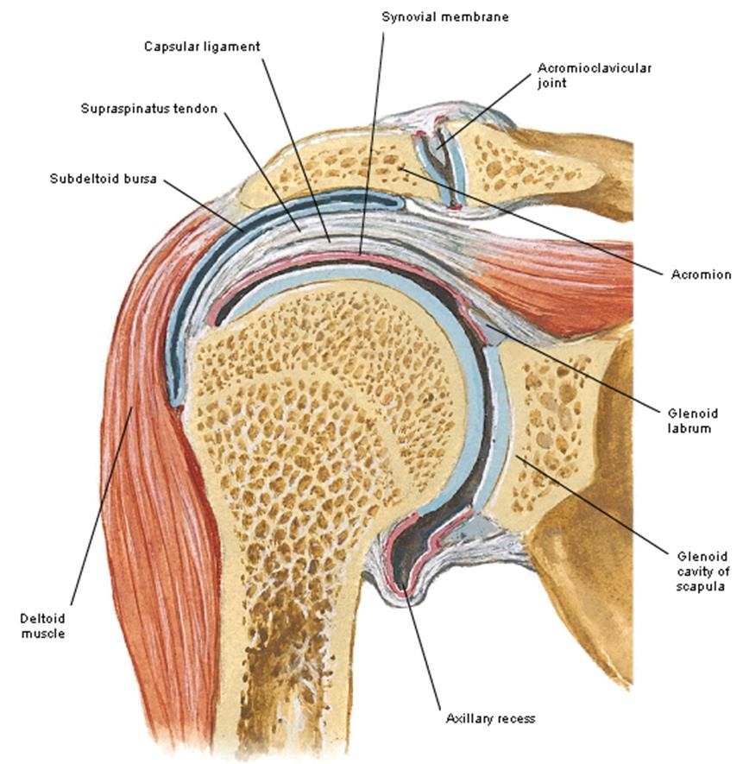
Attachments:
Fibrous capsule of the shoulder joint ..1
Medially: to the margins of the glenoid cavity including the supraglenoid tubercle.
Laterally: to the anatomical neck of the humerus:
It descends for 1 cm the medial side of the surgical neck.
The inferior part is thin and lax and projects into the upper part of the quadrangular space named axillary recess.

Slide 6
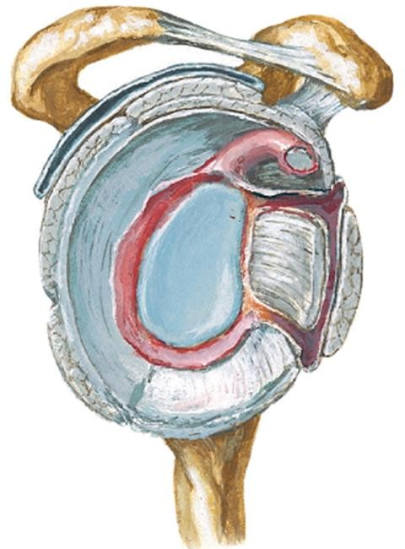
Fibrous capsule of the
shoulder joint ..2
Openings in the capsule:
Below the coracoid process: connects the joint cavity to the subscapular bursa.
Between greater and lesser tuberosities: transmits the tendon of the long head of triceps and its synovial sheath.
Posterior opening (occasional): connects the joint cavity to the infraspinatus.

Slide 7
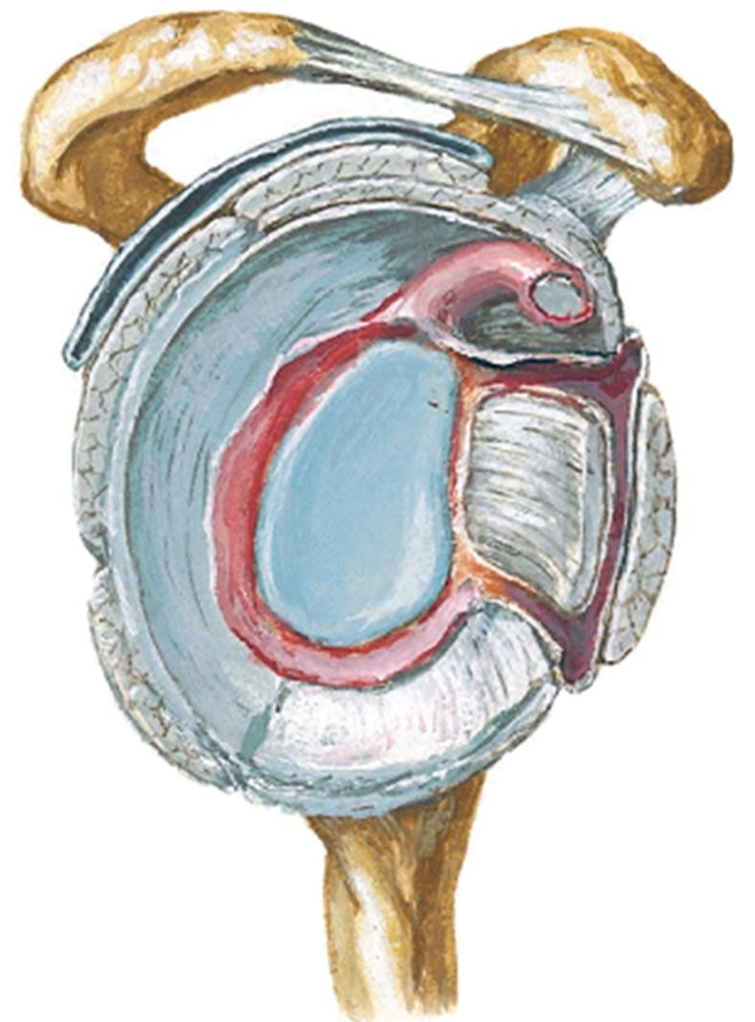
Ligaments of the shoulder joint ..1
Coracohumeral ligament:
A strong band
Extends from the lateral border of the root of the of the coracoid process to the tip of the greater tuberosity of the humerus.
Supports the joint
superiorly

Slide 8
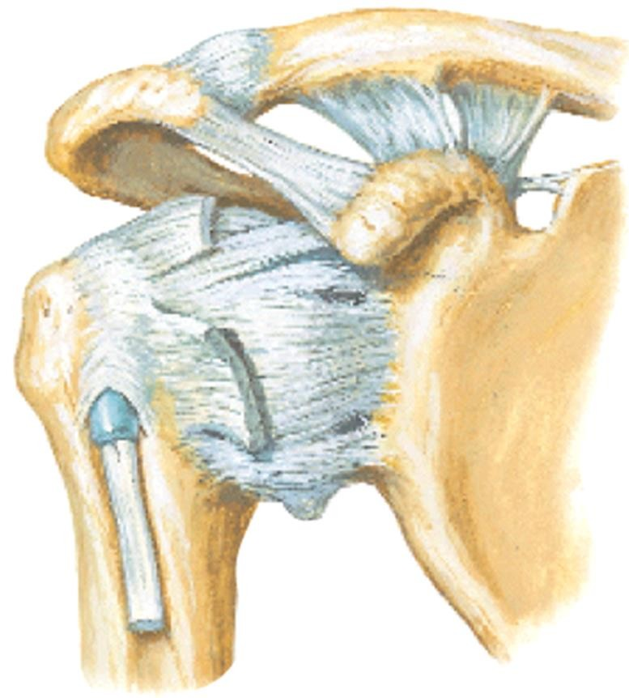
Ligaments of the shoulder joint ..2
Gleno-humeral ligament:
Thickened parts of the capsule.
Connects the upper part of the anterior margin of the glenoid cavity to the lesser tuberosity and anatomical neck of the humerrus

Slide 9
Ligaments of the shoulder joint ..3
Transverse humeral ligament:
Attached between the 2 tuberosities of the humerus.
Acts as a retinaculum for the tendon of the long head of biceps.

Slide 10
Ligaments of the shoulder joint ..4
Coraco-acromial ligament:
Triangular ligament.
Connects the tip of the acromion to the lateral margin of the coracoid process.
Forms an arch that prevents upward dislocation of the head of the humerus.

Slide 11
Intracapsular structures
Tendon of the long head of biceps muscle.
Labrum glenoidale. Synovial membrane:
Lines the inner surface of the capsule.
Covers the upper part of the medial aspect of the
surgical neck of the humerus.
Sends tubular sheath around the tendon of the long head of biceps.

Slide 12
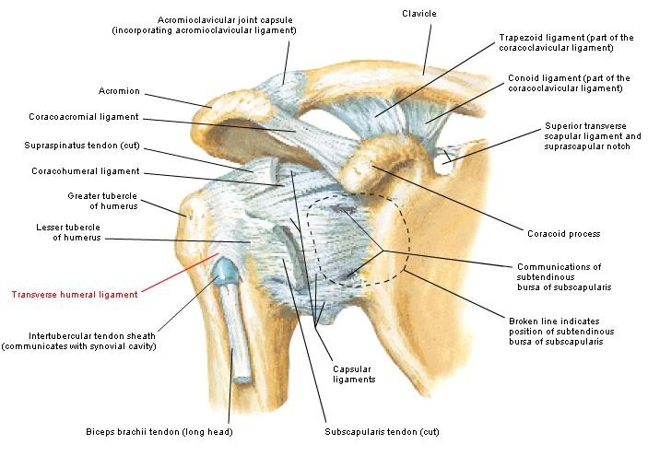

Slide 13
Bursa related to the shoulder joint ..1
A bursa is simply a pad-like sac found between two moving surfaces.
It is lined with synovial membrane.
It contains a small amount of lubricating fluid inside; synovial fluid to reduce friction and aid movement.
Bursae occur in connective tissue wherever two body parts—other than joints— move against each other. Their function is to lessen the friction between tendon and bone, ligament and bone, tendons and ligaments, and between muscles.
Inflammation or infection of the bursa is called bursitis.

Slide 14
Bursa related to the shoulder joint ..2
Subscapular bursa:
Lies between the tendon of subscapularis muscle and the neck of the scapula.
It communicates with the synovial membrane of the joint through an opening in the anterior wall of the capsule.

Slide 15
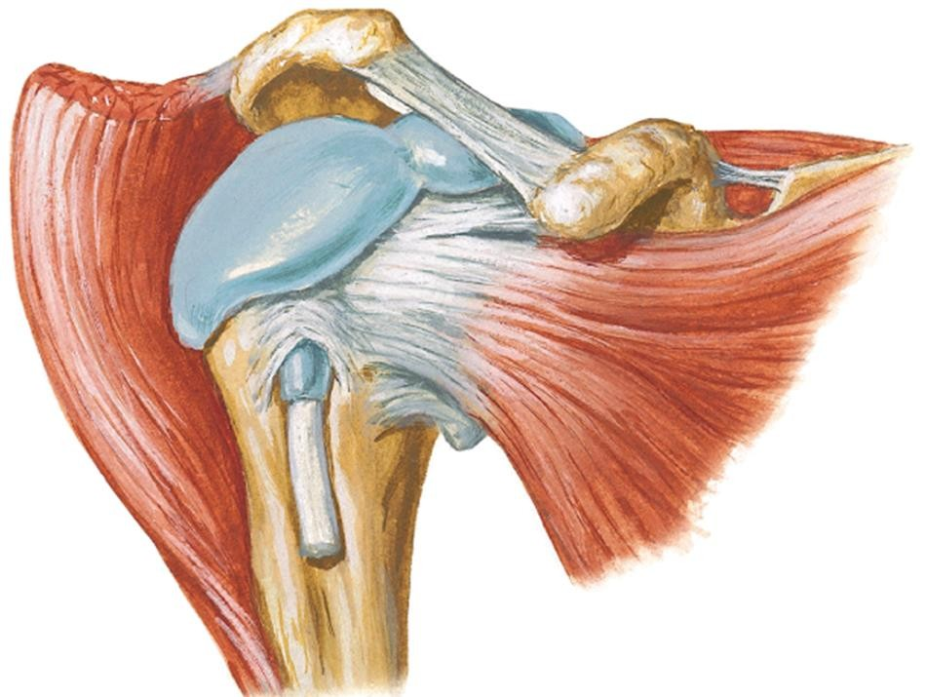
Bursa related to the shoulder joint ..3
Subacromial bursa:
Lies between the coraco-acromial arch and the tendon of supraspinatus muscle.
Extends laterally between deltoid muscle and greater tuberosity.
Commonly fuses with deltoid bursa.

Slide 16
Nerves and vessels of the shoulder joint
Nerves:
Axillary nerve
Suprascapular nerve
Lateral pectoral nerve
Vessels:
Anterior circumflex humeral artery
Posterior circumflex humeral artery
Suprascapular artery

Slide 17
Relations of the shoulder joint
Anteriorly:
Subscapularis muscle and bursa
Posteriorly:
Infraspinatus
Teres minor
Superiorly:
Supraspinatus
Subacromial bursa
Coraco-acromial ligament
Inferiorly:
Long head of triceps
Axillary nerve
Posterior circumflex humeral artery

Slide 18
Movements of the shoulder joint
Movement | Muscles producing the movement
Flexion | 1- Clavicular head of pectoralis major 2- Deltoid (anterior fibres) Coracobrachialis Short head of biceps
Extension | 1- Posterior fibres of the deltoid 2- Latissimus dorsi Teres major Sternocostal head of pectoralis major
Abduction | Supraspinatus Middle fibres of the deltoid
Adduction | Pectoralis major Latissimus dorsi Teres major and teres minor 4- Subscapularis 5- Coracobrachialis
Medial rotation | Pectoralis major Latissimus dorsi Teres major Subscapularis Anterior fibres of the deltoid
Lateral rotation | Infraspinatus Ters minor Posterior fibres of the deltoid

Slide 19
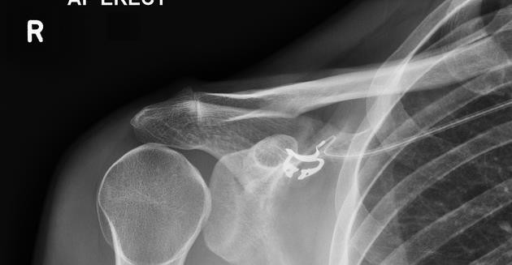

Slide 20
Elbow joint

Slide 21
Type of the joint: synovial joint of the hinge variety.
Articular surfaces:
Trochlea and capitulum of the humerus
Trochlear notch of the ulna and the upper surface of the head of the radius

Slide 22
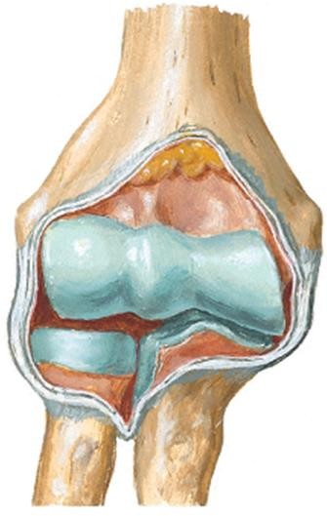
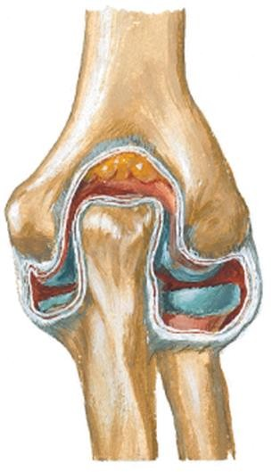
Fibrous capsule:
Attachment:
Above: attached just above coronoid, radial and olecranon fossae and to the roots of the medial and lateral epicondyles.
Below: Attached to the margins of the olecranon and coronoid processes of the ulna and to the annular ligament. This attachment is continuous at the sides with ulnar and radial collateral ligaments.
Synovial membrane: Lines the fibrous capsule and covers the intracapsular structures except the articular surfaces.
It is continuous with the synovial membrane of the superior radio-ulnar joint.

Slide 23
Ligaments of the elbow joint
Ulnar collateral ligament:
A strong triangular ligament.
Attachement:
Apex: to the medial epicondyle
Base: to the medial margin of the coronoid process and the
medial margin of the olecranon.
The ulnar nerve and ulnar collateral artery are related to this ligament.
Radial collateral ligament:
A strong triangular ligament.
Attached to the lateral epicondyle and margins of the annular ligament and supinator crest.

Slide 24
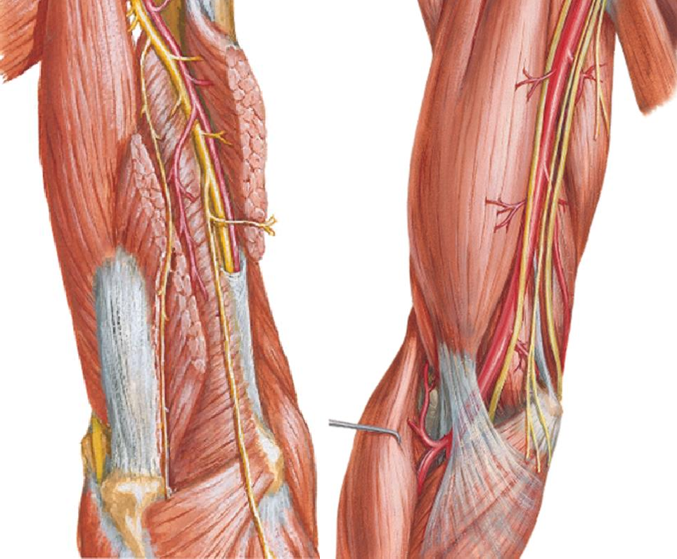
Relations of the elbow joint
Anteriorly:
Biceps brachii
Brachialis
Brachial artery
Median nerve
Posteriorly:
Triceps brachii
Anconeus
Medially:
Common flexor origin
Ulnar nerve
Laterally:
Common extensor origin
Brachioradialis
Extensor carpi radialis
longus
Radial nerve

Slide 25
Movements at the elbow joint
Movement | Muscles producing the movement
Flexion | Brachialis Biceps brachii Brachioradialis Flexors of the forearm
Extension | Triceps Anconeus Extensors of the forearm

Slide 26
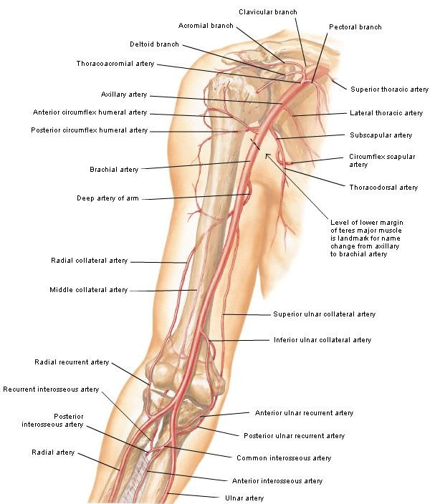
Nerves and vessels of the elbow joint
Nerves:
Musculocutaneous nerve
Radial nerve
Arteries:
Anastomosis around the elbow
Brachial
Radial
Ulnar

Slide 27
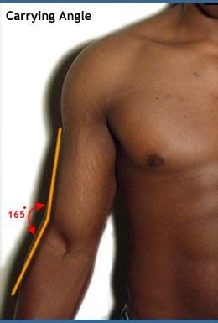
Carrying angle of the elbow
In full extension and supination, an angle of 165° is present between the long axis of the upper arm and that of the forearm.
This angle is caused by the:
Medial edge of the trochlea of the humerus projects
~ ½ cm downwards below the lateral edge.
Oblique superior articular surface of the coronoid process.
It allows for holding objects in the hand
in full extension of the elbow.

Slide 28
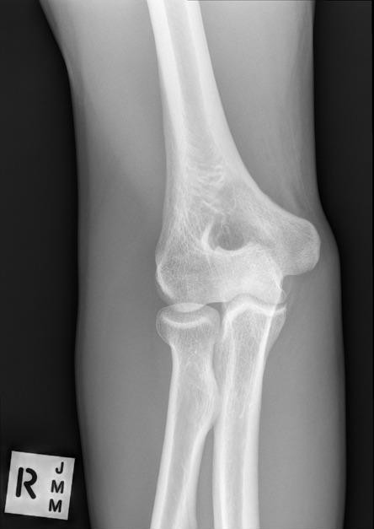
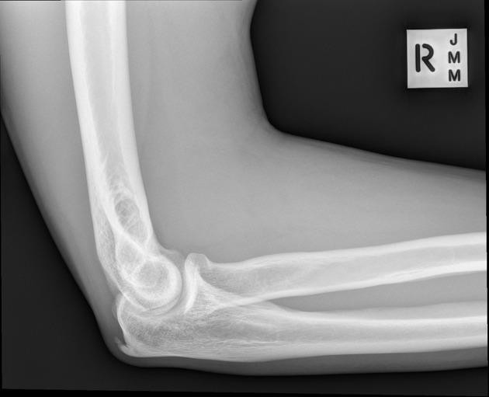

Slide 29
Superior (proximal) radio-ulnar joint

Slide 30
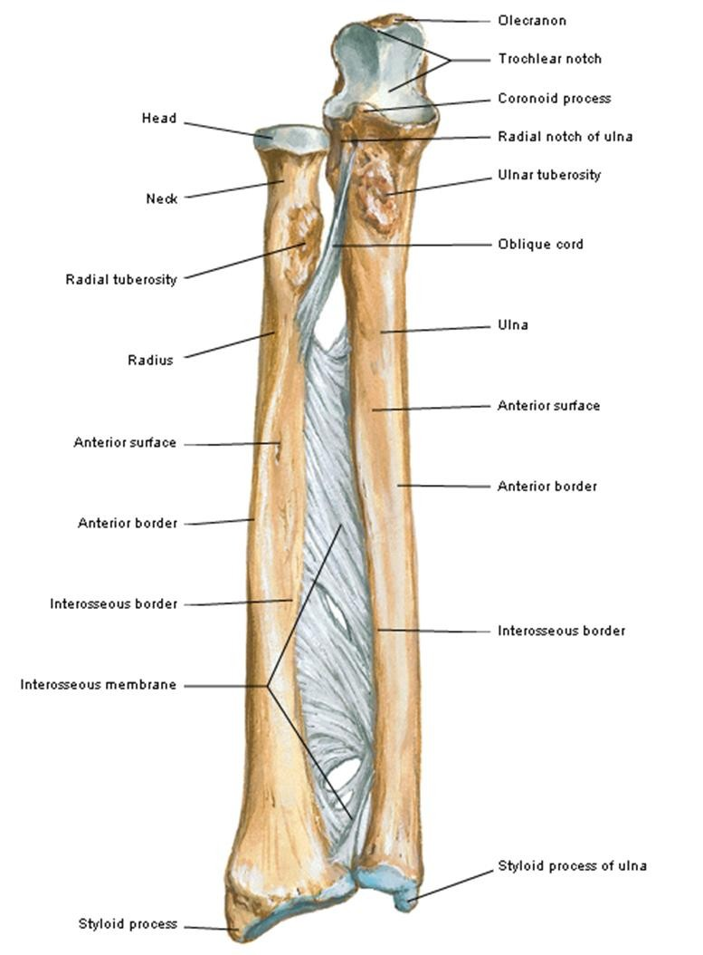
Type: Synovial joint of the pivot variety.
Articular surfaces:
Laterally: circumference of the head of the radius.
Medially: The osseo- fibrous ring formed by the radial notch of the ulna and the annular ligament.

Slide 31
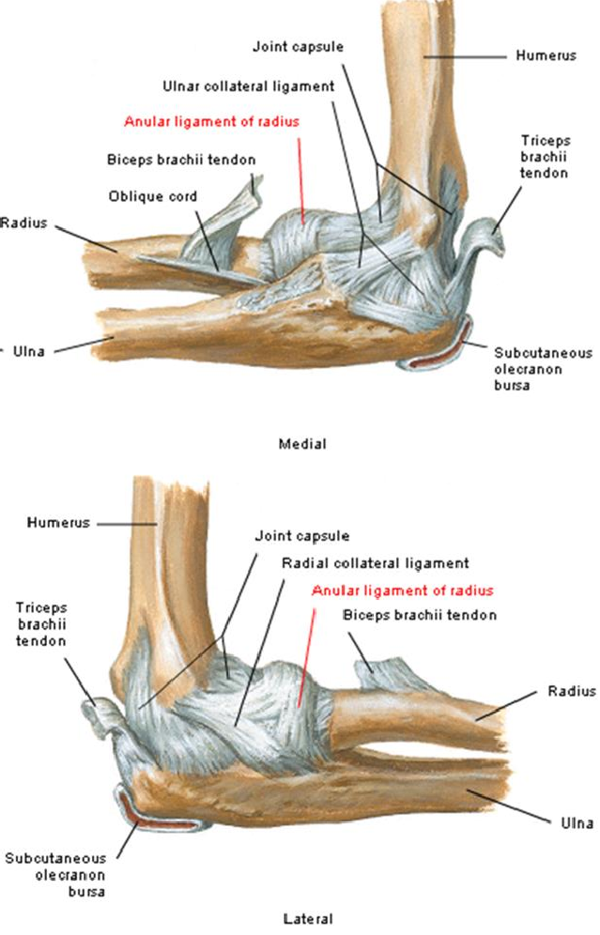
Ligaments of the superior radio-ulnar joint
Annular ligament:
Strong ligament, continuous with the capsule of the elbow joint.
Attached to the posterior and anterior margins of the radial notch of the ulna.
It encircles the head and neck of the radius.
It gives attachments to the supinator
muscle and lateral collateral ligament.
Quadrate ligament:
Thin fibrous quadrangular band.
Connects the lower border of the radial notch of the ulna to the neck of the radius.

Slide 32
Inferior (distal)
radio-ulnar joint

Slide 33
Type: Synovial joint of the pivot variety.
Articular surfaces:
Laterally: Ulnar notch of the radius.
Medially: Head of the ulna.
The two bones are firmly connected together by an articular disc.

Slide 34
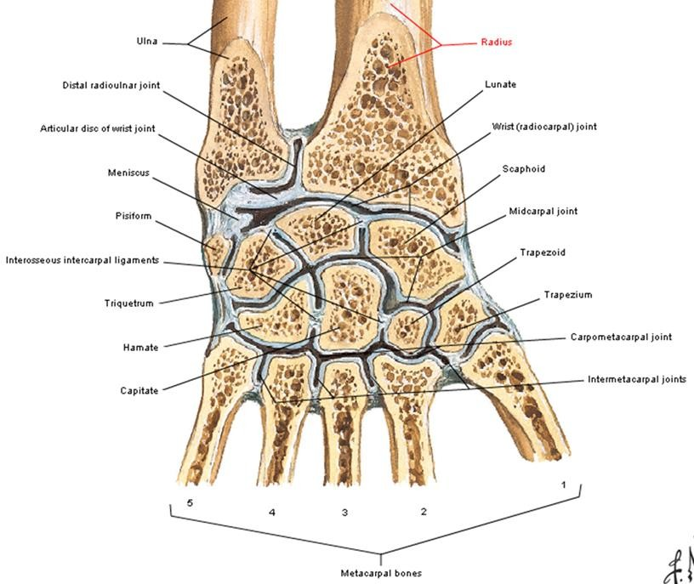
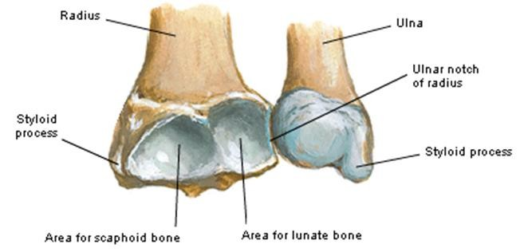
Capsule of the inferior radio-ulnar joint
Attached to the margins of articular surfaces.
Thickened anteriorly and posteriorly.
Thin superiorly over the synovial
membrane.
Projects upwards as a small pouch between thee radius and ulna; recessus sacciformis.

Slide 35
Articular disc of the inferior radio-ulnar joint
Triangular plate of fibrocartilage separating this joint from the bones of the wrist joint.
Its upper and lower surfaces are
concave.
Attached to the:
Apex to the root of the ulnar styloid process.
Base to the lower surface of the margin of the ulnar notch of the radius.
Allows rotation of the radius over the
ulna without separating both bones.

Slide 36
Middle radio-ulnar joint

Slide 37
Type: fibrous syndemosis.
Interosseous membrane: extends between the corresponding borders of the radius and ulna.
Oblique cord: extends from the lower part of the ulnar tuberosity to just below the radial tuberosity.
A gap exists between the interosseous membrane and the oblique cord.
There is a small opening at the lower par of the interosseous membrane for the passage of the anterior interosseous vessels towards the posterior aspect.

Slide 38
Functions of the interosseous membrane
Connecting the moving radius to the relatively fixed ulna.
Prevents upwards gliding of the radius over the ulna.
Provides attachment to some muscles of the forearm.

Slide 39
Pronation and Supination
In the anatomical position the forearms are in supine position.
In supination the radius and ulna lie parallel to each other.
In pronation the palm of the hand is directed backwards and the radius crosses obliquely in front of the ulna.
The axis of rotation in pronation is a line drawn from the centre of the head of the radius to the head of the ulna.

Slide 41
Muscles Producing Supination and Pronation
Movement | Muscles producing the movement
Pronation | 1- Pronator quadratus (the main muscle) 2- Pronator teres 3- Barchioradialis (from full supination to mid prone position)
Supination | 1- Supinator (slow, un-opposed supination) 2- Biceps (fast, powerful supination) 3- Brachioradialis (from pronation to mid prone position)

