Slide 1
Vessels of the Upper Limb

Slide 2
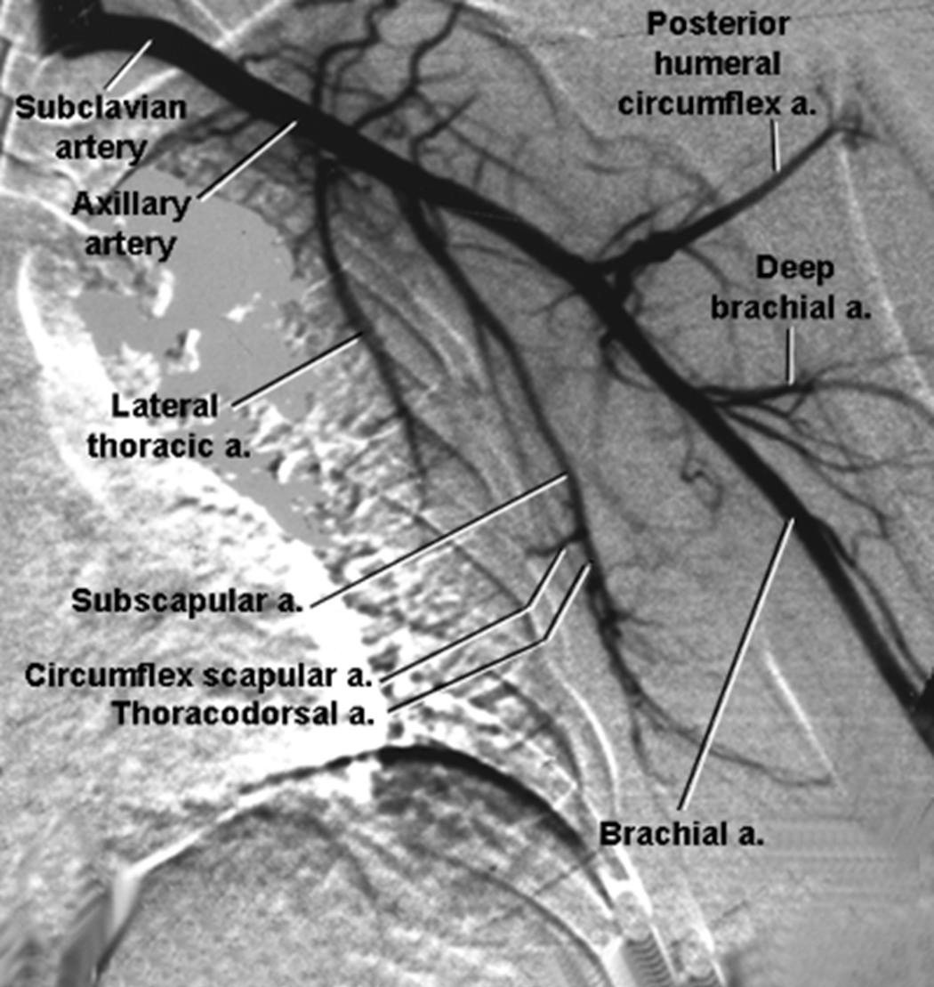
Axillary Artery
Beginning: at the outer border of the first rib as a continuation of the subclavian artery
Course: Passes downwards in the axilla from the apex to the base.
Termination: ends at the lower border of the teres major muscle, where it continues as the brachial artery.
Parts: it is divided by pectoralis
minor into three parts:
First Part: lies above the pectoralis minor
Second part: lies behind the pectoralis minor
Third part: lies below the pectoralis minor

Slide 3
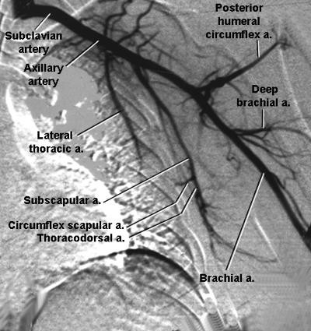

Slide 4
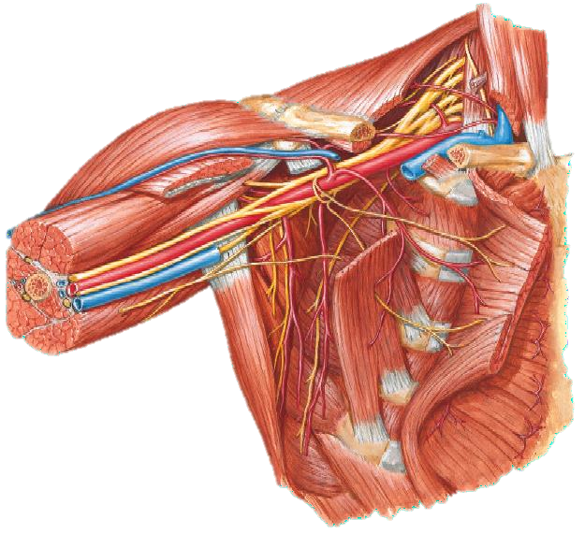

Slide 5
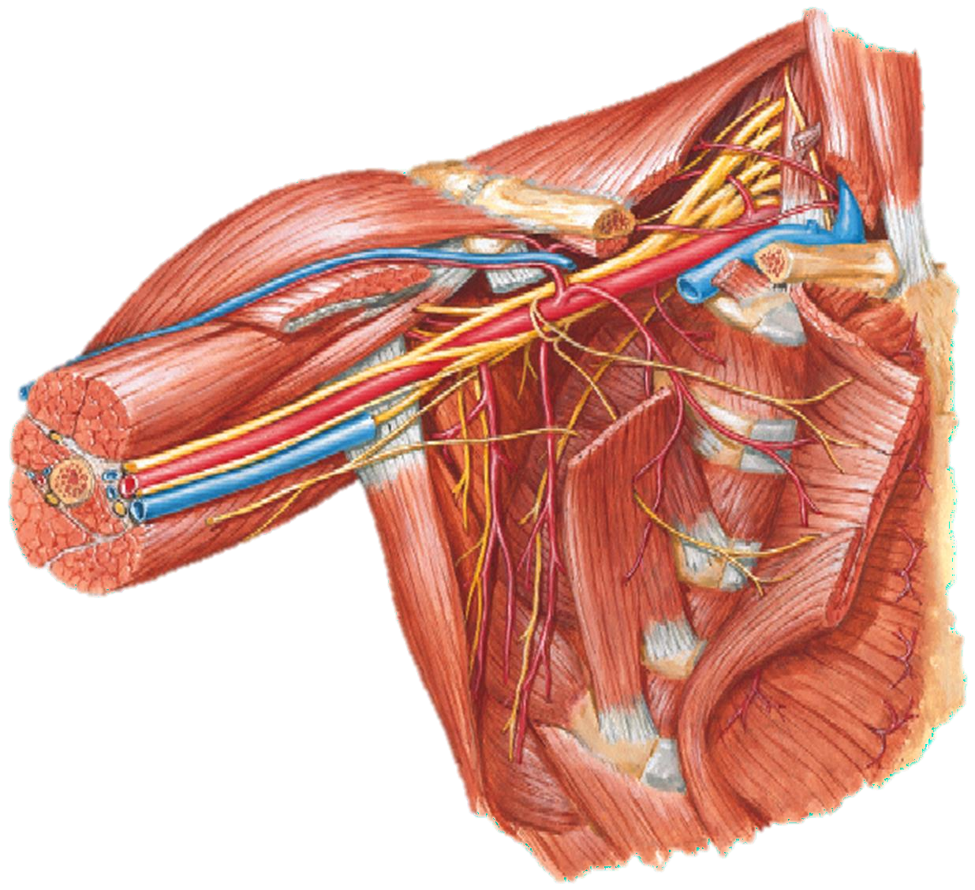
Relations of the 1st part of the axillary artery
Anteriorly: the clavicular part of pectoralis major, the clavipectoral fascia and vessels and nerves superficial to it
Posteriorly: 1st intercostal space, 1st digitation of serratus anterior and medial cord of brachial plexus
Laterally: lateral and posterior cords of the brachial plexus
Medially: The axillary vein

Slide 6
Relations of the 2nd part of the axillary artery
Anteriorly: The pectoralis minor and
pectoralis major
Posteriorly: The posterior cord of the brachial plexus and the subscapularis muscle
Laterally: The lateral cord of the brachial
plexus
Medially: The medial cord of the brachial plexus, medial pectoral nerve and the axillary vein

Slide 7
Relations of the 3rd part of the axillary artery
Anteriorly: its upper part is covered by pectoralis major but its lower part is covered by skin, superficial and deep fascia. The artery it is crossed by the medial root of the median nerve
Posteriorly: The subscapularis, the latissimus dorsi, and the teres major. The axillary and radial nerves also lie behind the artery.
Laterally: The coracobrachialis, the biceps, and the humerus. The lateral root of the median and the musculocutaneous nerves also lie on the lateral side.
Medially: The ulnar nerve, the axillary vein, and the medial cutaneous nerve of the arm and the forearm

Slide 8
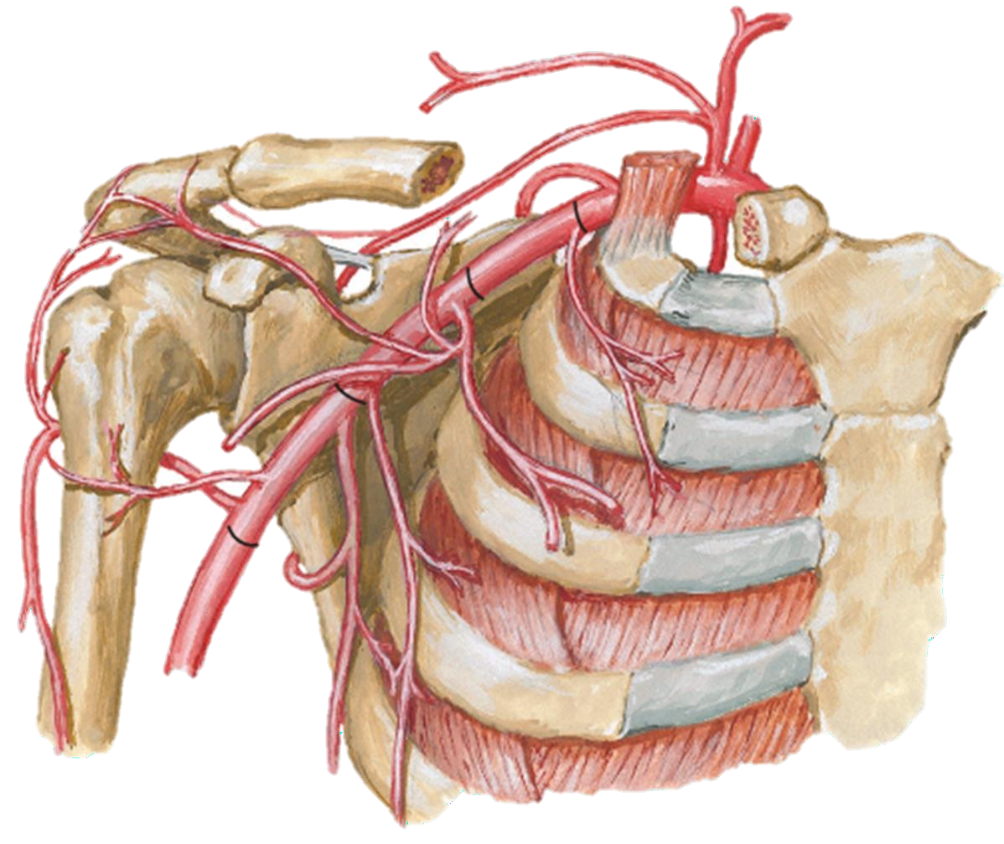
From the first part:
Branches of the Axillary Artery:
The superior thoracic artery
From the second part:
The thoracoacromial trunk
The lateral thoracic artery
From the third part:
The subscapular artery
The anterior circumflex humeral artery
The posterior circumflex humeral artery

Slide 9
2
6
3
4
5

Slide 10
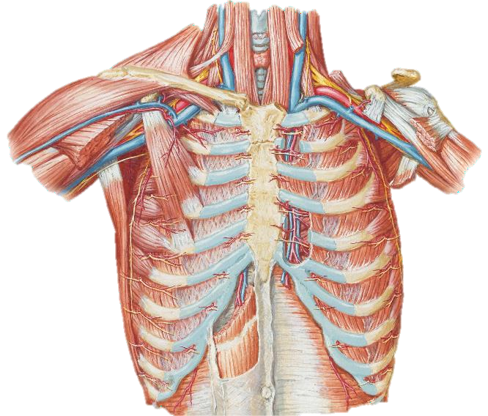
Axillary vein
Beginning: at the lower border of teres major as
a contiuation of basilic vein
End: at the outer border of the 1st rib where it
becomes subclavian vein
It lies on the medial side of the axillary artery
Tributaries: 2 venae comitantes of brachial artery, cephalic vein and other tributaries follow the axillary arterial branches

Slide 11
Brachial Artery

Slide 12
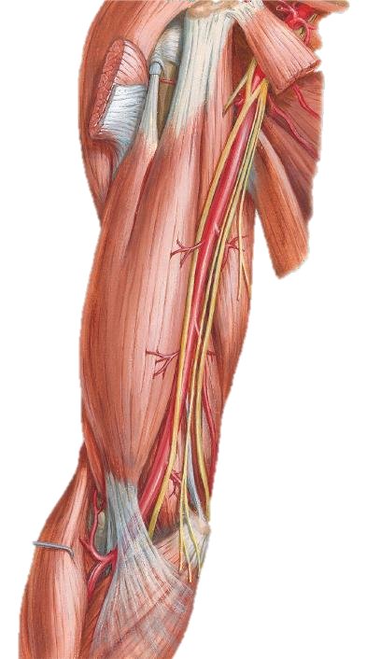
Brachial artery ..1/5
Beginning: At the lower border of the teres major.
End: Opposite the neck of the radius 1 cm below the crease of the elbow joint.
The artery changes its direction from the medial side of the humerus at its beginning to the front of the humerus at its lower end.
The brachialis muscle separates the artery at its lower part from the humerus.

Slide 13
Relations:
Brachial artery ..2/5
Anteriorly:
Skin, superficial fascia and deep fascia.
Crossed by the median nerve.
Bicipital aponeurosis at its lower end.

Slide 14
Brachial artery ..3/5
Relations:
Posteriorly:
Long head of triceps; separated from it by the profunda brachii and radial nerve.
Medial head of triceps.
The insertion of coracobrachialis.
The brachialis muscle.

Slide 15
Brachial artery ..4/5
Relations:
Medially:
Basilic vein throughout its course.
Medial cutaneous nerve of the forearm, and ulnar nerve above.
Median nerve below.
Laterally:
Coracobrachialis and median nerve, above.
Biceps brachii, below.

Slide 16
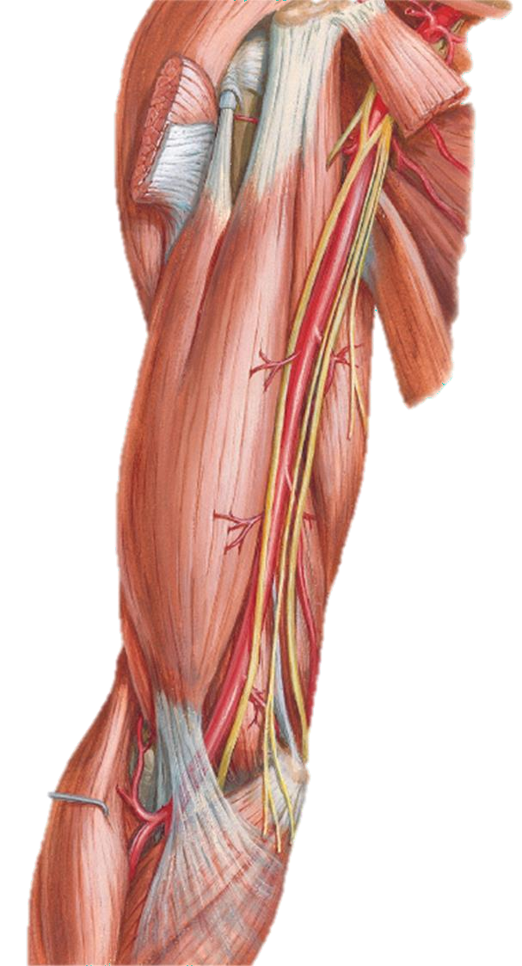
Brachial artery ..5/5
Branches:
Profunda brachii
Superior ulnar collateral
Inferior ulnar collateral
Nutrient artery
Muscular branches

Slide 17
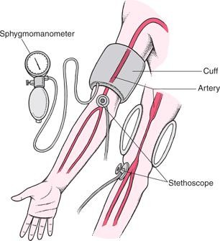
Clinical notes
The brachial artery is the artery commonly used to check the blood pressure.
The artery can be compressed against the humerus in its upper part; this is done to control bleeding from the artery.

Slide 18
Radial Artery

Slide 19
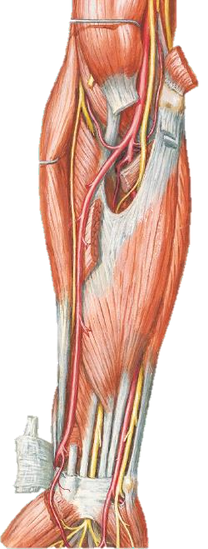
Radial artery ..1/5
Biceps brachii
The smaller of the two terminal branches of the brachial artery.
Radial a.
Supinator
Pronator teres
Begins at the level of the neck of the radius, accompanied by 2 vena comitantes and lies successively on the following structures:
Tendon of biceps
Supinator muscle
Pronator teres
Radial origin of flexor digitorum superficialis
Flexor pollicis longus
Anterior surface of the lower end of the radius
Flex. Digit. Superficial.
Flex. Pol. Long

Slide 20
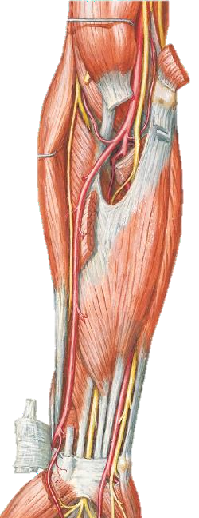
Radial artery ..2/5
Covered by brachioradialis above and becomes superficial in the lower part of the forearm.
Accompanied by the superficial radial nerve on its lateral side.
The tendon of flexor carpi radialis lies on its medial side in the lower part of the forearm

Slide 21
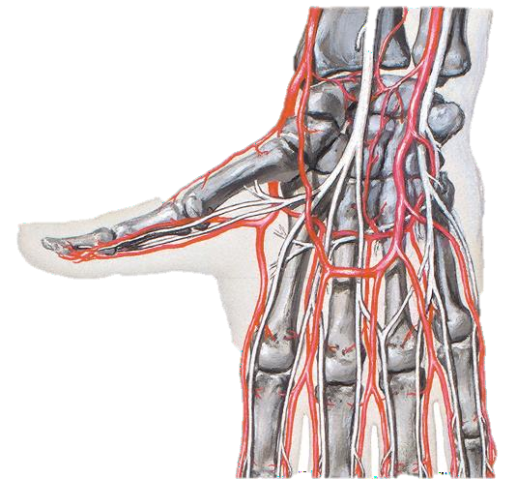
Radial artery ..3/5
The artery make a curve laterally ate the wrist.
Runs deep to the tendons of abductor pollicis longus and extensor pollicis brevis
Enters the anatomical snuff box then passes
deep to the tendon of extensor pollicis longus
Passes between the 2 heads of the 1st dorsal interosseous muscle.
Passes between the 2 heads of the adductor pollicis muscle
Curves medially and terminates as the deep palmar arch

Slide 22
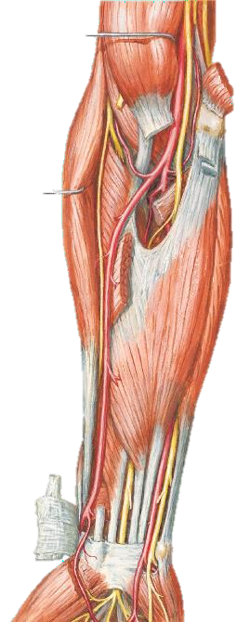
Radial artery ..4/5
Branches:
Radial recurrent
Muscular
Anterior (palmar) carpal
Superficial palmar
Posterior (dorsal) carpal
First dorsal metacarpal
Dorsal digital
Prinicipis pollicis
Radialis indicis

Slide 23
Relations of the radial artery 5/5
Throughout its whole length the radial artery is closely accompanied by venae comitantes.
At first, its lies between the pronator teres and the brachio-radialis, and is overlapped to a variable extent on the lateral side by the fleshy belly of the brachio- radialis.
Lower down, the brachio-radialis is on its lateral side, and the flexor carpi-radialis on its medial side; and so they remain as far as the wrist.
Where the muscles mentioned are fleshy, the artery lies at some depth from the surface; but when their tendons appear it assumes a superficial position, and is covered merely by the skin and fasciae.
The radial nerve lies along its lateral side in the middle third of the forearm; higher up, the nerve is separated from the vessel by a slight interval; and, distally, the nerve leaves the artery and turns round the lateral margin of the forearm, under cover of the tendon of the brachio-radialis.

Slide 24
Ulnar Artery
24

Slide 25
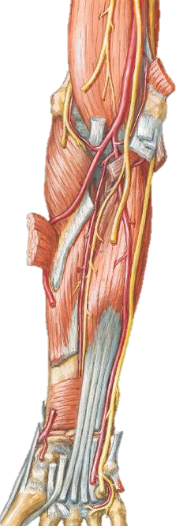
Ulnar artery
The larger of the two terminal branches of the brachial artery.
Its upper 1/3 passes obliquely downwards and medially on the brachialis
and flexor digitorum profundus (covered by the 5 superficial muscles).
Its lower 2/3 is vertical running on the flexor digitorum profundus.
The last 5 cm in the forearm are superficial.
Passes over the flexor retinaculum deep to palmaris brevis.
Continues into the hand as the superficial palmar arch.

Slide 26
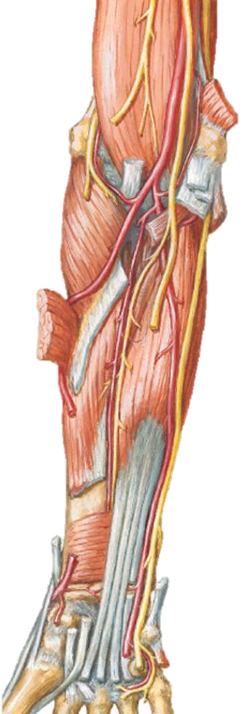
Branches of the ulnar artery.. 1
Anterior ulnar recurrent: arise just below the elbow and ascends between brachialis and pronator teres in front of the medial epicondyle. Anastomoses with ulnar collateral artery.
Posterior ulnar recurrent: arise just below the elbow and ascends behind the medial epicondyle. Anastomoses with ulnar collateral arteries.

Slide 27
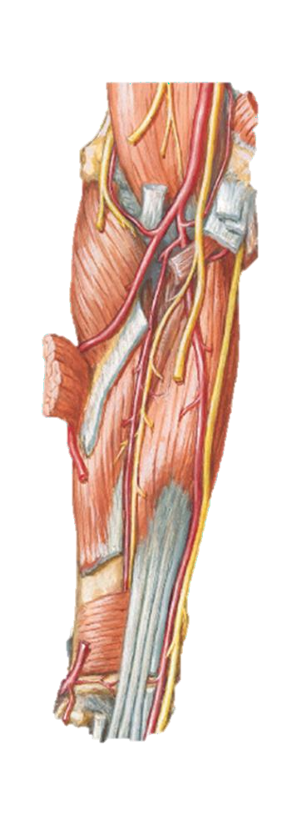
Branches of the ulnar artery.. 3
Common interosseous artery: it is a small trunk that arises just below the radial tuberosity and passes backwards to the upper border of the interosseous membrane, it divides into:
Anterior interosseous: descends between the flexor pollicis longus and flexor digitorum profundus. It pierces the lower end of the interosseous membrane and passes backwards to anastomose with the posterior interosseous artery.
Posterior interosseous: it’s a small artery that supplies (partially) muscles of the posterior compartment.

Slide 28
Allen Test (for Radial & Ulnar Arteries Patency)
Tests for … | Patency of the radial & ulnar arteries
Position | Sitting with forearm free to move, elbow bent with fingers pointing up toward the ceiling.
Stimulus | Compress the radial & ulnar arteries at the wrist, one thumb on the ulnar artery & the other on the radial artery. The patient should open & close fist quickly, then releases the pressure on one artery & observe the filling pattern of the vessels in the palm. Do the same for the other artery.
(+ve) Response | Blanching remains in the palm after pressure is released from the artery.

Slide 29
Arterial Anastomoses in the upper limb

Slide 30
Meaning of anastomosis المفاغرة
anastomosis /anas·to·mo·sis/ (ah-nas″tah-mo´sis) pl.
anastomo´ses [Gr.]
communication between vessels by collateral channels.
surgical, traumatic, or pathological formation of an opening between two normally distinct spaces or organs.

Slide 31
Anastomosis around the scapula

Slide 32
Sharing vessels
Suprascapular artery: from the thyrocervical trunk. Passes to the scapula above the suprascapular ligament, reaches the supraspinous fossa, then passes to infraspinous fossa through the spinoglenoid notch.
Deep branch of the transverse cervical artery: from the thyrocervical trunk. Runs along the medial border of the scapula till the inferior angle.
Subscapular artery: from the second part of the axillary artery. Runs along the lateral border of the scapula and gives the circumflex scapular artery.
Lateral branches from posterior intercostal arteries.

Slide 33
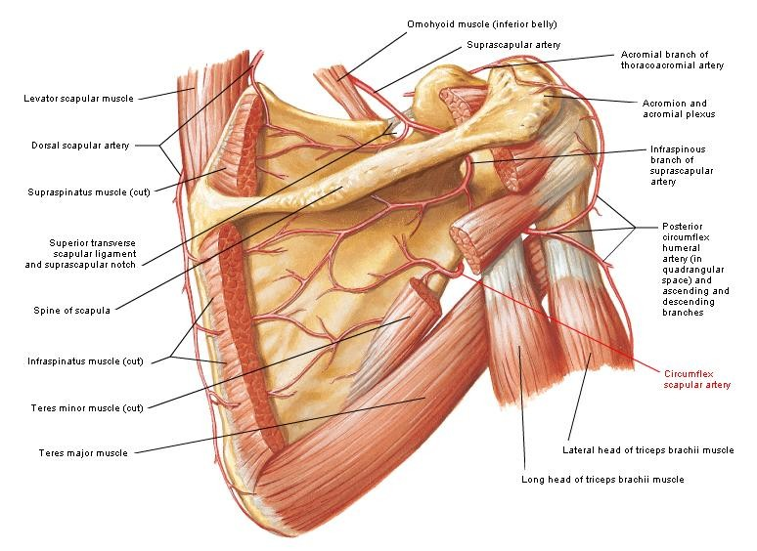

Slide 34
Anastomosis on the acromion

Slide 35
Sharing vessels
Suprascapular artery from the subclavian artery.
Acromial and deltoid branches from the 2nd part of the axillary artery.
Ascending branch from the posterior circumflex humeral artery

Slide 36
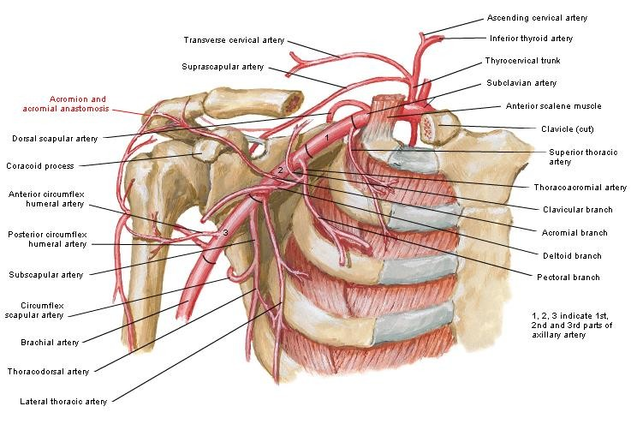

Slide 37
Anastomosis around the surgical neck of the humerus

Slide 38
Sharing vessels
Anterior circumflex humeral artery from the 3rd part of the axillary artery.
Posterior circumflex humeral artery from the 3rd part of the axillary artery.
Ascending branch from the profunda brachii artery.

Slide 39
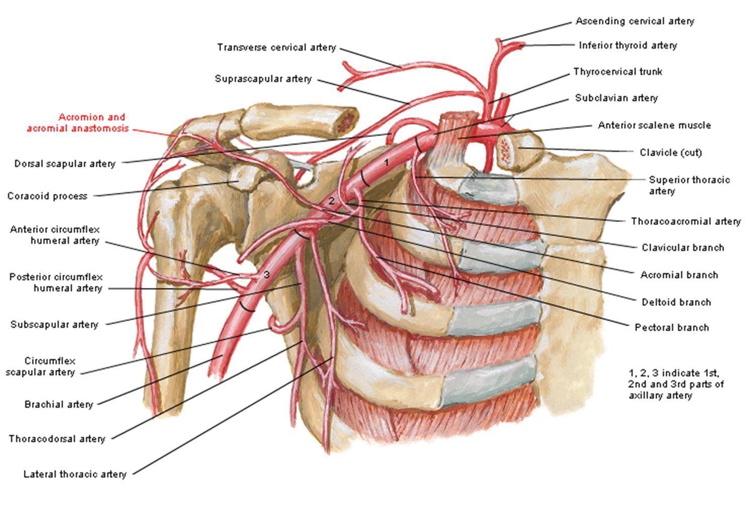

Slide 40
Anastomosis around the elbow

Slide 41
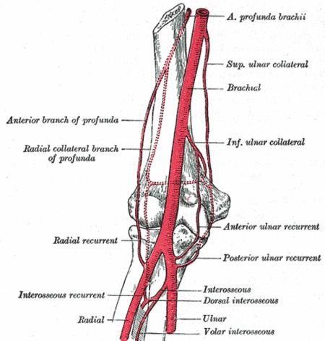

Slide 42
Anterior ulnar
recurrent (ulnar)
Anteriorly:
Anterior branch of the inferior ulnar collateral (brachial)
Around the medial epicondyle:
Posterior ulnar recurrent (ulnar)
Posterior branch of the inferior ulnar collateral (brachial)
Posteriorly:
Superior ulnar collateral (brachial)

Slide 43
Radial collateral
artery (profunda)
Anteriorly:
Radial recurrent artery (radial)
Around the lateral epicondyle:
Middle collateral artery (profunda)
Posteriorly
Interosseous recurrent (posterior interosseous-ulnar)

Slide 44
Anastomosis around the wrist

Slide 45
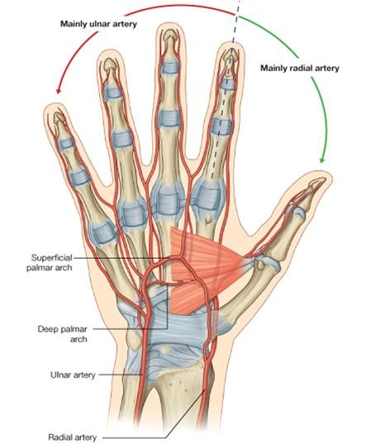

Slide 46
Anterior (palmar) carpal arch:
Anterior carpal branch of the radial artery
Anterior carpal branch of the ulnar artery
Recurrent branch from the deep palmar arch
Branch from the anterior interosseous artery

Slide 47
Posterior (dorsal) carpal arch:
Posterior carpal branch of the radial artery
Posterior carpal branch of the ulnar artery
Anterior interosseous artery
Posterior interosseous artery

