Slide 1
Lower Limb X Ray

Slide 2
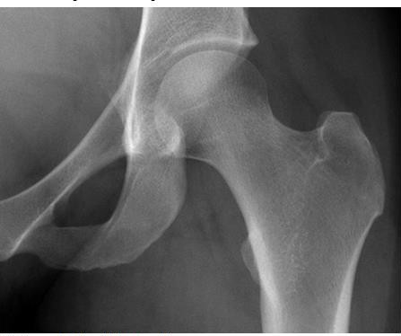
Go to http://radiologymasterclass.co.uk

Slide 3
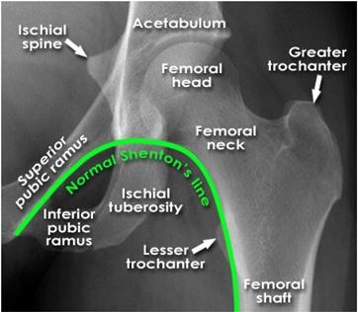

Slide 4
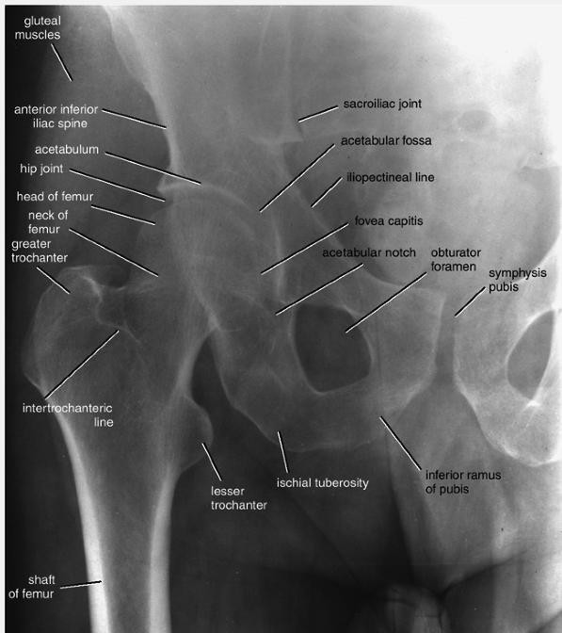
Shenton's line is a useful means of assessing the angle of the femoral neck on a radiograph of the hip region
Note that the inferior margin of the neck of the femur should form a continuous curve with the upper margin of the obturator foramen (Shenton's line)
3/30/2019

Slide 5
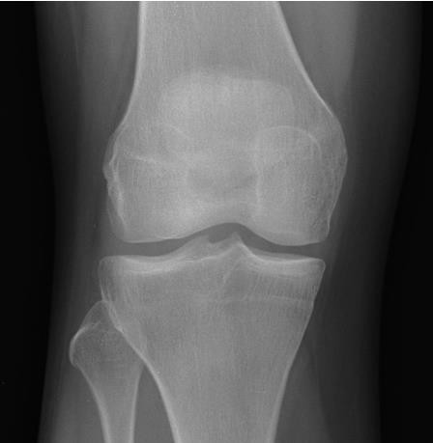
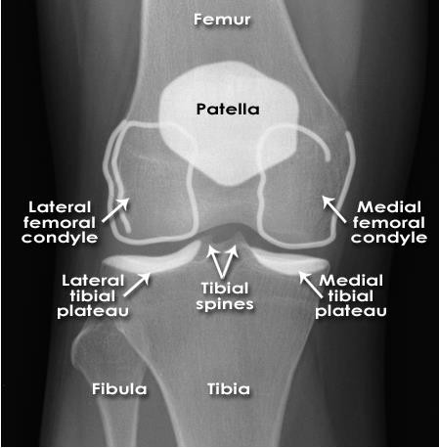
Knee - Normal AP
The patella is often not clearly seen on this view

Slide 6
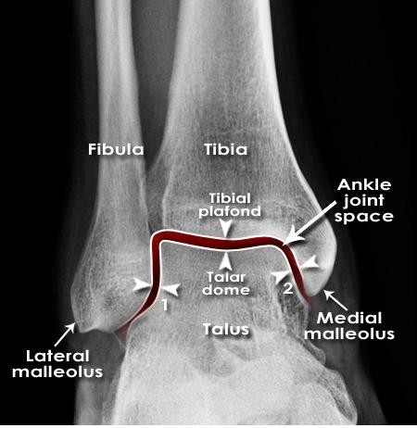
Ankle anatomy - Normal AP 'mortise'
The weight-bearing portion is formed by the tibial plafond and the talar dome
The joint extends into the 'lateral gutter' (1) and the 'medial gutter' (2)
The joint is evenly spaced throughout

Slide 7
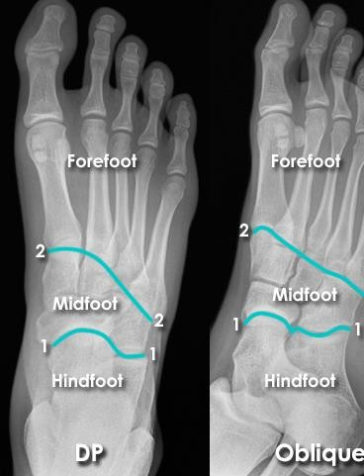
Foot X-ray anatomy - DP and Oblique views
Hindfoot = Calcaneus + Talus
Midfoot = Navicular + Cuboid + Cuneiforms
Forefoot = Metatarsals + Phalanges
1 = Hind-midfoot junction
2 = Mid-forefoot junction = Tarsometatarsal joints (TMTJs)

Slide 8
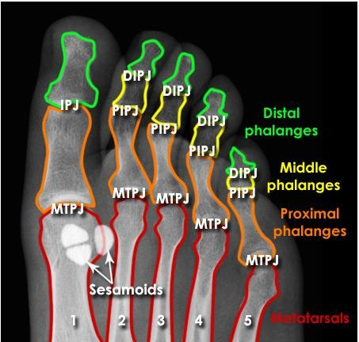
Forefoot X-ray anatomy - Joints
MTPJ = Metatarsophalangeal Joints
IPJ = Interphalangeal Joint (of big toe only)
PIPJ = Proximal Interphalangeal Joints
DIPJ = Distal Interphalangeal Joints
Note the medial side sesamoid is 'bipartite' (in 2 parts) - this is a common normal variant - not a fracture

Slide 9
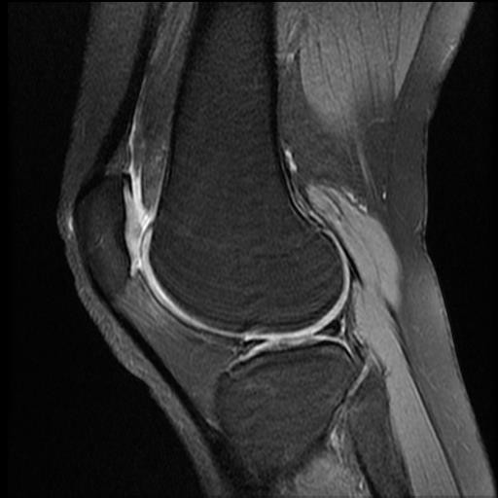
11-MRI of the knee: sagittal view
QUADRICEPS TENDON
SUPRAPATELLAR BURSA
FEMUR
LATERAL
MENISCUS
PATELLA
PATELLAR TENDON
FIBULA
TIBIA

Slide 10
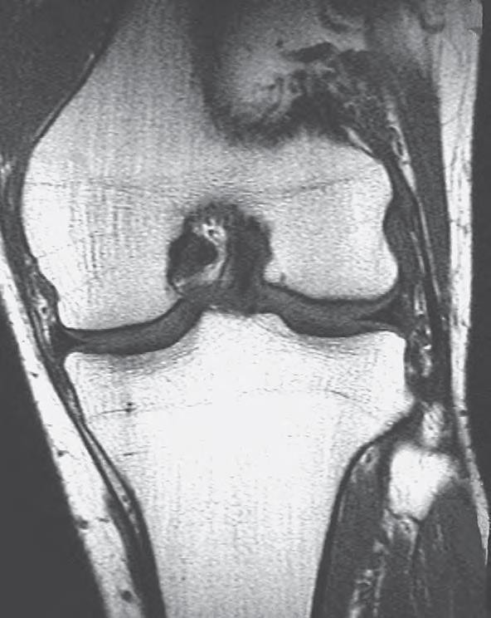
Epiphysial line
Lateral collateral ligament.
Medial collateral
ligament
Anterior cruciate ligament.
Posterior cruciate ligament.
Medial meniscus
Lateral meniscus
Head of fi bula.
3/30/2019
Fig. 82.10 Coronal T1-weighted magnetic resonance image (MRI) of the knee in an adult male. (By courtesy of Dr Justin Lee, Chelsea and Westminster Hospital, London.)

