Slide 1
Lumber Plexus and Anterior Fasial Ompartment

Slide 2
LUMBER PLEXUS
4/18/2021
Dr.Amjad Shatarat, Dep. of Anatomy

Slide 3
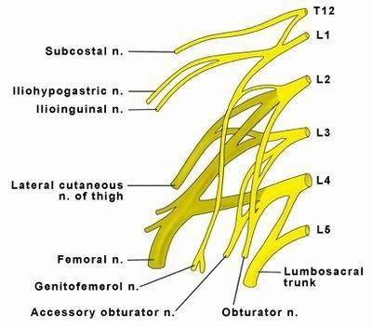
T h e l u m be r pl e x u s
Is formed by
The anterior primary rami
of the
upper four lumbernerves
in the substance of psoas major muscle
It also receives a contribution from
T12 (subcostal) nerve
4 small nerves ?+2 main nerves ?

Slide 4
Femoral nerve (L2, 3, 4)
Obturator nerve (L2, 3, 4)
4 small nerves
2 main (large ) nerves
Ilio-hypogastric (L1)
Ilio-inguinal (L1)
Genitofemoral (L1, L2)
Lateral cutaneous nerve of the thigh (L2, L3)

Slide 5
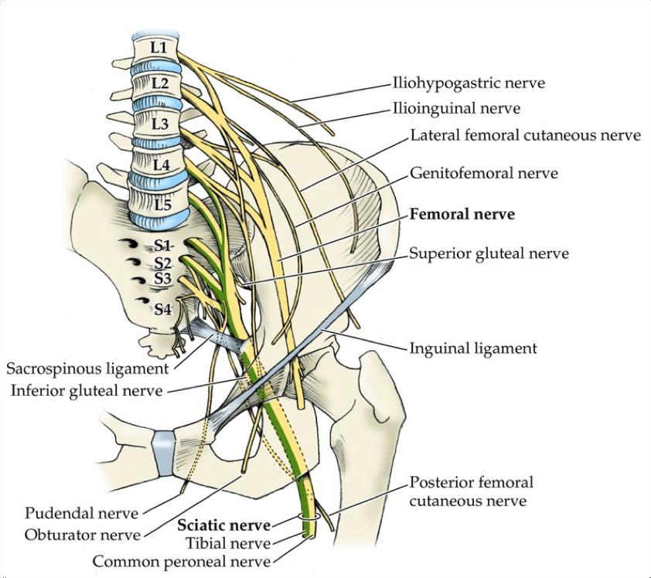

Slide 6
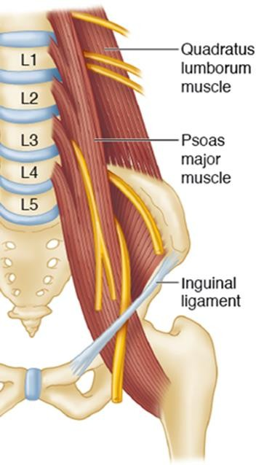
Each nerve of the lumber plexus emerges ( exits) from the
substance of the psoas major muscle as flows:
From lateral side of the psoas major muscle
The Iliohypogastri
The Iliohypogastric The Ilioinguinal
The Lateral cutaneous nerve of the thigh
Femoral nerve
The Ilioinguinal
From the medial side
The Lateral cutaneous nerve of the thigh
Obturator nerve and Lumbosacral trunk
From the anterior surface
Femoral nerve
Genitofemoral nerve

Slide 7
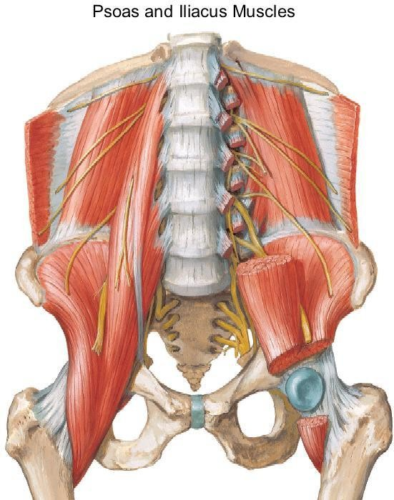
FROM THE LATERAL SIDE
The Iliohypogastric
From the anterior side
The Ilioinguinal
Genitofemoral
nerve
The Lateral cutaneous nerve of the thigh
Femoral nerve
From the medial side
Obturator nerve
30/01/2016

Slide 8
The ilio-hypogastric and ilio-inguinal nerves arise as a single trunk from the anterior ramus of L1
Either before or soon after emerging from the lateral border of the psoas major muscle, this single trunk divides into:
the ilio-hypogastric and the ilio-inguinal nerves
Note:
The iliohypogastric nerve is larger than the ilio-inguinal nerve
The iliohypogastric nerve runs superior to the ilio-inguinal nerve

Slide 9
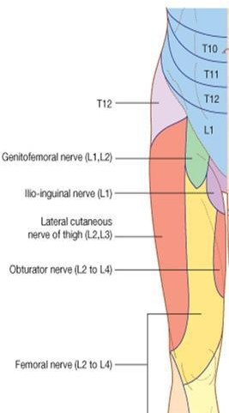
Iliohypogastric nerve
It is a branch from the lumber plexsus (L1)
Emerges from the lateral border of Psoas major muscle
supplies the posterolateral gluteal skin and it distributes to the skin in the pubic region

Slide 10
Ilio-inguinal nerve
It is a branch from the lumber plexsus (L1)
Emerges from the lateral border of Psoas major muscle
provides cutaneous innervation to the upper medial thigh, the root of the penis, and the anterior surface of
the scrotum in men, or the mons pubis and labium majus in women

Slide 11
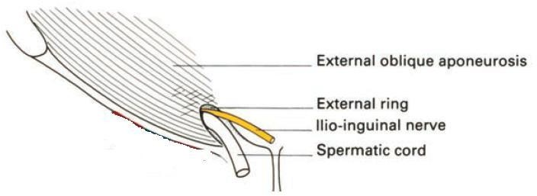
Clinical correlations
The surgeon should be very careful to the Ilio-inguinal nerve while giving incision and hernia repair as it could be injured during these procedures

Slide 12
Genitofemoral nerve
Genitofemoral nerve
(L1 and L2)
The genitofemoral nerve arises from the anterior rami of the nerves of L1 and L2 emerges on the anterior
surface of psoas major
It eventually divides into genital and femoral branches.

Slide 13
The femoral branch of genitofemoral nerve
supply the skin of the upper
anterior thigh
The genital branchof genitofemoral nerve
in men, innervates the cremasteric
muscle and terminates
on the skin in the upper anterior part of the scrotum;
in women, accompanies the round ligament of the uterus and
terminates on the skin of the mons pubis and
labium majus.
30/01/2016

Slide 14
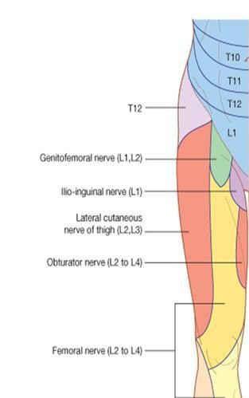
Lateral cutaneous nerve of thigh (L2 and L3)
The lateral cutaneous nerve of thigh arises from the anterior rami of nerves L2 and L3
It emerges from the lateral border of the psoas
major muscle
It passes posterior to the inguinal ligament and
enters the thigh.
it supplies the skin on the anterior and lateral thigh to the level of the knee

Slide 15
Lateral cutaneous nerve of thigh
Intrapelvic: causes include pregnancy, abdominal, tumors Extrapelvic: causes include trauma to the region of the ASIS (eg, from a seatbelt in a motor vehicle accident), tight garments, belts, girdles, or stretch from obesity, bone marrow graft.
Mechanical :factors include
prolonged sitting or standing.

Slide 17
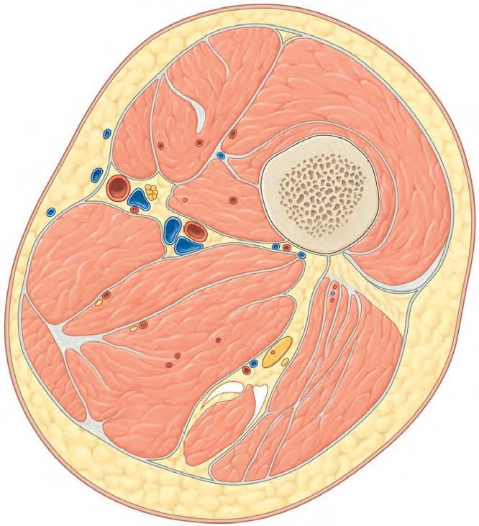
Deep fascia of the thigh (fascia lata)
Fascia lata is connected to the
linea aspera by
three intermuscular septa; 1- Medial intermuscular septum 2- Lateral intermuscular septum
3- Posterior intermuscular septum
Anterior
Thus the deep fascia and septa divide the thigh into three compartment;
Anterior Posterior
Medial.
Medial
Posterior

Slide 18
1-Muscles: Sartorius, iliacus, psoas, pectineus, and quadriceps femoris
Contents of the Anterior Fascial Compartment of
the Thigh
Blood supply: Femoral artery
Nerve supply: Femoral nerve
Note: that not all the contents of the anterior compartment have the Same function. For example psoas is the m a i n f l e x o r of the thigh at the hip joint while quadriceps femoris is the
m a i n e x t e n s o r of the leg at the knee joint.

Slide 19
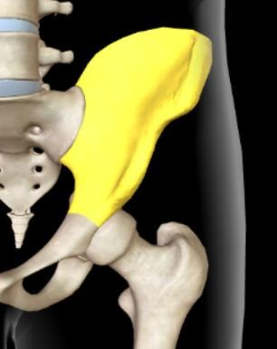
S a r t o r i u s
Origin: Anterior superior iliac spine
Insertion: Upper medial surface of shaft of tibia
Nerve supply: Femoral nerve
Actions: Flexes, abducts, laterally rotates thigh at hip joint
Flexes and medially rotates leg at knee joint
Anterior superior iliac spine of the hip bone

Slide 20
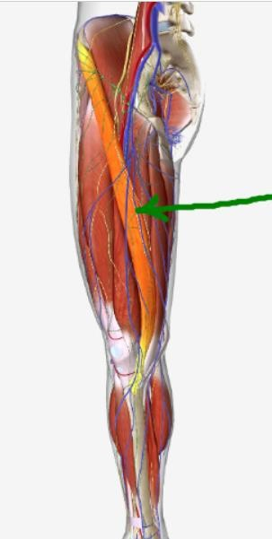
Origin: Anterior superior iliac spine
S a r t o r i u s
Insertion: Upper medial surface of shaft of tibia

Slide 21
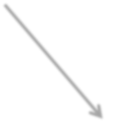
P e c t i n e u s
Origin: Superior ramus of pubis
Insertion: Upper end of linea aspera of shaft of femur
Nerve supply: Femoral nerve?
Actions: Flexes and adducts thigh at hip joint

Slide 22
Origin: Superior ramus of pubis
P e c t i n e u s
Insertion: Upper end of linea aspera of shaft of femur

Slide 23
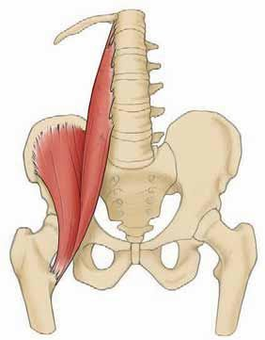

Slide 24
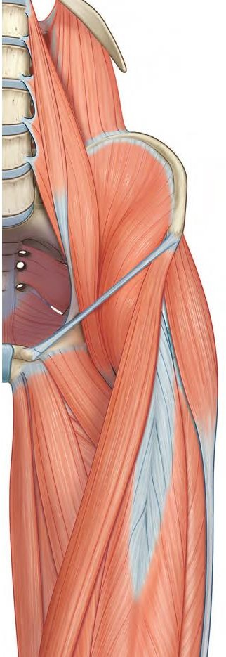
P s o a s m a j o r
Origin: Transverse processes, bodies, and intervertebral discs of the 12th thoracic and five lumbar vertebrae
Origin: Iliac fossa of hip bone
Both muscles pass behind the inguinal ligament

Slide 25
Insertion
This means that the iliopsoas crosses anterior to hip joint
Any muscle crosses anterior to hip joint will flex it, therefore,
it Flexes thigh on trunk; if thigh is fixed
(The insertion is fixed while the origin is moving)
It flexes the trunk on thigh as in sitting up from lying
down.
sit-up’ exercise

Slide 26
Origin: Transverse processes, bodies, and intervertebral discs of the 12th thoracic and five lumbar vertebrae
lesser trochanter of femur

Slide 27
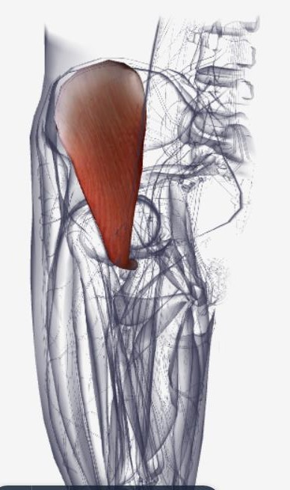
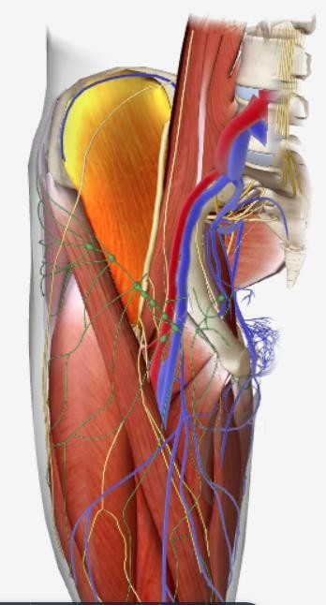
I l i a c u s

Slide 28
Psoas major muscle: Lumbar plexus
Nerve supply
Iliacus muscle: by the Femoral nerve in the pelvis before it passes behind the inguinal ligament
Iliopsoas may be tested clinically by actively flexing the hip against resistance, in the supine position with hip and knee flexed.

Slide 29
The quadriceps femoris muscle
Consisting of:
The rectus femoris
The vastus intermedius 3- The vastus lateralis
4- The vastus medialis
R e c t u s
f e m o r i s
V a s t u s l a t e r a l i s
Origin : Upper end and shaft of femur (linear origin)
V a s t u s m e d i a l i s
Origin : Upper end and shaft of femur (linear origin)

Slide 30
f e m o r i s
R e c t u s
V a s t u s
l a t e r a l i s
V a s t u s
m e d i a l i s

Slide 31
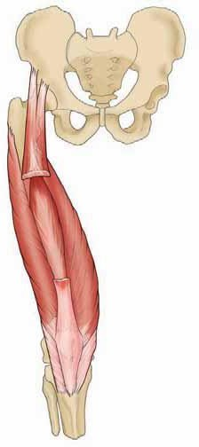
V a s t u s i n t e r m e d i u s

Slide 32
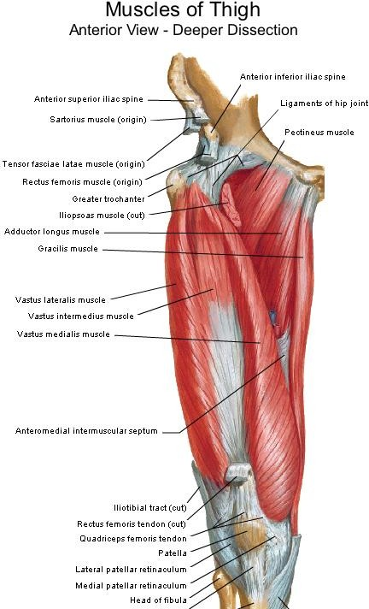
V a s t u s
i n t e r m e d i u s
Origin: Anterior and lateral surfaces of shaft of femur

Slide 33
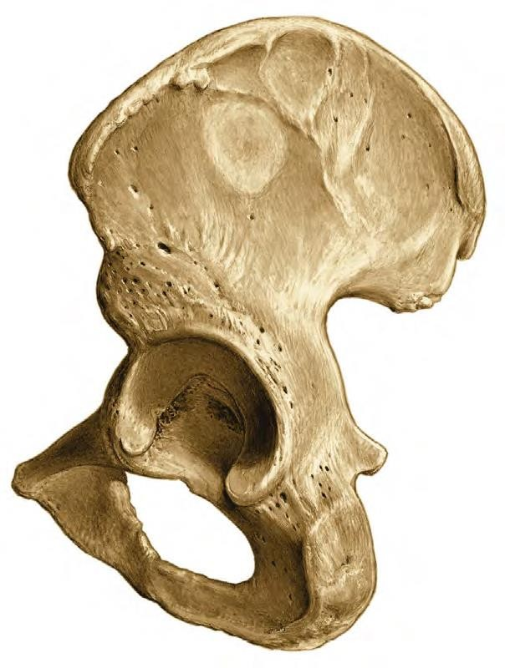
R e c t u s f e m o r i s
Originates by two heads
Straight head from anterior
inferior iliac spine
Reflected head from ilium above
acetabulum
Flexion of the hip joint
Rectus can fl ex the hip and extend the knee simultaneously.

Slide 34
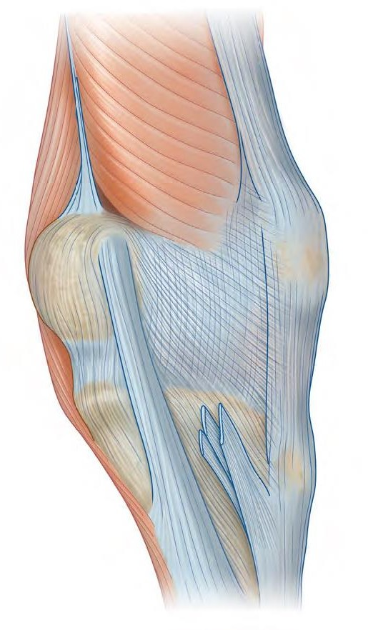
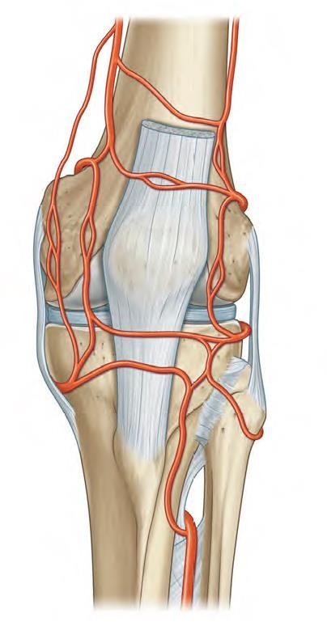
Insertion: the four heads are attached to the
patella and, via the ligamentum patellae, to the
tibial tuberosity (the real insertion)

Slide 35
Any muscle crosses anterior to the knee joint, will extend it
Actions: the quadriceps femoris muscle
Extends the leg at knee joint; flexes thigh at hip joint (only the rectus
femoris head).
Quadriceps femoris is the main extensor of the knee joint
Nerve supply : femoral nerve

Slide 36
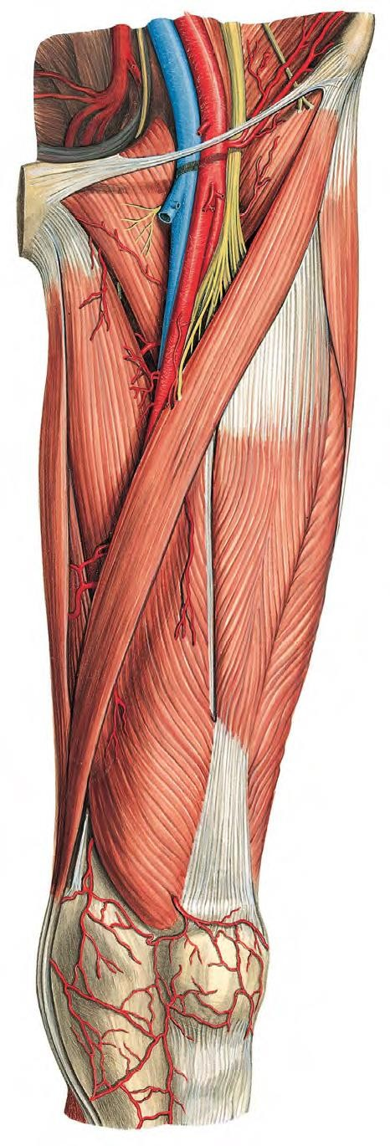
F e m o r a l N e r v e
It is the largest branch of the lumbar plexus (L2, 3, and 4).
It emerges from the lateral border of the psoas muscle
enters the thigh lateral to the femoral artery
and the femoral sheath, behind the inguinal
ligament.
it terminates by dividing into anterior and posterior divisions.
lateral

Slide 37
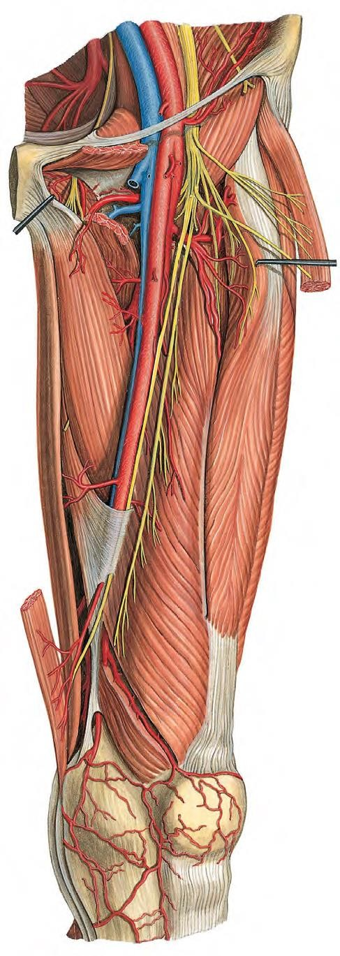
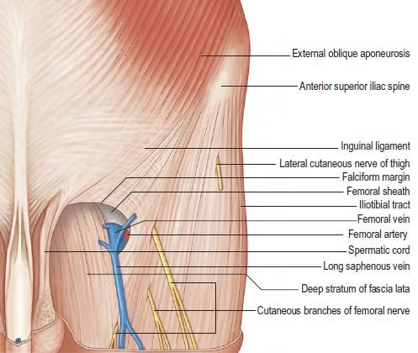
Anterior Division
The anterior division gives off two
cutaneous branches
The medial cutaneous nerve of the thigh.
The intermediate cutaneous nerve
of the thigh
and two muscular branches.
Nerve to sartorius and nerve to
pectineus muscles.

Slide 38
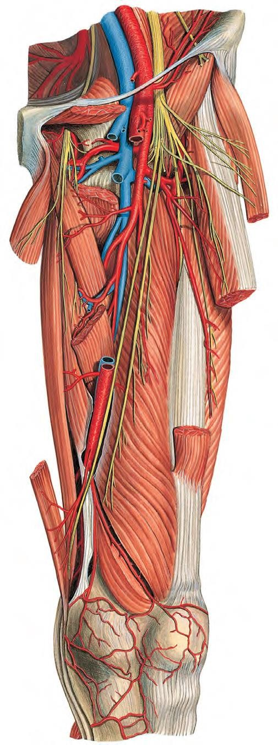
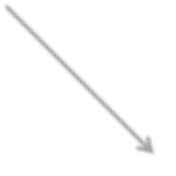
Posterior Division
The posterior division gives off one cutaneous branch
The Saphenous nerve
and muscular branches to the quadriceps muscle.
THE SAPHENOUS NERVE
runs downward and medially.
It emerges between the tendons of sartorius and gracilis
It then runs down in company with the great Saphenous vein.
It passes in front of the medial
malleolus and along the medial border of the foot, where it terminates in the region of the ball of the big toe

Slide 39
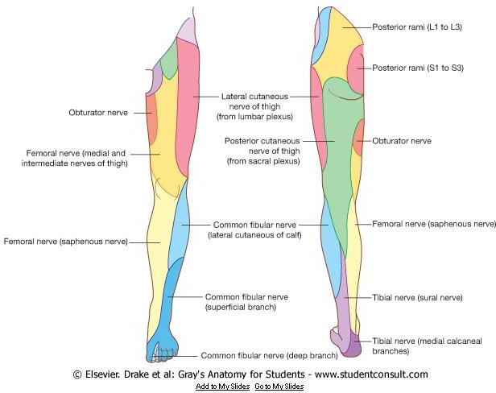
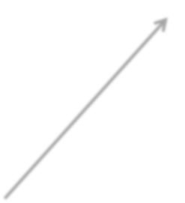
supplies skin on the medial side of the knee, leg, and foot.

