Slide 1
The Nose and Nasal Cavity

Slide 2
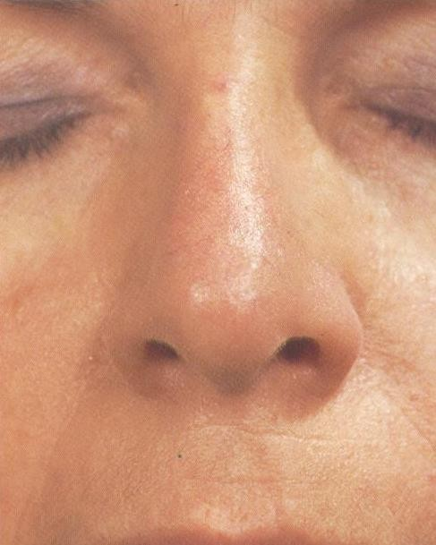
Columella
Philtrum

Slide 3
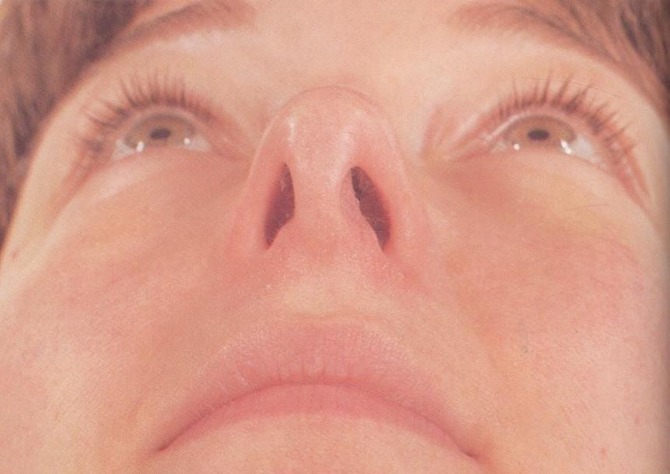

Slide 4
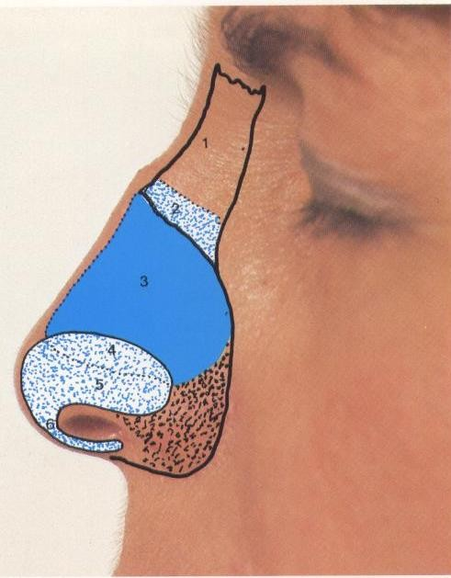

Slide 5
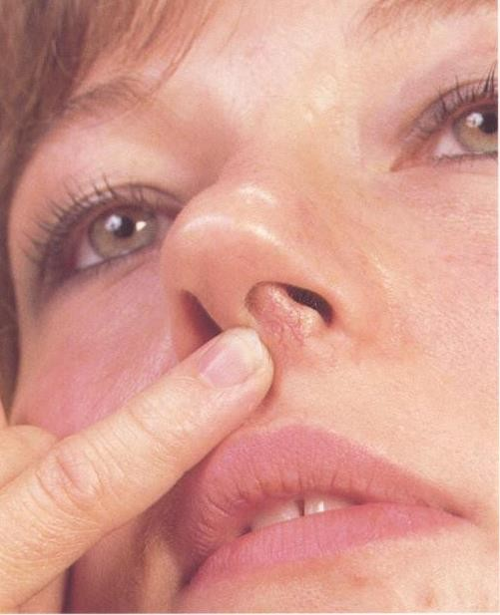

Slide 6
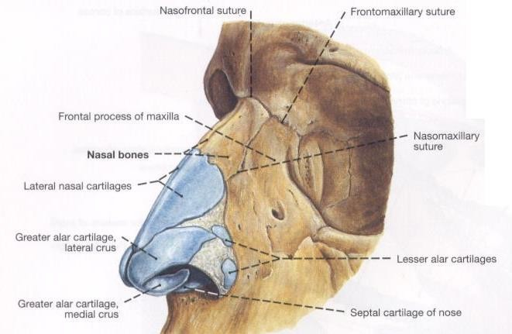

Slide 7
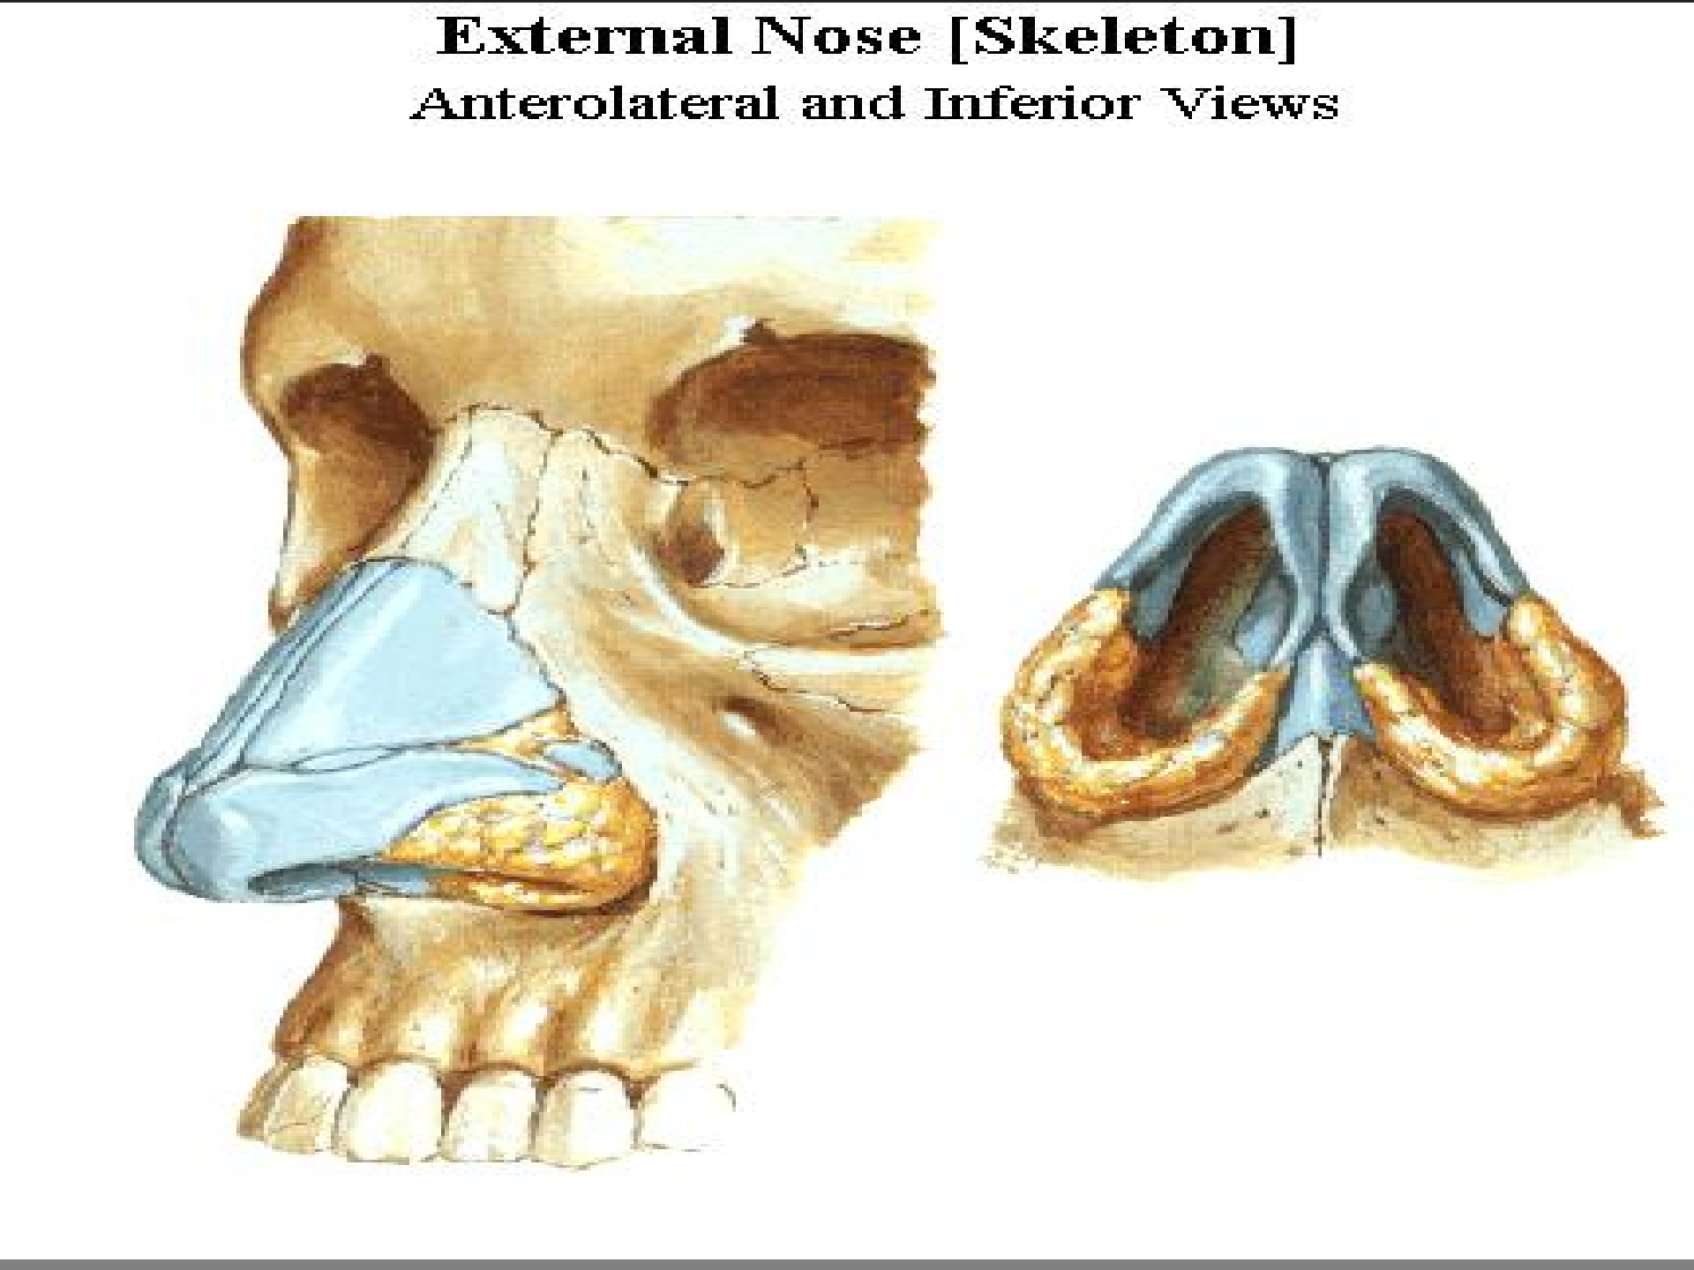

Slide 8
Nasal Cavity Basic Structure
The Nares (nostrils):open into the nasal cavity at the vestibule.
The Choana: opens into the nasopharynx.
The Septum: extends medially from the roof to the floor. Cartilage + bone.
Conchae (turbinates): Project from the lateral wall into the
cavity.
Meatus: a slit like space below the conchae.
8

Slide 9
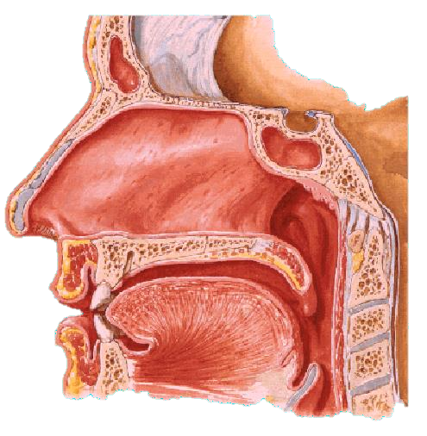
Floor of the Nasal Cavity
The hard palate, formed by:
The palatine process of the maxilla and horizontal plate of palatine bone.
Has the incisive foramen
which transmits:
Nasopalatine nerve.
Sphenopalatine artery.

Slide 10
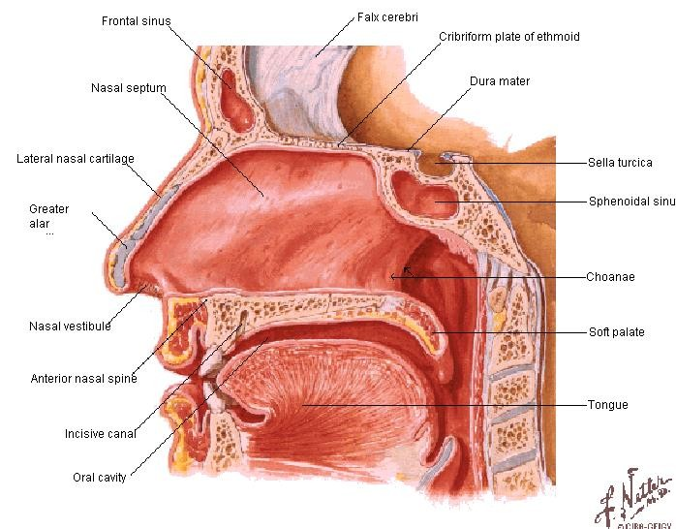
Roof of the Nasal Cavity
Anterior (sloping):
Frontal and nasal bones
Middle (horizontal):
Cribriform plate of the ethmoid.
Posterior (sloping):
Body of he sphenoid

Slide 11
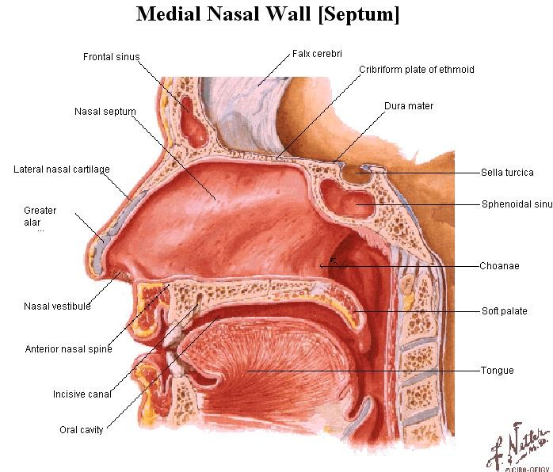
Medial Wall of the Nasal Cavity
The nasal septum forms the medial wall.
It is commonly deviated to one side.
Parts:
Anteriorly: Septal cartilage.
Postero-inferior: Vomer bone.
Postero-superior: Perpendicular plate of the ethmoid.

Slide 12
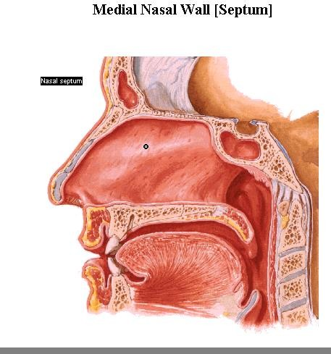

Slide 13
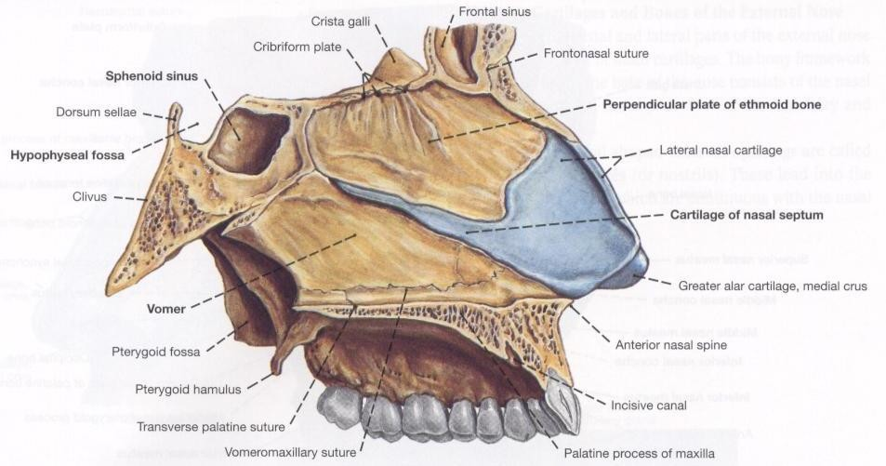

Slide 14
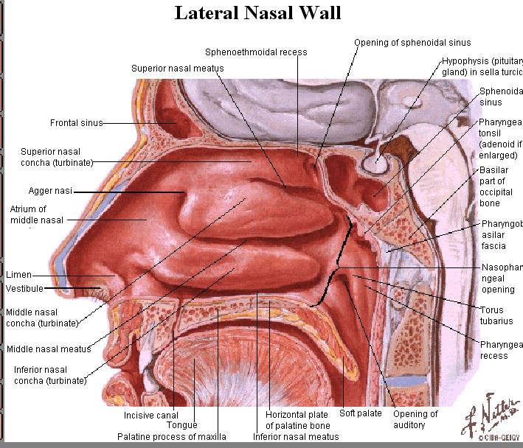
Lateral Wall of the Nasal Cavity
The maxilla, antero-
inferiorly
The perpendicular plate of the palatine bone posteriorly.
The three concha and meatuses below them.
Sphenoethmoidal recess above the superior concha.

Slide 16
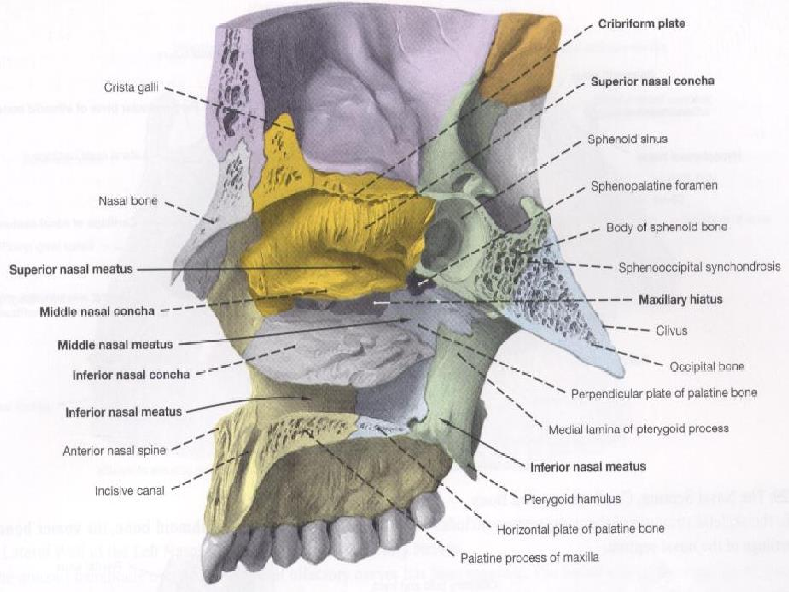

Slide 17
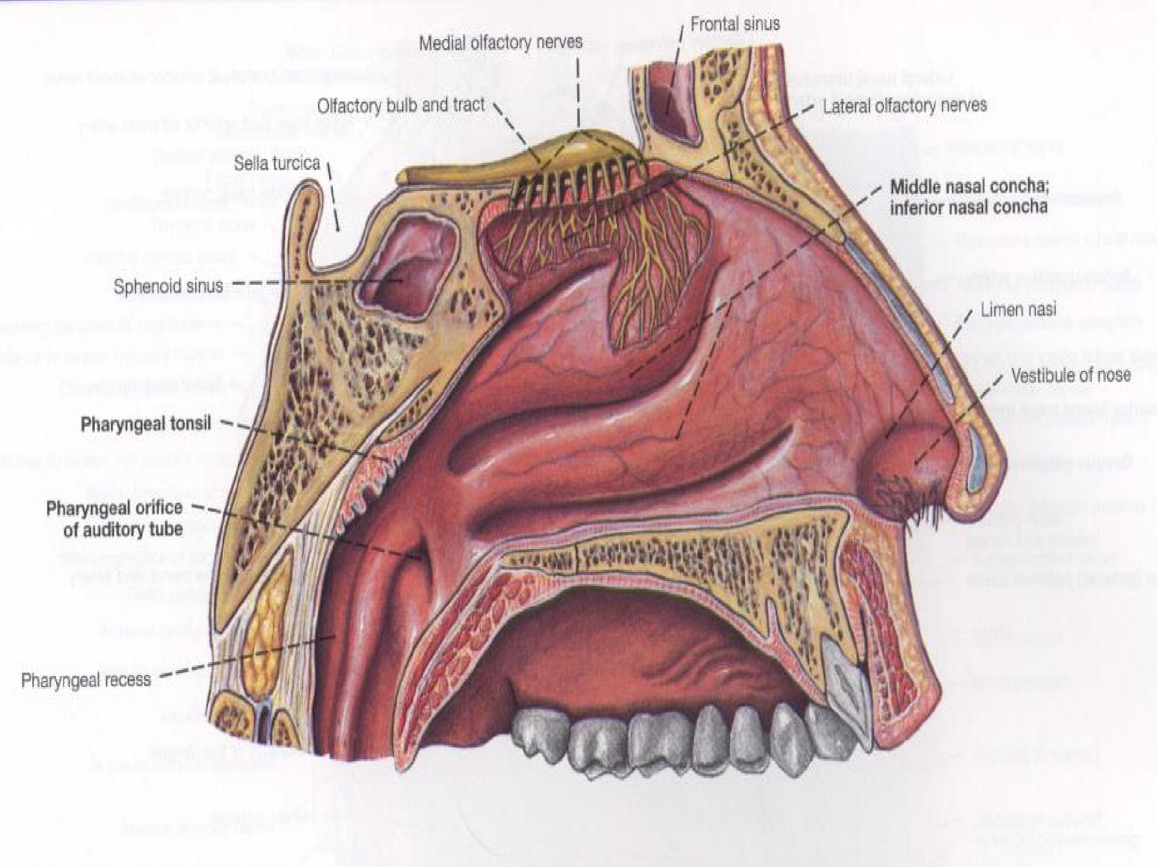

Slide 18
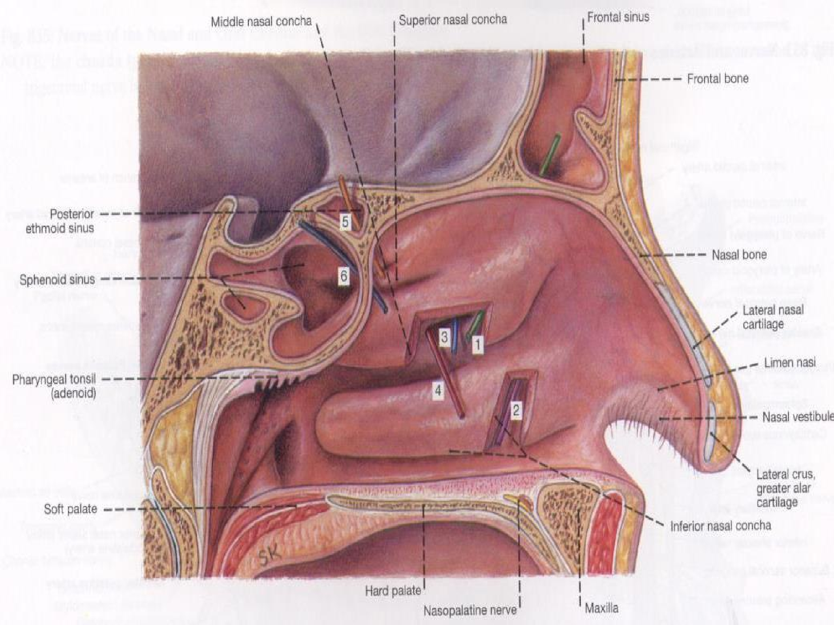

Slide 19
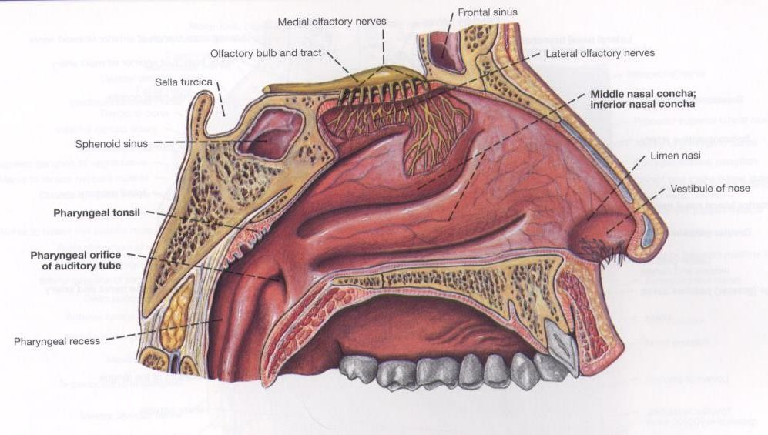
Nasal Mucosa….(1)
Olfactory:
Covers the superior nasal concha and the upper 1/3 of the nasal septum.
It appears yellowish in color.

Slide 20
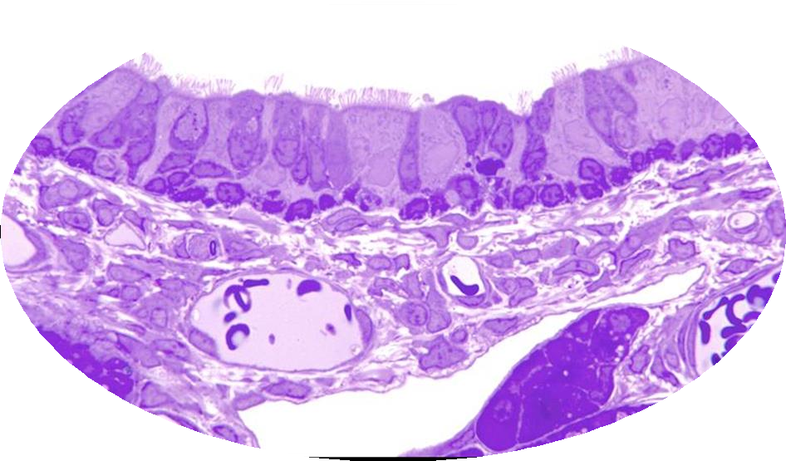
Nasal Mucosa….(2)
Conductive:
Covers the lower part of the nasal cavity.
Appears purple in color.
Covered by skin in its lower part 🢥
vestibule.
Covered by respiratory epithelium in its upper part.
The junction between the 2 epithelia
_white line (mucocutaneous junction).

Slide 21
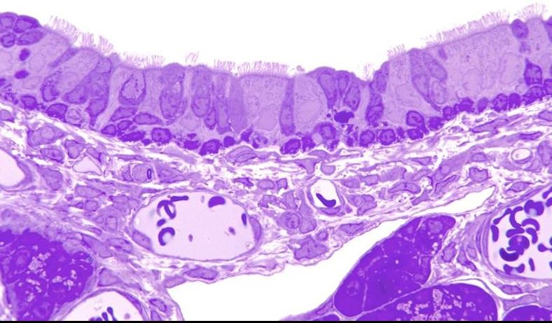

Slide 22
Venous Drainage of the Nasal Cavity
Nasal veins tend to drain into the pterygoid plexus.
The submucous plexus modifies the physical properties of air.
Venous engorgement is associated with mucosal edema occlusion of the airway.

Slide 23
Innervation of the Nasal Cavity
Antero-superior quadrant:
Anterior ethmoidal nerve (nasociliary).
Antero-inferior quadrant:
Anterior superior alveolar nerve (maxillary).
Postero-superior quadrant:
Sphenopalatine nerve and nasal branches of the sphenopalatine ganglion.
Postero-inferior quadrant:
Greater palatine nerve.

Slide 24
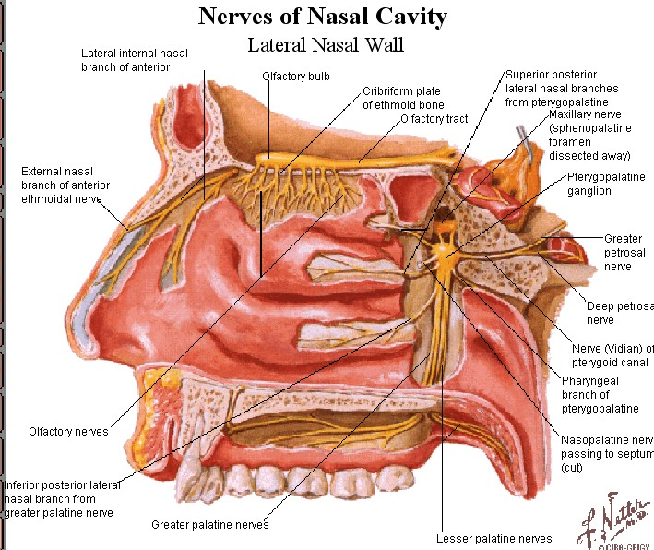

Slide 25
Innervation of the Nasal Septum
Olfactory nerve.
Anterior ethmoidal nerve. Sphenopalatine nerve.
Posterior superior alveolar nerve.

Slide 26
Epistaxis and Little’s Area
Epistaxis: bleeding from the nose. Commonly occurs from Little’s area:
Lies in the anterior part of the nasal septum, 2.5 cm from the nares,
opposite the vestibule.
It is the site of anastomosis of:
Sphenopalatine artery.
Greater palatine artery.
Septal branches of the facial.
Arteries in the area form together Kieselbach’s plexus.

Slide 27
Blood Supply of the Nasal Cavity
anterosuperior quadrant
Anterior and posterior ethmoidal
posterosuperior quadrant
Sphenopalatine artery
Supplied in quadrants
anteroinferior quadrant & nasal septum
Superior labial of facial
Posteroinferior quadrant
Greater palatine artery

Slide 28
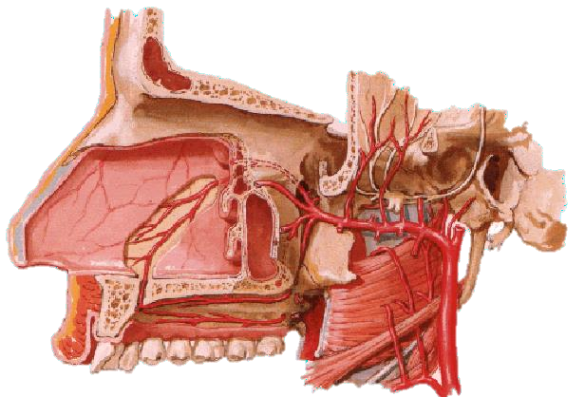

Slide 29
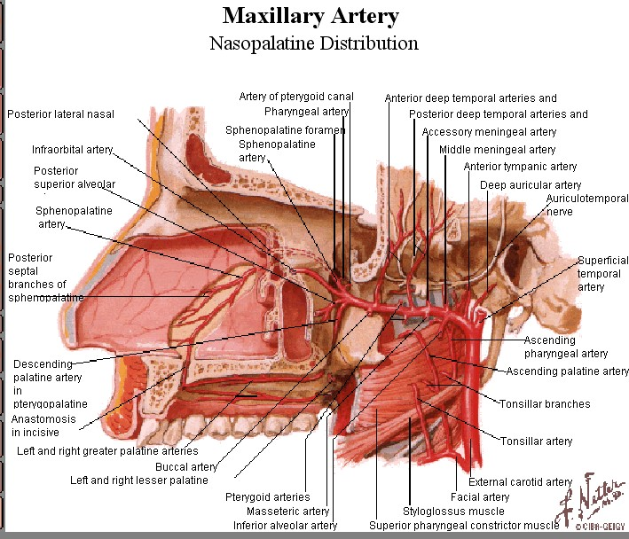

Slide 30
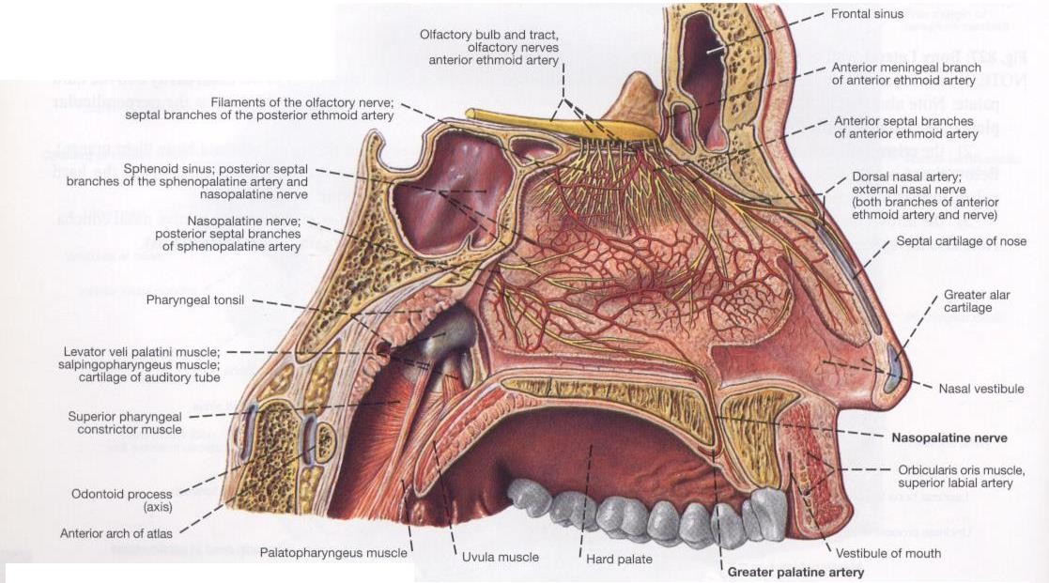
Vessels and Nerves of the Nasal Septum

