Slide 1
THE LARYNX

Slide 2
General principles of development
The development of the larynx can be divided into prenatal and postnatal stages.
At birth, the larynx is located high in the neck between the C1 and C4 vertebrae, allowing concurrent breathing or vocalization and deglutition.
By age 2 years, the larynx descends inferiorly; by age 6 years, it reaches the adult position between C4 and C7 vertebrae. This new position provides a greater range of phonation (because of the wider supraglottic pharynx) at the expense of losing this separation of function, i.e., deglutition and breathing.

Slide 3
The larynx develops from the endodermal lining and the adjacent mesenchyme of the foregut between the fourth and sixth branchial arches.
At 20 days' gestation, the foregut is first identifiable with a ventral laryngotracheal groove. It continues to deepen until its lateral edges fuse.
Trachea becomes separated from the esophagus by the tracheoesophageal septum with a persistent slit like opening into the pharynx
This fusion occurs in the caudal-to-cranial direction, and incomplete fusion results in development of persistent communication between the larynx or trachea and the esophagus

Slide 4
The main changes occurring in the larynx postnatally are a change in the axis, luminal shape, length, and proportional growth of the laryngeal elements.
The larynx grows rapidly during the first 3 years of life, while the arytenoids remain approximately
the same size.
Beginning at age 18-24 months, the larynx descends in the neck to achieve its final position at vertebrae C4-C7 by age 6 years.
The larynx elongates as the hyoid, thyroid, and cricoid cartilages separate from each other
The cricoid cartilage continues to develop during the first decade of life, gradually changing from a funnel shape to a wider adult lumen; therefore, it is no longer the narrowest portion of the upper airway.

Slide 5
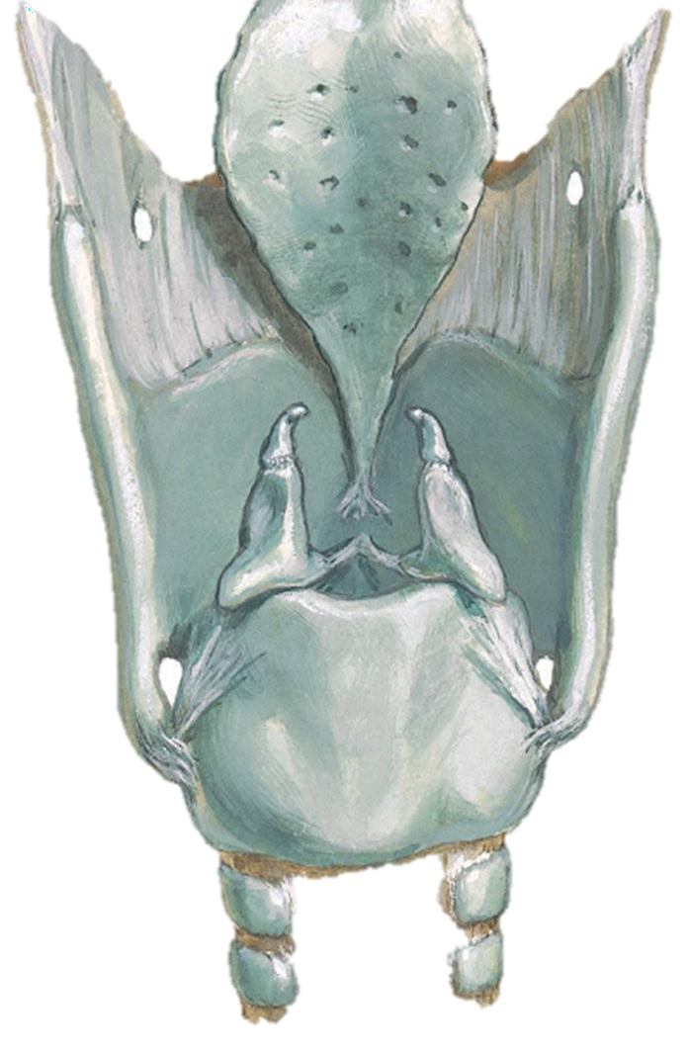
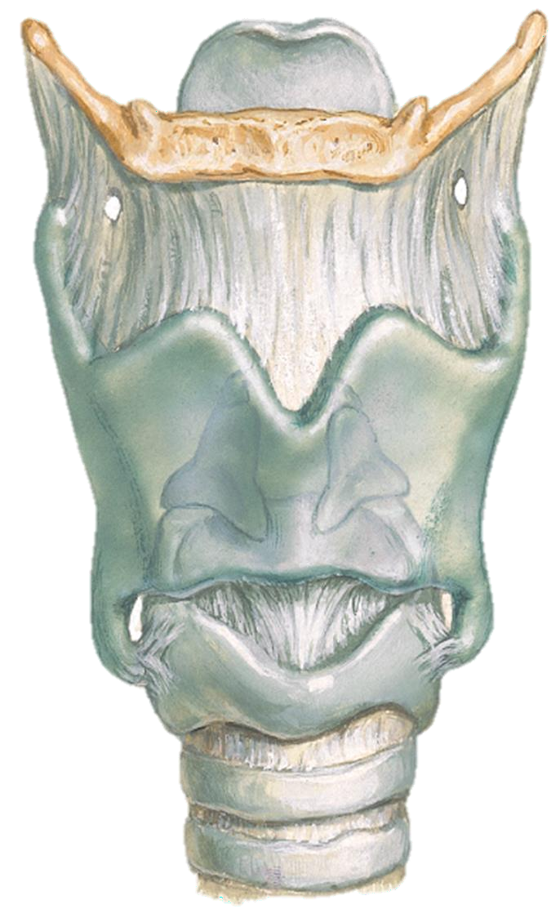
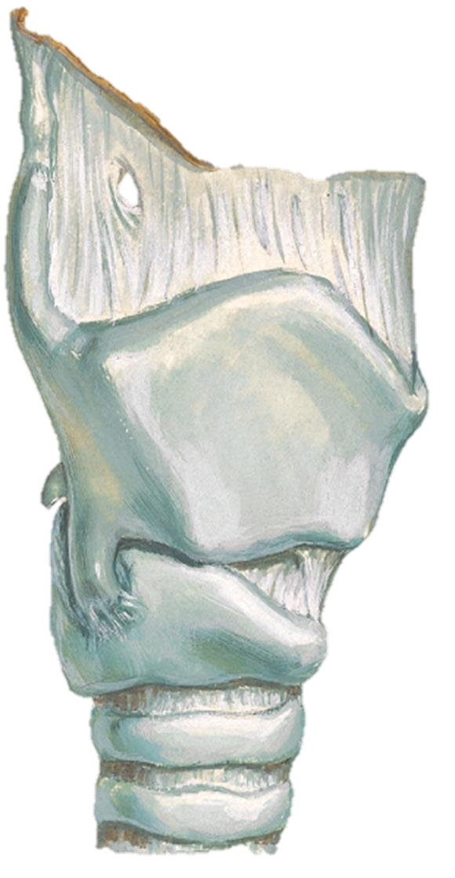
Thyroid Cartilage
Sheild shaped, open posteriorly, angulated anteriorly
Angulation more acute in males
Its function is to shield larynx from injury and provide an attachment to vocal cords

Slide 6
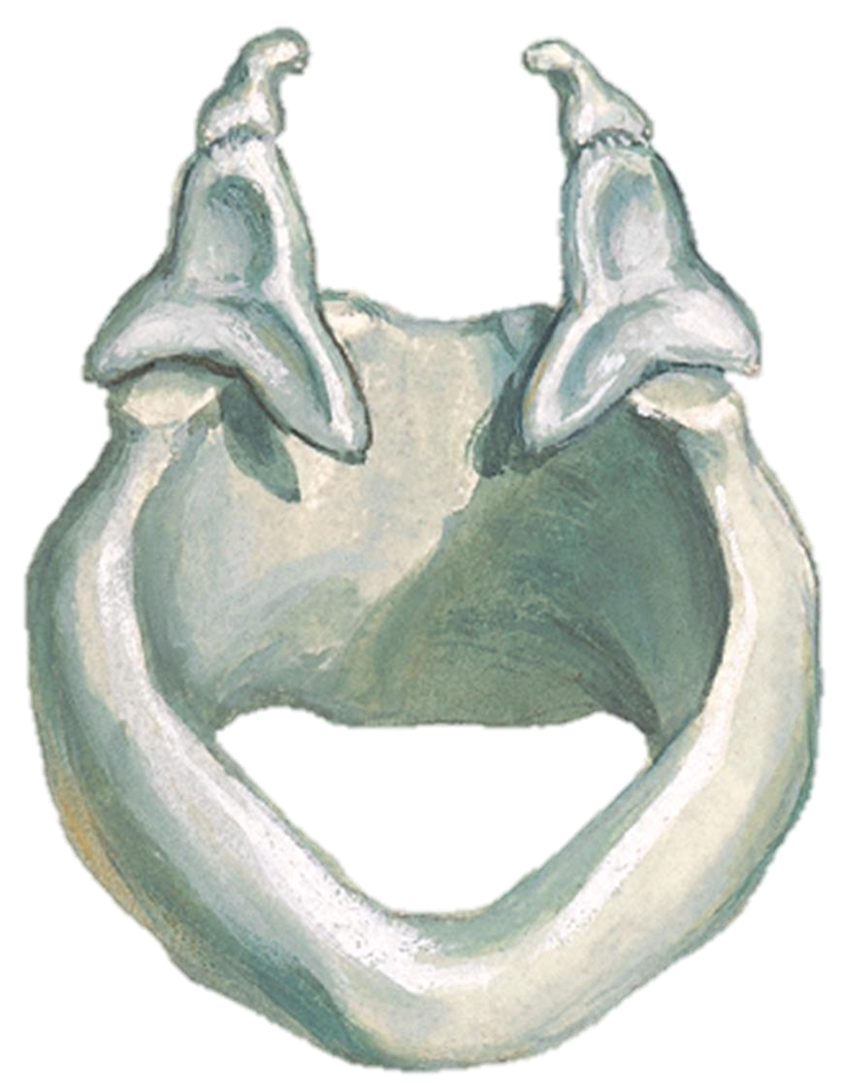
Cricoid Cartilage ..1/2
Signet ring shaped
Lamina
Stronger than thyroid cartilage.
Lamina – 2 to 3 cm from above downwards, considerably broader than anterior arch.
Anterior arch

Slide 7
Cricoid Cartilage ..2/2
Base for entire larynx
Support to arytenoid cartilage Attachment to intrinsic muscles
The only part of cartilaginous framework of the respiratory system that forms continuous
Once injured or strictured, difficult to resect
while preserving laryngeal function

Slide 8
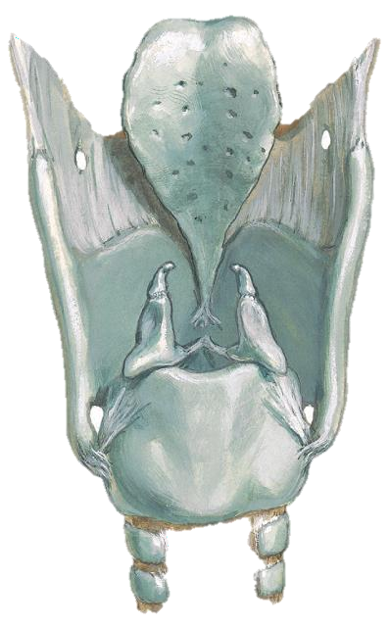
Epiglottis ..1/2
Thin leaf shaped fibro-cartilage, situated in midline
Upper free end broad & rounded, projects up behind base of tongue
Narrow base called pitiole
This attachment forms lower limit of pre-epiglottis space
Half of it projects above hyoid
This part has a laryngeal and a lingual surfaces

Slide 9
Epiglottis ..2/2
Infrahyoid portion has no free anterior surface
Forms posterior wall of PES
Epiglottic cartilage contains many pits filled with mucous glands
Little barrier between infrahyoid portion and PES

Slide 10
Aryteniod Cartilages

Slide 11
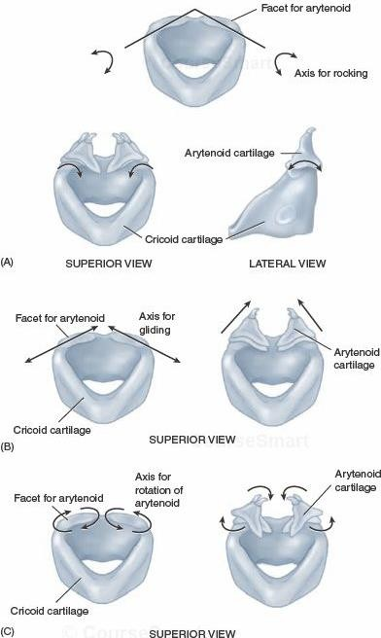
Crico-Arytenoid Articulation

Slide 12
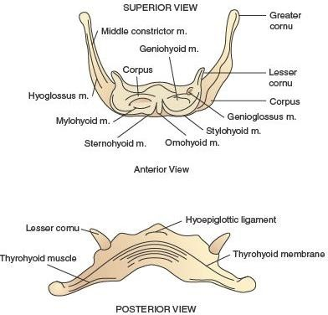
Osseous Structure
Hyoid

Slide 13
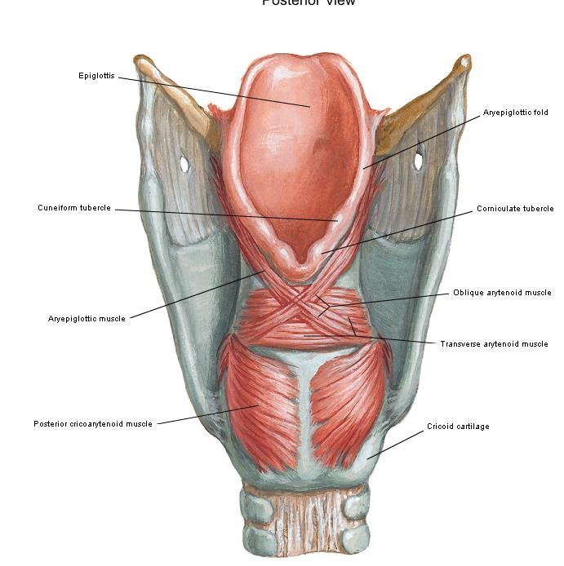
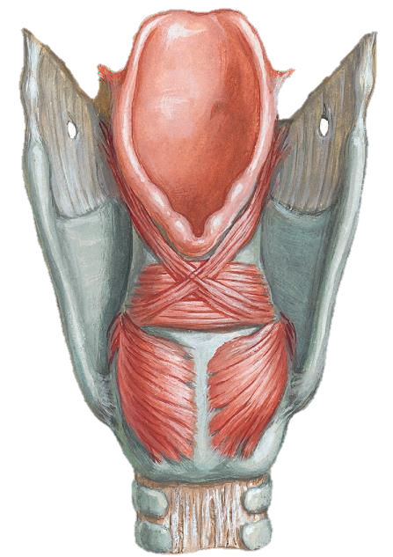

Slide 14
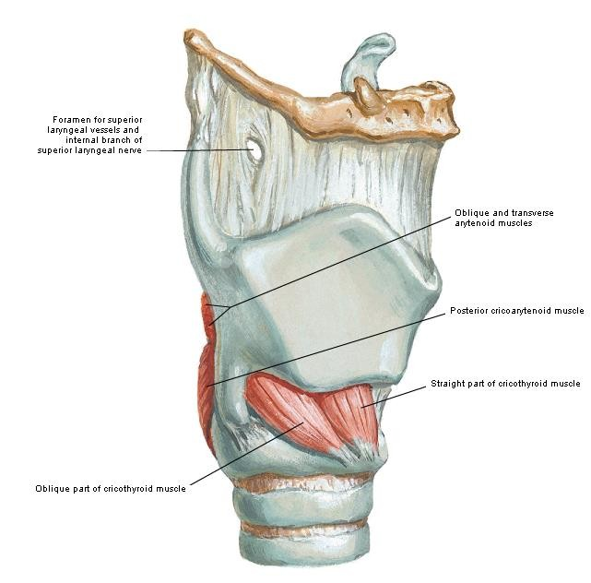
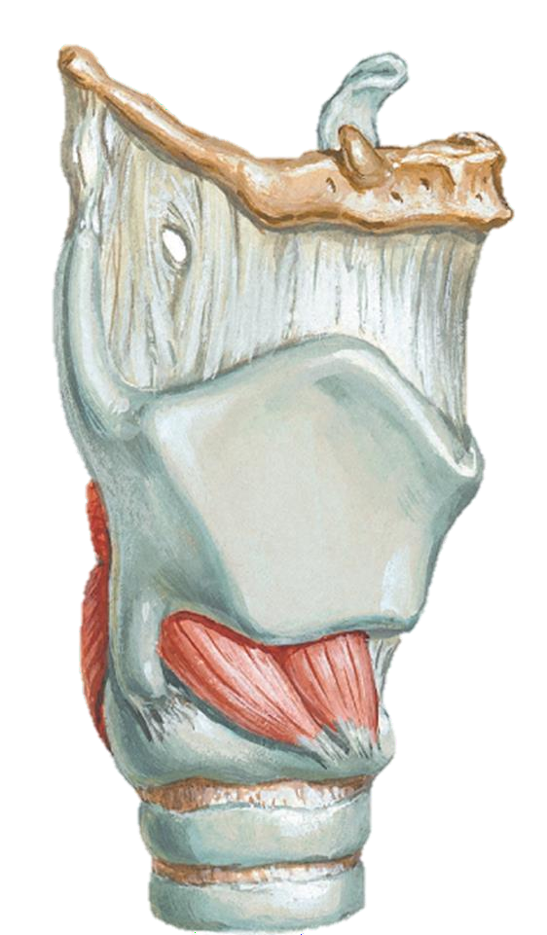

Slide 15
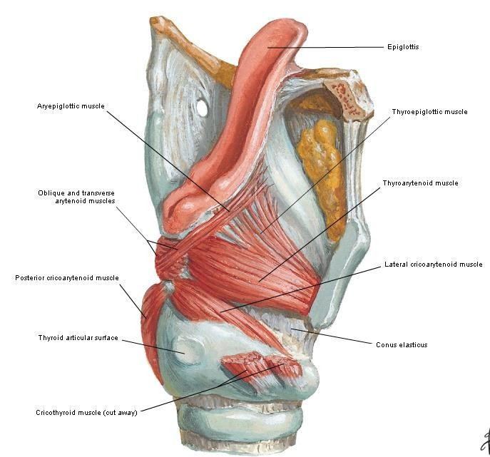
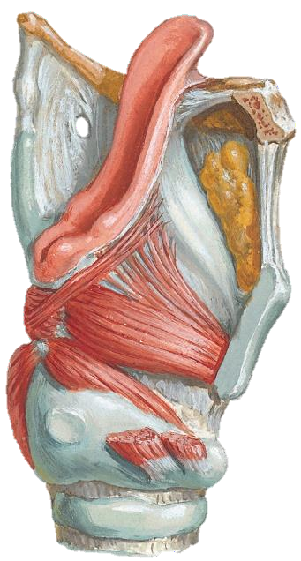

Slide 16
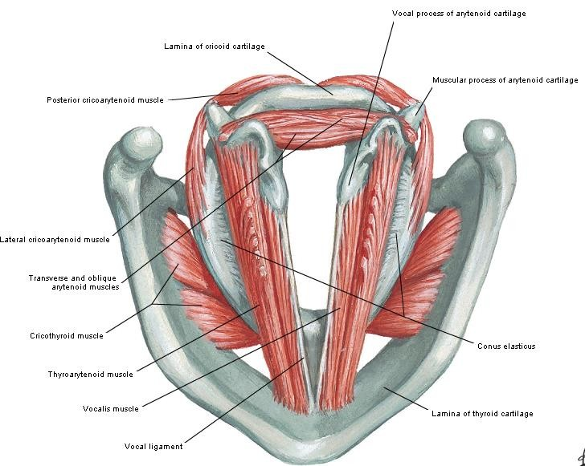
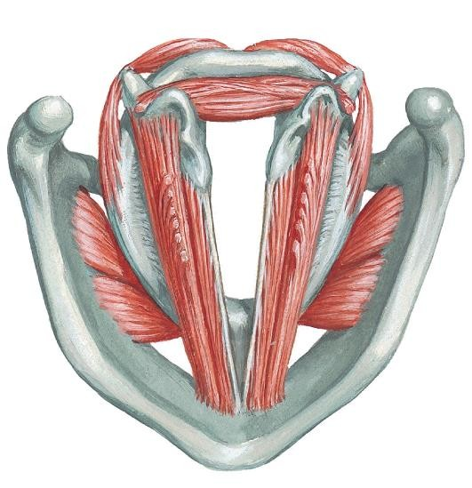

Slide 17
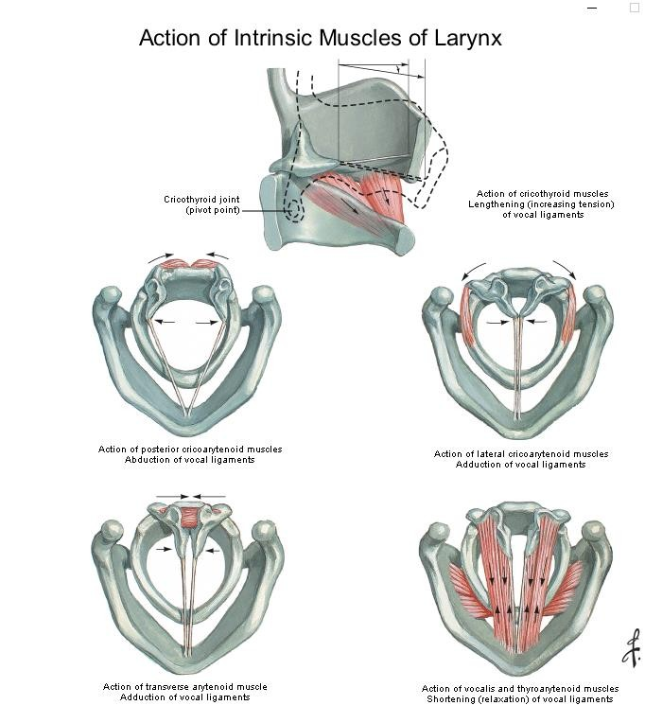
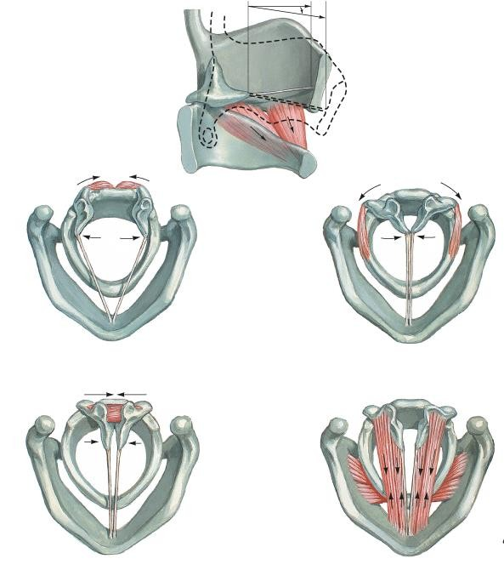

Slide 18
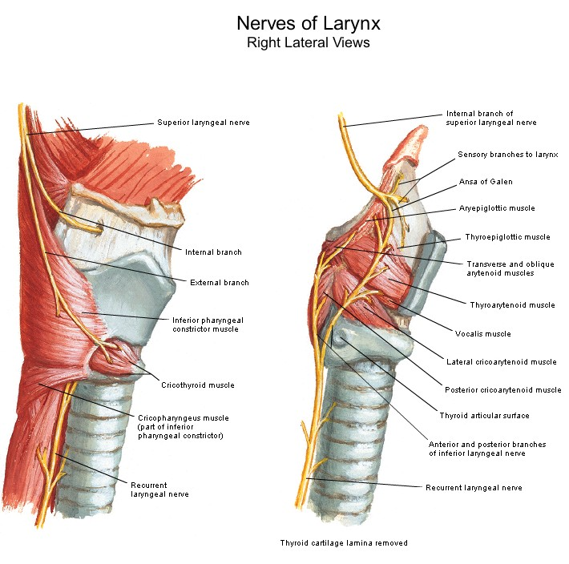
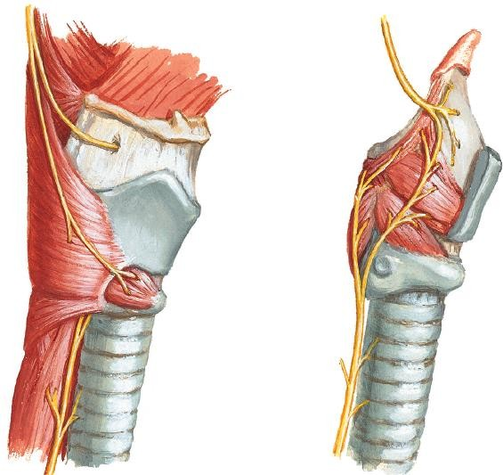

Slide 19
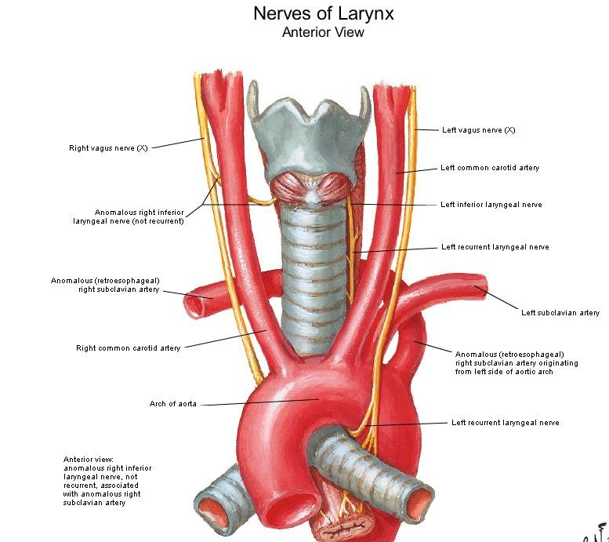
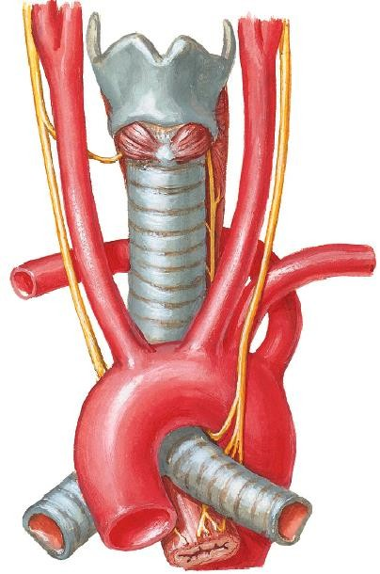

Slide 20
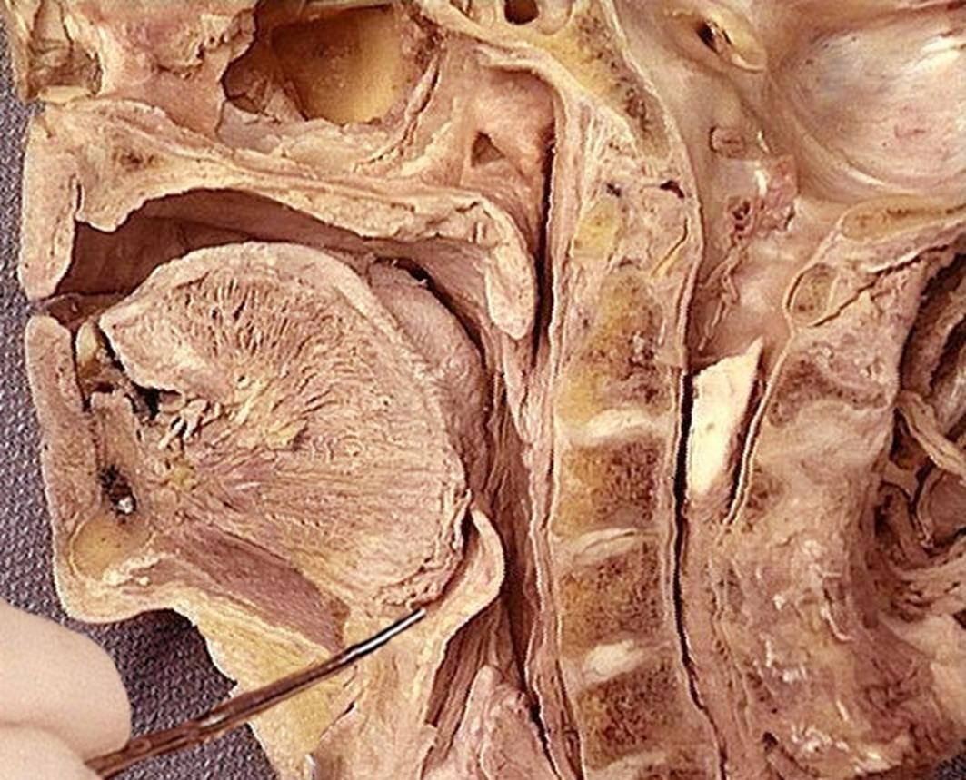

Slide 21
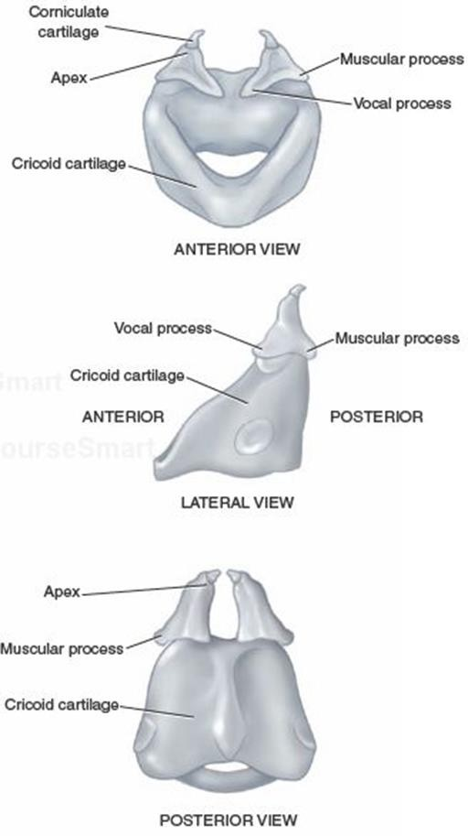
Arytenoid Cartilage
Paired cartilages, pyramidal in shape
Base articulated with cricoid
Posterior and Lateral cricoarytenoid
muscles attach on muscular process
Anterior angle elongated into vocal process which receives insertion of vocal ligament

Slide 22
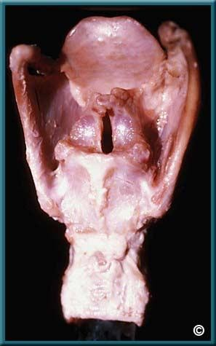
Supraglottis
Consists of ventricles, false cords, laryngeal surface of epiglottis, aryepiglottic folds and the mucosal expanse.
Posterior tapering shape reduces area of mucosa in posterior region

Slide 23
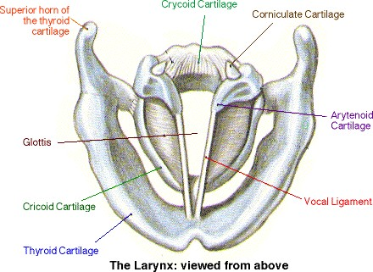
Glottis
Consists of true cords, anterior
commissure and posterior commissure
Narrow triangular space between the true cords is called rima glottis
Anterior 2/3 is membranous
Posterior third consists of vocal processes
of arytenoids
Posterior 1/3 of cords and covering
mucosa are called posterior commissure

Slide 24
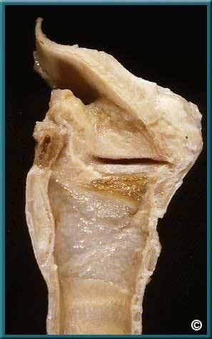
Sub-glottis
Begins about 5mm below free margins of VC
Consists of a mobile upper and fixed lower part

Slide 25
Mucosa
Mucosa of glottic and Supraglottic regions is stratified squamous epithelium.
Mucosa of ventricles and sub-glottic regions is pseudo-stratified ciliated epithelium
Supra and sub glottic regions particularly ventricles are rich in submucosal mucous or minor salivary glands while glottis is not.

Slide 26
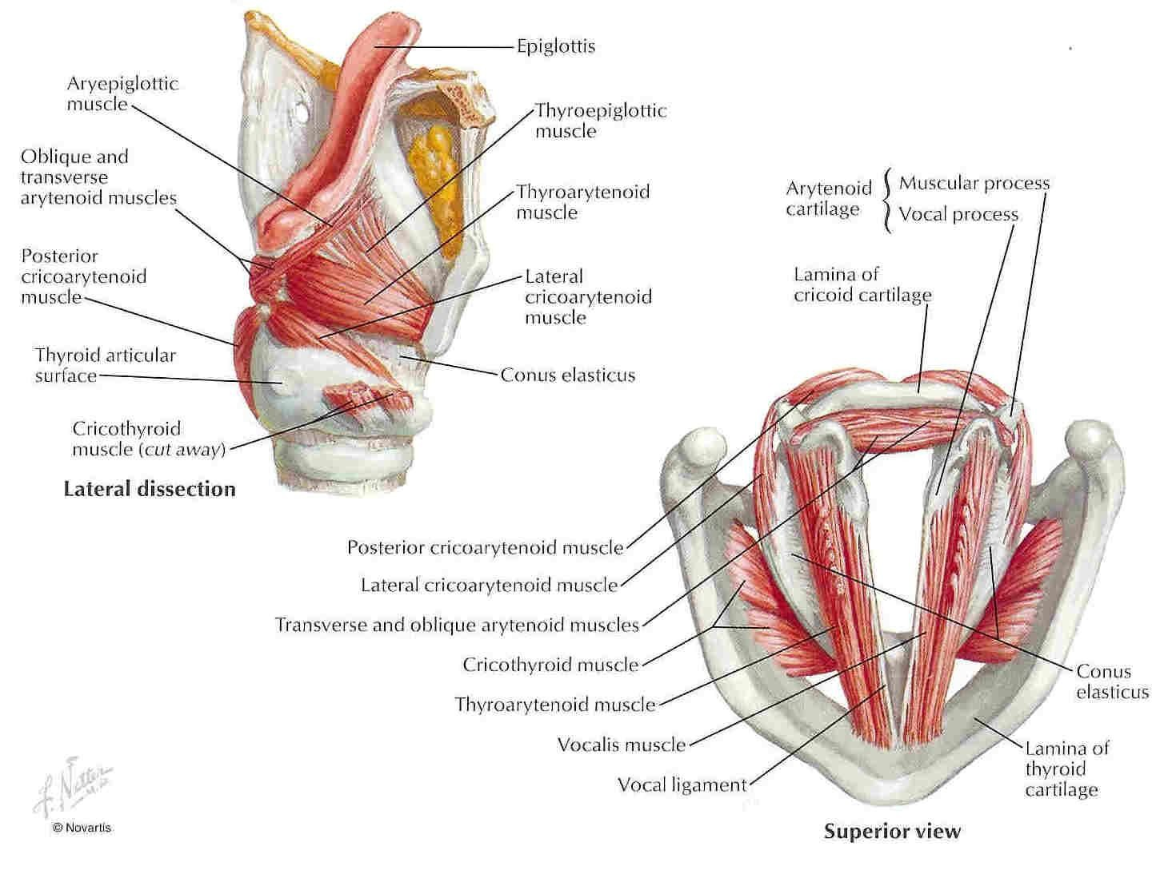
INTRINSIC MUSCLES

Slide 27
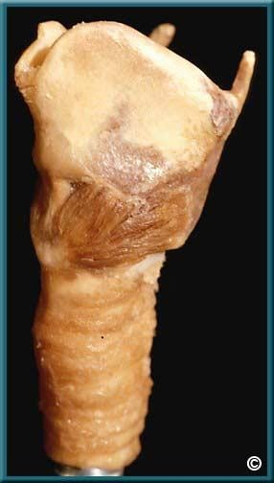
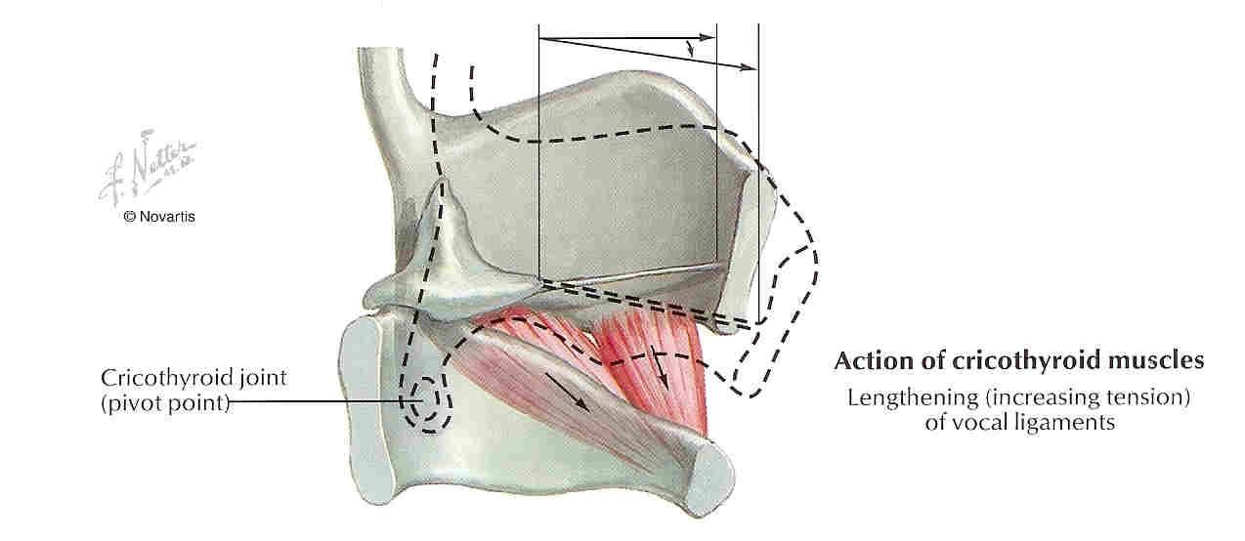
CRICOTHYROID MUSCLE

Slide 28
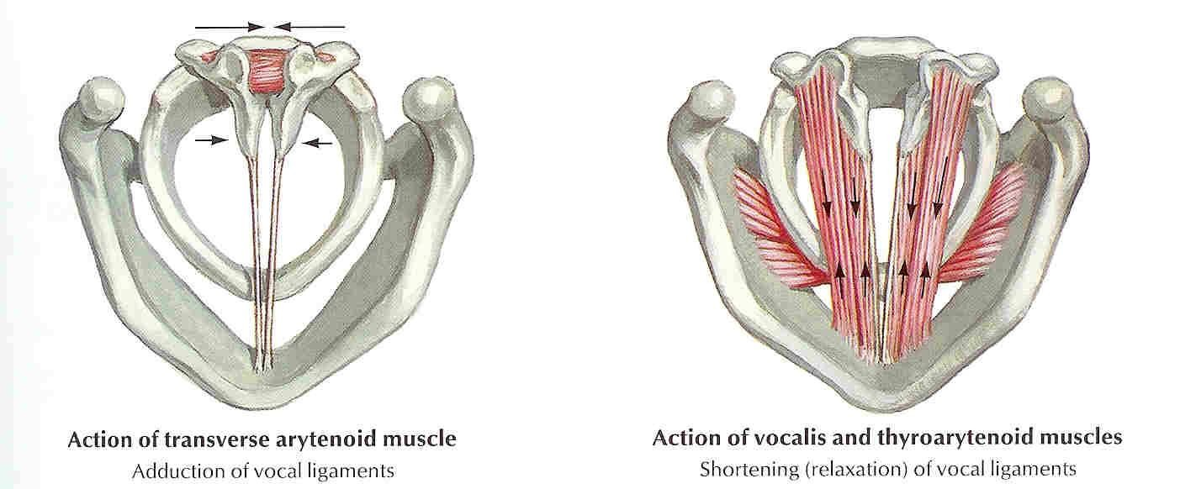
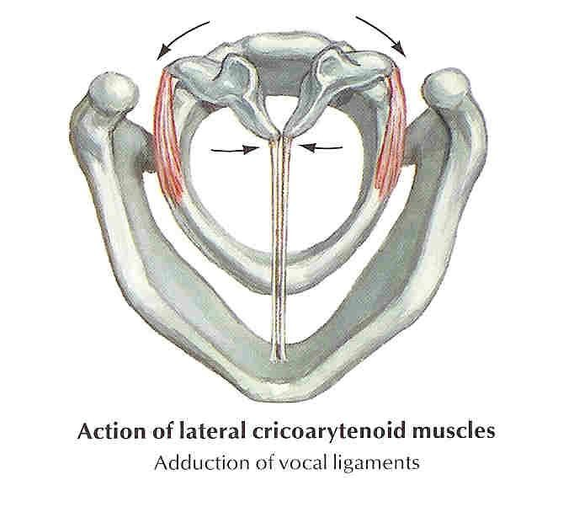
FOLDS

Slide 29
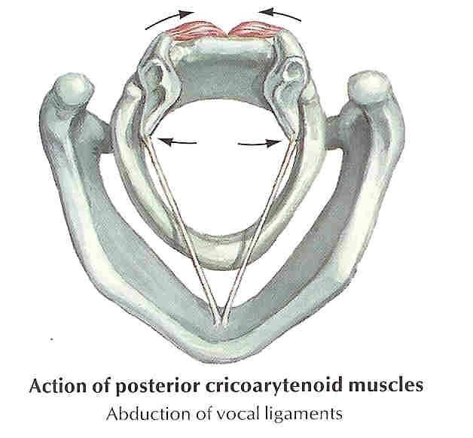
ABDUCTOR OF LARYNX

Slide 30
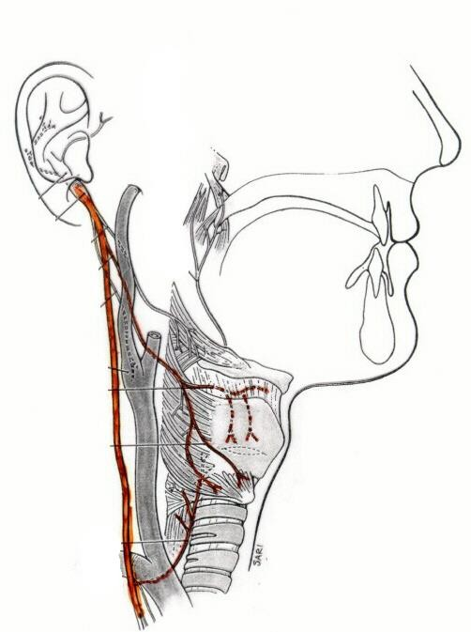
Superior Laryngeal Nerve - It leaves the vagus nerve high in the neck
Nerve Supply: Derived from the Vagus
Internal -It provides sensation of the glottis and supraglottis, which includes the pharynx, underside of the epiglottis and the larynx above the cords. Remember: SIS-superior internal sensory.
External -It supplies motor function to the cricothyroid muscle which tenses the vocal cords and could cause laryngopasm.

Slide 31
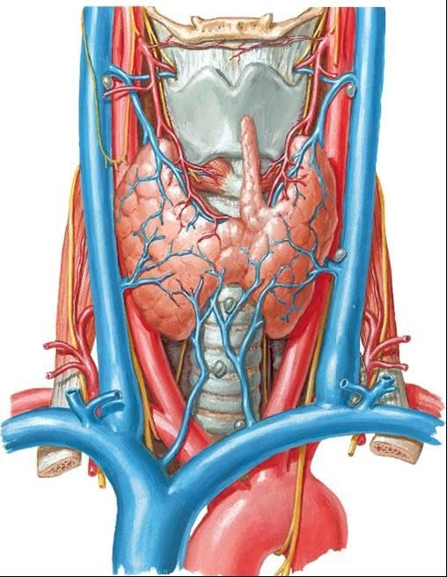
Recurrent Laryngeal Nerve: provides sensation to the subglottic area which includes the larynx below the vocal cords and upper esophagus. It provides motor function to the intrinsic muscles of the larynx.
It branches from the vagus in the mediastinum and turns back up into the neck. On the right, it travels inferior to the subclavian and loops up, and on the left it travel inferior to the aorta and loops up.

Slide 32
Arterial Supply
Superior laryngeal artery from the superior thyroid artery
Inferior laryngeal artery from the inferior thyroid artery

Slide 33
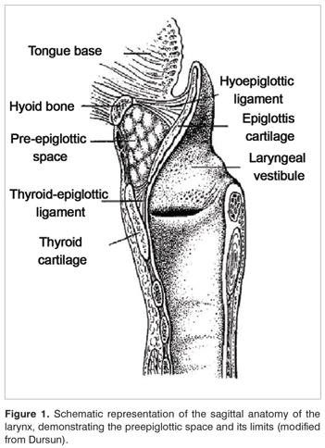
Pre-Epiglottic Space
Bound sup by hyo-epiglottic ligament, ant by thyrohyoid memb. & thyroid cartilage and posteriorly by epiglottis
Filled with fat and areolar tissue
Continuous with para-glottic space
Cx of laryngeal surface of epiglottis
readily spread to PreEpiSpace

Slide 34
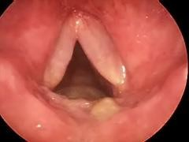
Reinke’s Space
The mucosa over the vocal ligament is loosely attached to ligaments
The space below the mucosa is known as Reinke’s space
It extends over the whole length of the true vocal fold

Slide 35
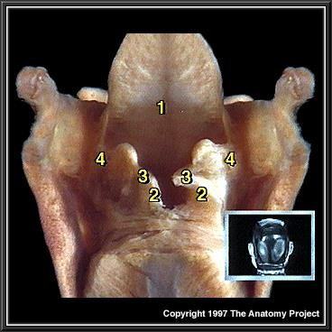
PARA-GLOTTIC SPACE

Slide 36
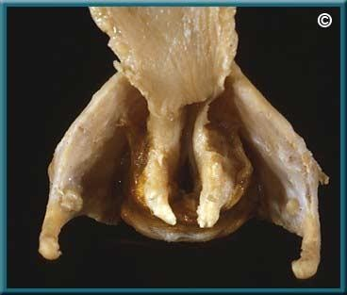
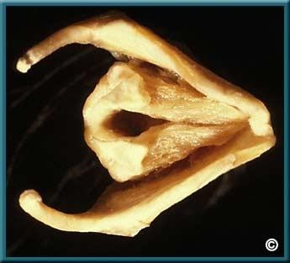

Slide 37
Intrinsic Ligaments of larynx
Quadrangular Membrane
Conus Elasticus

Slide 38
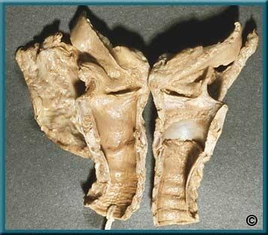
CONUS ELASTICUS

Slide 39
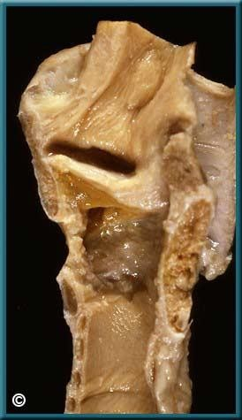

Slide 40
Cricothyroid
Posterior cricoarytenoid
Lateral cricoarytenoid
Intrinsic
Transverse arytenoid
Oblique arytenoid
Thyroarytenoid
Sternothyroid muscles
Laryngeal Muscles:
Omohyoid muscles
Sternohyoid muscles
Inferior constrictor
muscles.
Thyrohyoid muscles
Extrinsic
Digastric
Stylohyoid
Mylohyoid
Geniohyoid
Hyoglossus
Genioglossus

Slide 41
Intrinsic laryngeal muscles

Slide 42
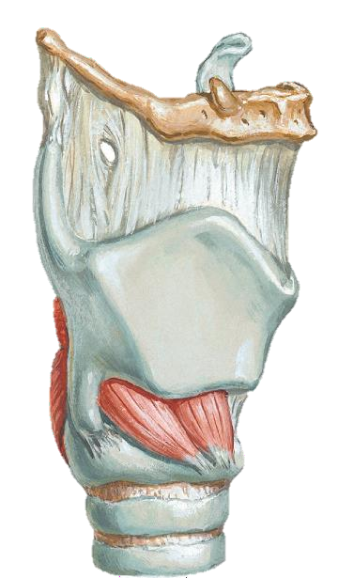
Cricothyroid Muscle
Origin: from the anterolateral aspect of the cricoid and the inferior cornu
Insertion: to the lower lamina of the thyroid cartilage
Action: Tilts the thyroid forward to help tense the vocal cords. It is the only tensor muscle of the larynx.
Innervation: It is the only laryngeal muscle innervated by the superior laryngeal branch of the vagus nerve known as the external branch of the superior laryngeal nerve

Slide 43
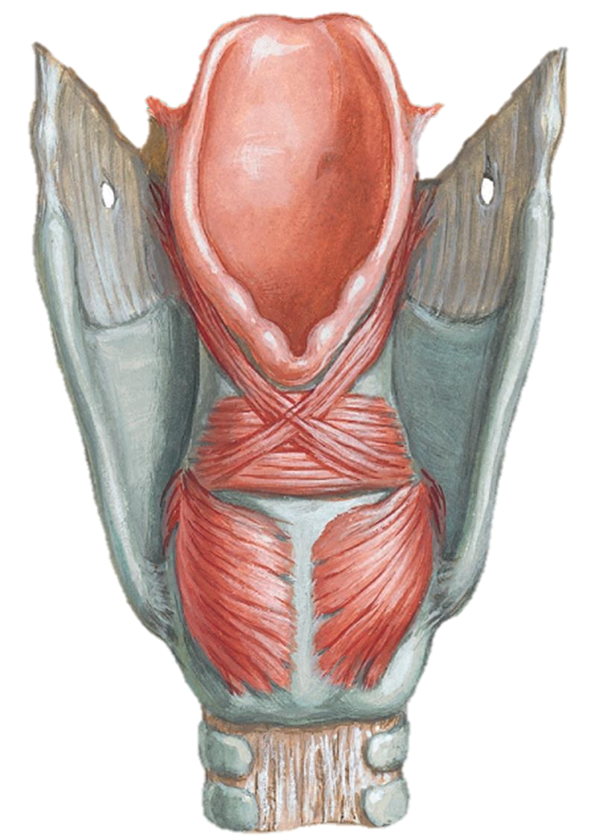
Posterior Cricoarytenoid Muscle
Origin: posterior part of the cricoid cartilage
Insertion: posterior surface of muscular process of the arytenoid cartilage
Action: abducts and laterally rotates the arytenoid cartilage, pulling the vocal ligaments away from the midline and forward and so opening the rima glottidis
Innervation: recurrent laryngeal nerve

Slide 44
Lateral Cricoarytenoid
Origin: Insertion: Action:
Innervation:

Slide 45
Transverse Arytenoid
Origin: Insertion: Action:
Innervation:

Slide 46
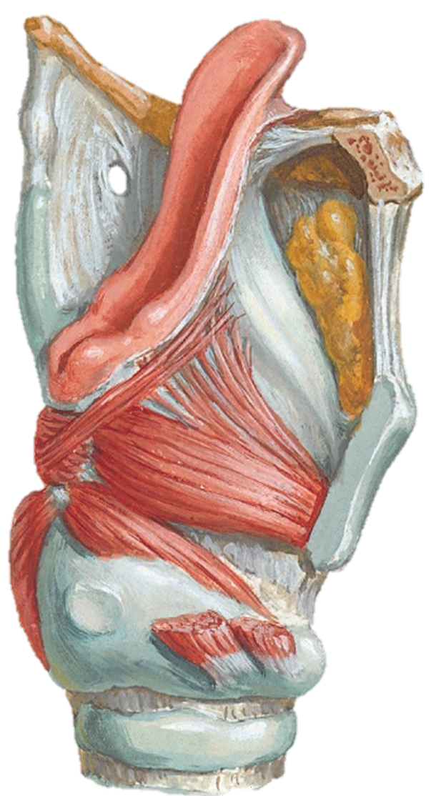
Oblique Arytenoid
Origin: Insertion: Action:
Innervation:

Slide 47
Thyroarytenoid
Origin: Insertion: Action:
Innervation:

Slide 48
Extrinsic Muscles

Slide 49
STERNOTHYROID MUSCLES OMOHYOID MUSCLES STERNOHYOID MUSCLES
INFERIOR CONSTRICTOR MUSCLES. THYROHYOID MUSCLES DIGASTRIC
STYLOHYOID MYLOHYOID GENIOHYOID HYOGLOSSUS GENIOGLOSSUS

