Slide 1
The Palate

Slide 2
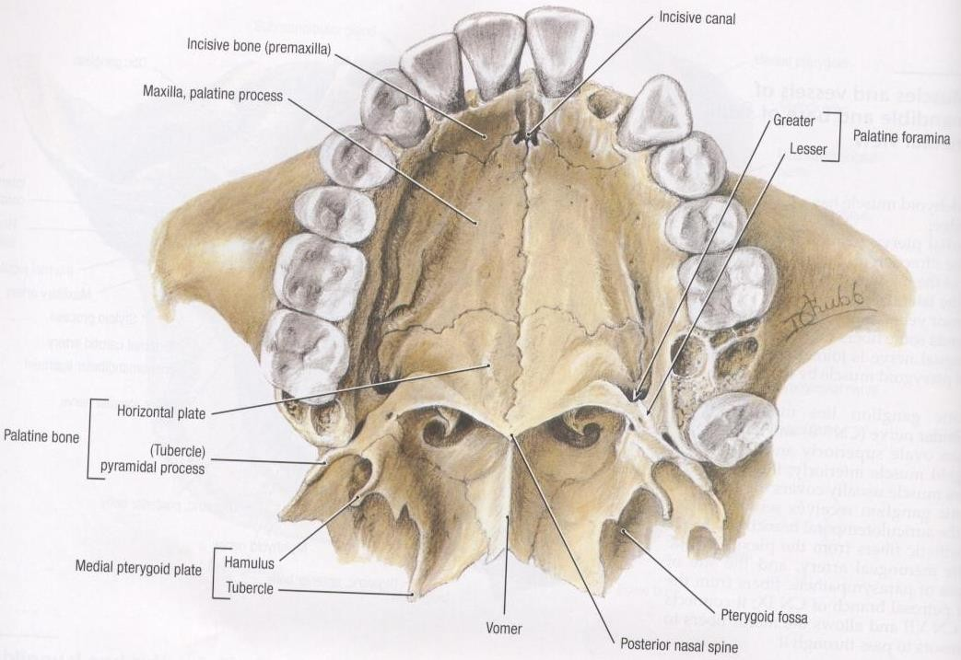

Slide 3
Separates the nasal cavity form the oral cavity.
The hard palate is the anterior 2/3 (in between the teeth).
The soft palate is the posterior 1/3 (behind the teeth).

Slide 4
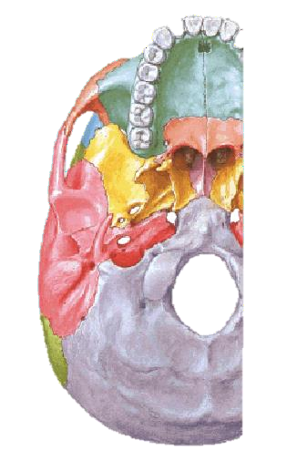

Slide 5
Superficial Features of the Palate
Mucosa of the hard palate is tightly adherent to the bone (mucoperiosteum).
Lingual gingiva is continuous with palatal gingiva 🢡 injection of anesthetic in the gingiva
🢡palatal anesthesia.
Submucous injections are extremely painful.

Slide 6
Sharpey’s fibres pass from the mucous membrane to the periosteum.
This fixation prevents displacement of the mucous membrane during mastication.

Slide 7
Superficial Features of the Palate
In the mid-line, posterior to the maxillary incisors 🢣 incisive papilla (anterior to the incisive fossa).
Deep to the mucosa are mucus-
secreting palatine glands.
Radiating laterally from the incisive papilla 🢣 transverse palatine folds. Can be felt by the tip of the tongue.
The palatine raphe extends in the
midline from the incisive papilla.
Can be felt by the tip of the tongue.

Slide 8
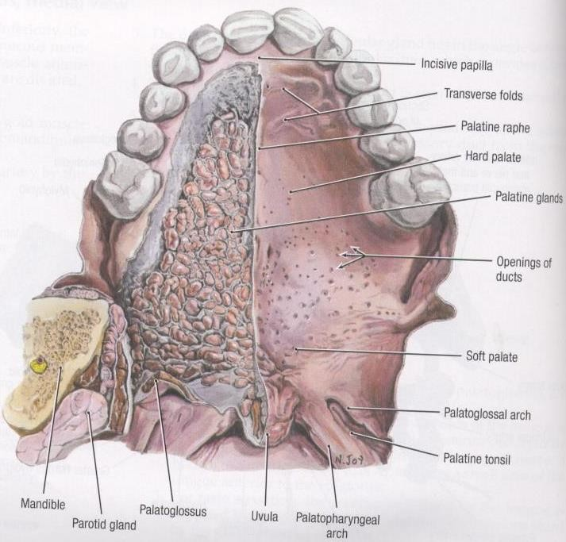

Slide 9
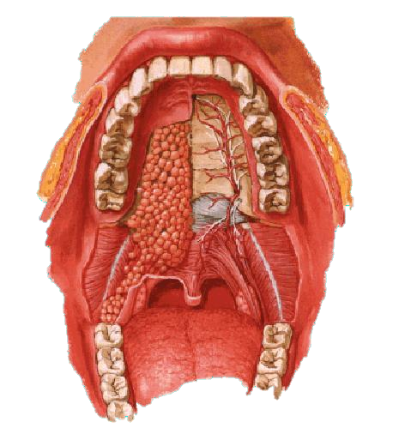

Slide 10
Hard Palate
Formed of the (1) palatine process of the maxilla and the (2) horizontal plate of the palatine bone.
Covered by a mucous membrane adherent to the underlying bone.
The mucus membrane contains taste buds.
Foramina:
Incisive foramen.
Greater and lesser palatine foramina.

Slide 11
The Soft Palate
A mobile fibromuscular fold attached to the margin of the hard palate.
It seals off the nasopharynx from the mouth during speech and swallowing acting as a valve.
Its mucous membrane has mucous glands on the upper surface and taste buds in the lower surface.
It is formed of the palatal aponeurosis and the palatine muscles.
The uvula hangs from the posterior border in the midline.

Slide 12
Muscles of the Palate
Muscle | Superior attachment | Inferior attachment | Main action
Tensor veli palatini | Scaphoid fossa of medial pterygoid plate, spine of sphenoid bone and cartilage of Eustachian tube. | Palatine aponeurosis | Tenses soft palate and opens mouth of pharyngotympanic tube during swallowing and yawing
Levator veli palatini | Cartilage of Eustachian tube and petrous part of temporal bone |  | Elevates soft palate during swallowing & yawing
Palatoglossus | Palatine aponeurosis | Side of tongue | Elevates posterior part of tongue and draws soft palate onto tongue
Palatopharyngeus | Hard palate and palatine aponeurosis | Lateral wall of pharynx | Tenses soft palate and pulls walls of pharynx superiorly , anteriorly and medially during swallowing
Musculus Uvulae | Posterior nasal spine and palatine aponeurosis | Mucosa of uvula | Shortens uvula and pulls it superiorly

Slide 13
All Palatal Muscles are Supplied by the Vagus Nerve EXCEPT the Tensor Veli Palatini which is supplied from the Mandibular nerve (nerve to medial pterygoid).

Slide 14
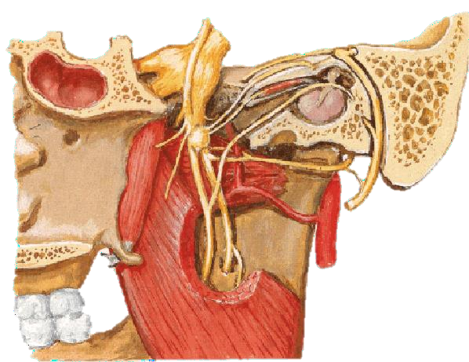
Tensor Veli Palatini

Slide 15
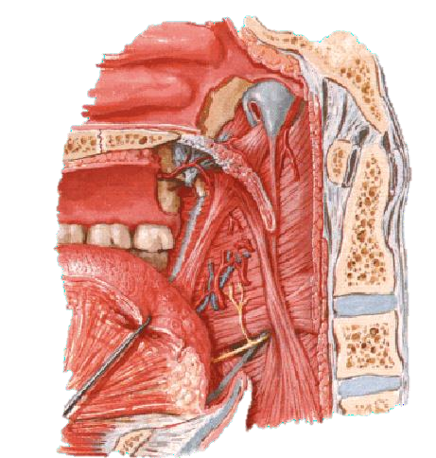
Tensor veli palatini

Slide 16
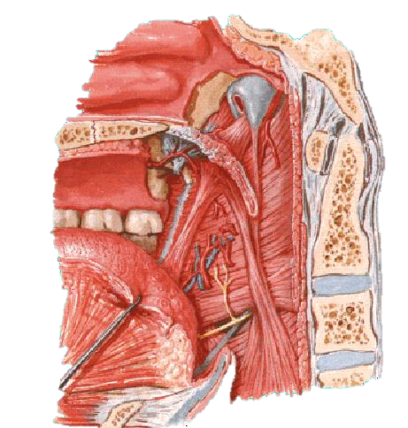
Levator Veli Palatini

Slide 17
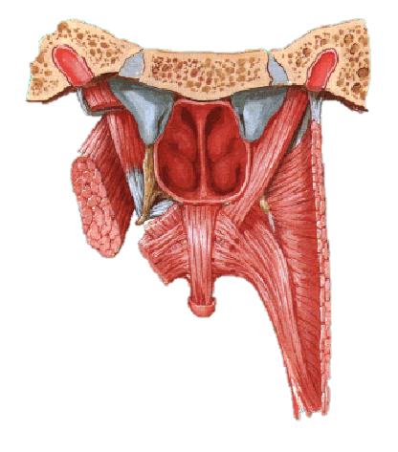
Tensor veli palatini
Levator veli palatini

Slide 18
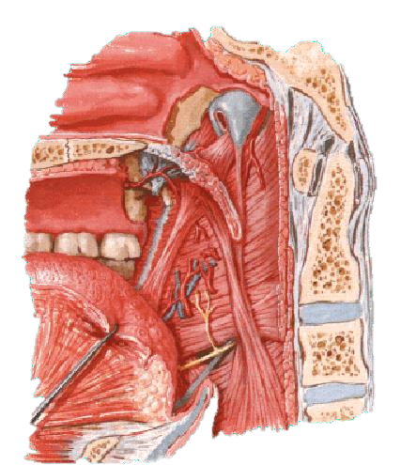
Palatoglossus

Slide 19
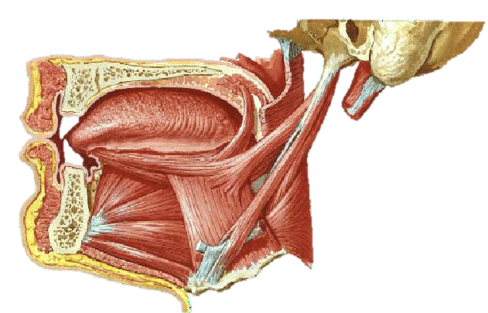
Palatoglossus

Slide 20
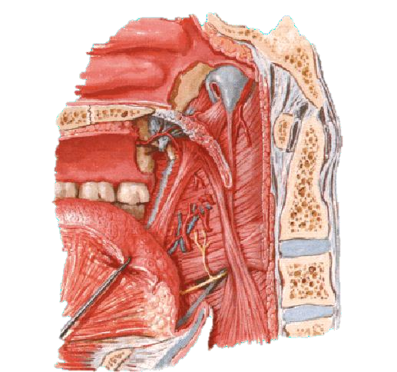
Palatopharyngeus

Slide 21
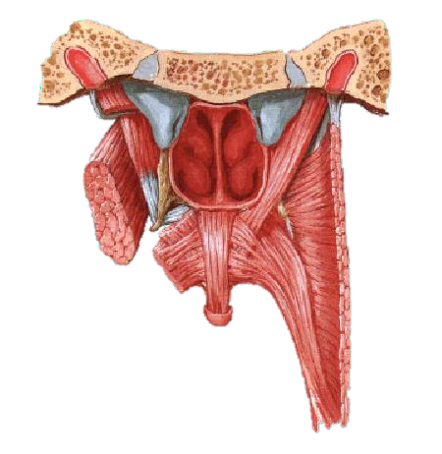
Musculus Uvualae

Slide 22
Sensory Innervation of the Palate
Hard Palate:
Greater palatine nerve (from the maxillary nerve via the pterygopalatine ganglion).
Premaxilla is supplied by the two nasopalatine nerves (from the same source).
Soft palate:
Lesser palatine nerve.
Glossopharyngeal nerve.

Slide 23
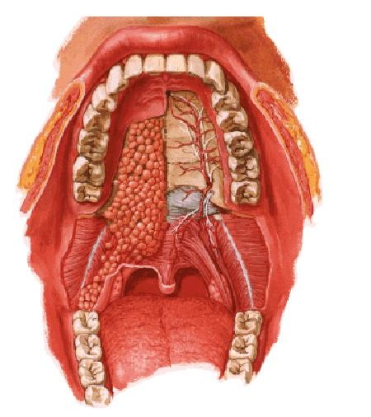

Slide 24
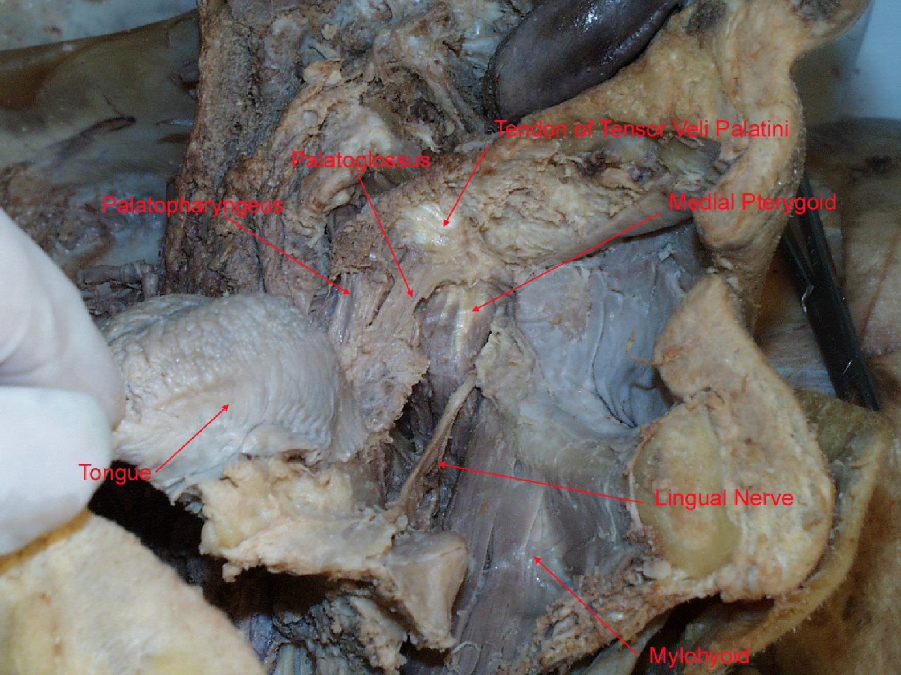

Slide 25
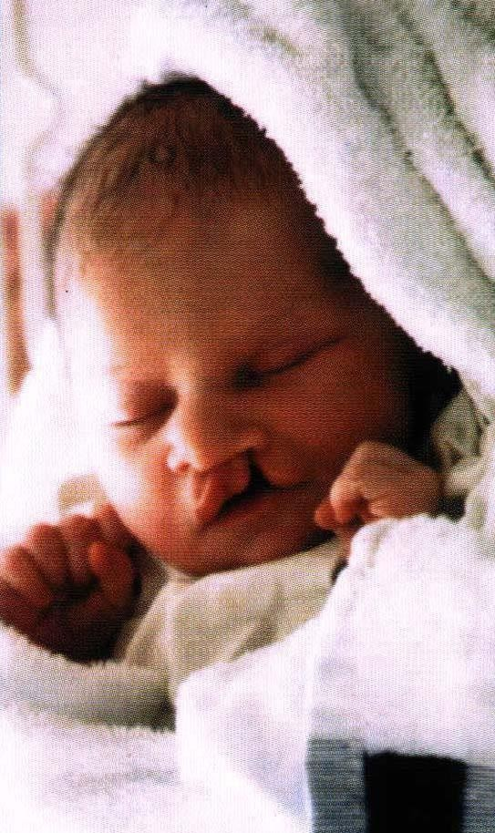

Slide 26
