Slide 1
The Scalp

Slide 2
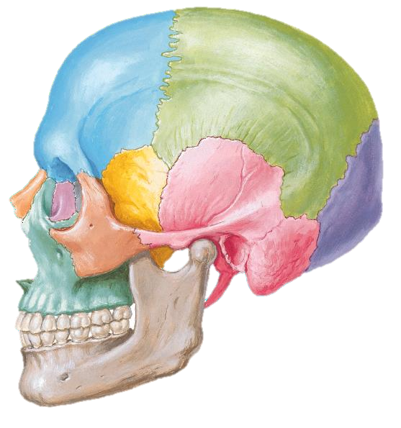
SCALP
It is the skin and underlying tissues covering the vault of the skull.
Extends:
Anteriorly: supraorbital margins.
On either side: superior
temporal lines.
Posteriorly: highest nuchal lines.
2

Slide 3
SCALP
Skin
Connective tissue
Aponeurosis
Loose connective tissue
Pericranium

Slide 4
Scalp………….Skin
Has the greatest concentration of hairs, sweat glands and sebaceous glands.
Hair distribution is determined by gender.
It is a common site for sebaceous cysts.
Has good arterial supply, venous and lymphatic drainages.

Slide 5
Scalp…….Connective tissue
Dense connective tissue binding the skin to the underlying aponeurosis.
Vasculature of the scalp is mainly present in this layer. Vascularity is profuse with extensive anastomosis.
Has many nerves within it.
Adventitia of vessels merge into this layer causing retraction of the vessels
when injured.
Swelling in this layer is limited and appears as lump because of the density
of C.T.

Slide 6
Scalp………….Aponeurosis
Known also as epicranial aponeurosis and Galea aponeurotica.
It is the intermediate tendon of the
occipitofrontalis muscle.
Frontalis: has no bony attachment, arises from the fascia above the eye brow. It raises the eye brows in surprise and fear.
Occipitalis: arise from the highest nuchal line and mastoid
process. It draws the scalp posteriorly (weak).
Supplied by twigs from VII (temporal & posterior auricular).
The muscle puts the aponeurosis under tension 🢥
wide gapping of lacerations.

Slide 7
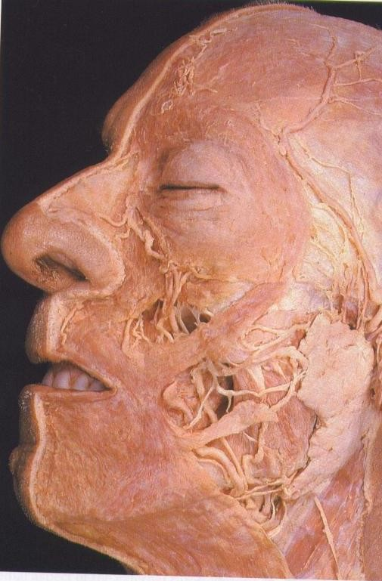
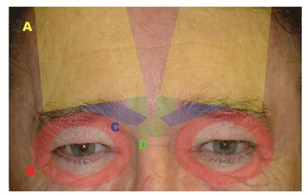
FRONTALIS

Slide 8
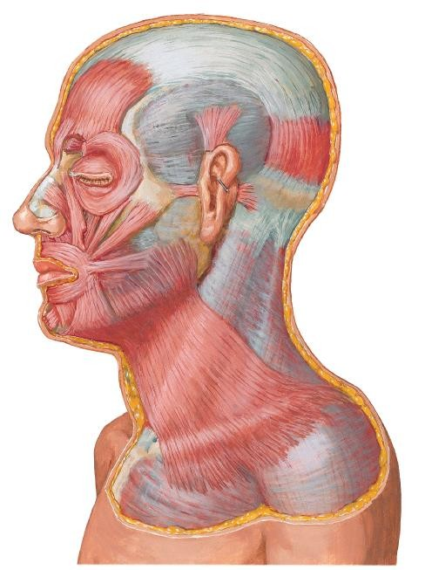

Slide 9
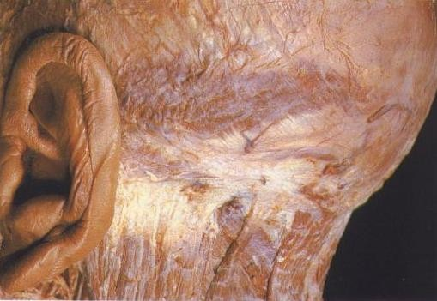
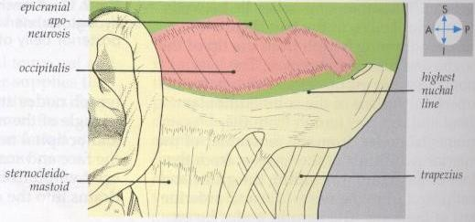
OCCIPITALIS

Slide 10
Scalp………..Loose connective tissue
Permits free movement of the aponeurosis over the periosteum.
Forms the subaponeurotic space.
Haematoma may extend in this space to the limits of the scalp.
The space represents a plane of separation in surgery or trauma.

Slide 11
Scalp………….Pericranium
Dense regular connective tissue.
Fuses with bone at the sites of sutures and with periosteum of near bones limiting the subperiosteal space.

Slide 12
Scalp……..Vasculature (1)
Arterial supply:
External carotid artery:
Occipital
Posterior auricular
Superficial temporal
Internal carotid artery:
Ophthalmic:
Supraorbital
Supratrochlear

Slide 13
Scalp……..Vasculature (2)
Venous drainage:
Superficial veins: in the subcutaneous layer parallel to the arteries.
Deep Veins: In the subaponeurotic space communicate with diploic veins.

Slide 14
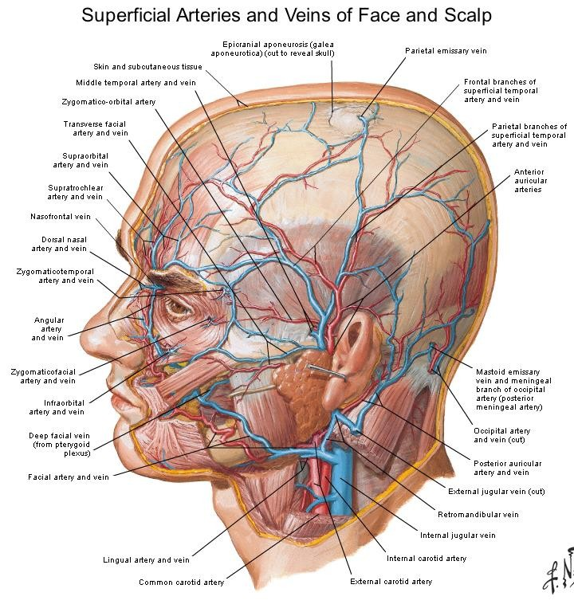

Slide 15
Innervation (1)
Somatic innervation:
Greater occipital nerve (C2) 🢥posterior aspect of the scalp.
Lesser occipital (C2-C3) 🢥 Behind the ear.
Least occipital (C3) 🢥 postero-inferior part of the scalp
Great auricular (C2-C3): 🢥around the ear.

Slide 16
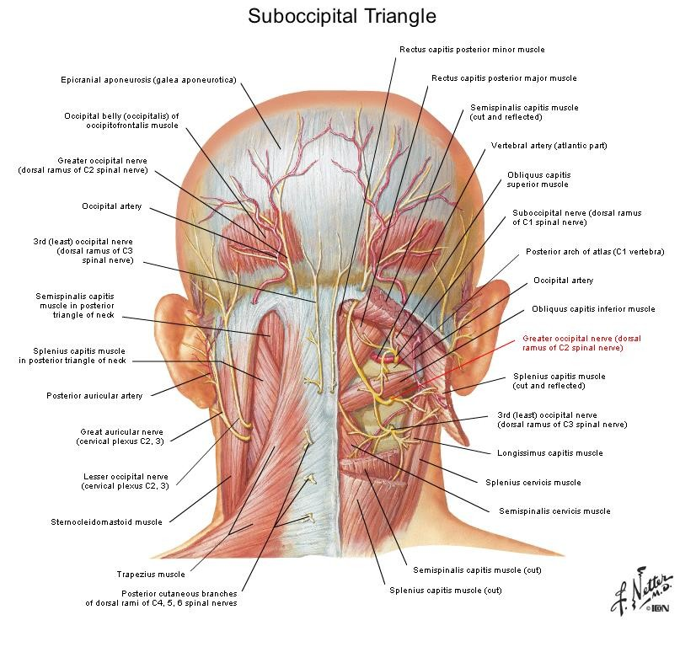

Slide 17
Innervation (2)
Cranial (Branchiomeric innervation):
- Sensory:
Ophthalmic of the trigeminal:
Supraorbital
supratrochlear
Maxillary of the trigeminal:
Zygomaticotemporal
Mandibular of the trigeminal:
Auriculotemporal
Motor:
Facial nerve

