Slide 1
The Skull
1

Slide 2
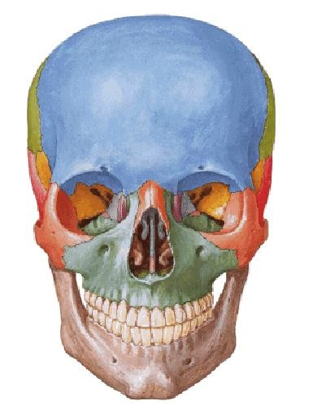
2

Slide 3
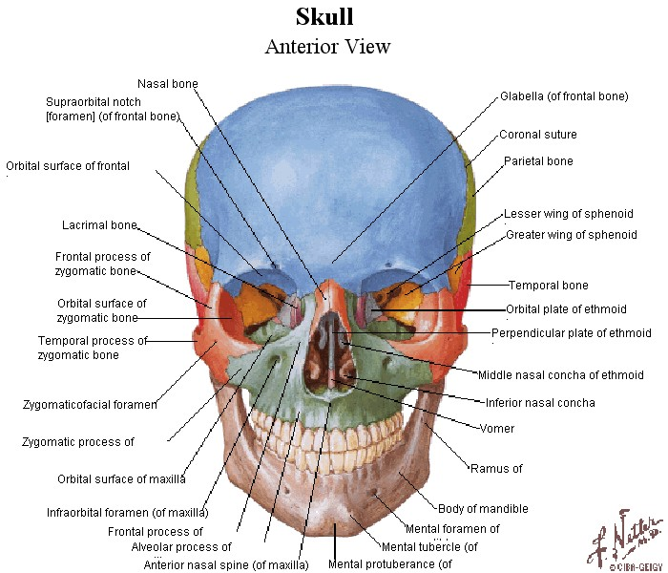

Slide 4
Foramina of the skull
Anterior cranial fossa
Middle cranial fossa Posterior cranial fossa Orbit
Foramina in the base of the skull externally
4

Slide 5
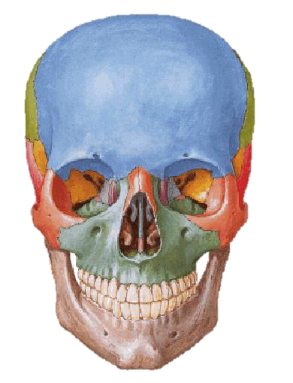
Notice that the supraorbital, infraorbital and mental foramina lie in the same vertical line.
5

Slide 6
6

Slide 7
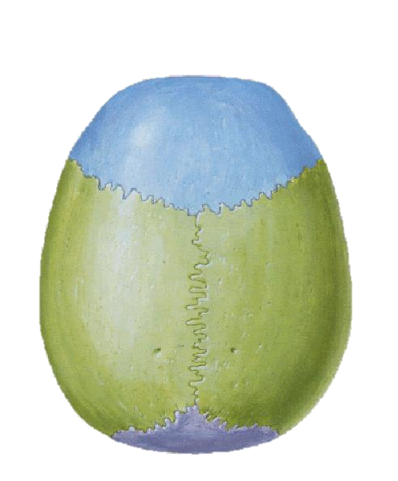
7

Slide 8
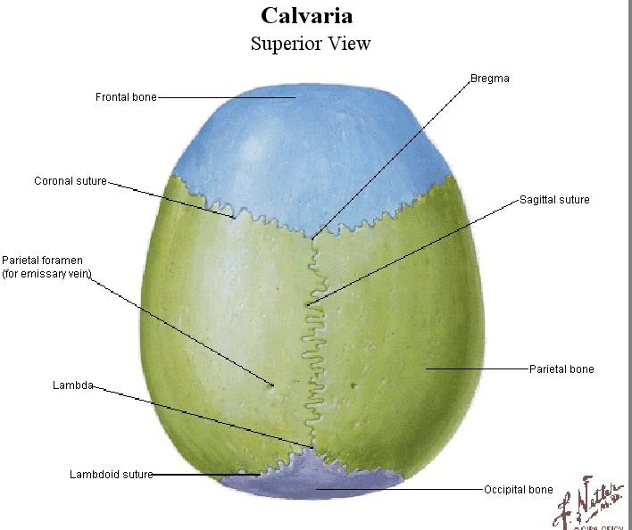
8

Slide 9
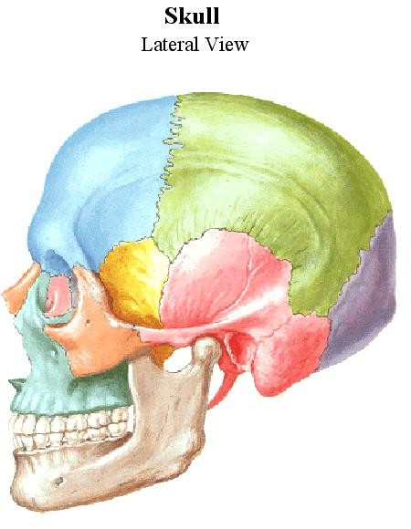
9

Slide 10
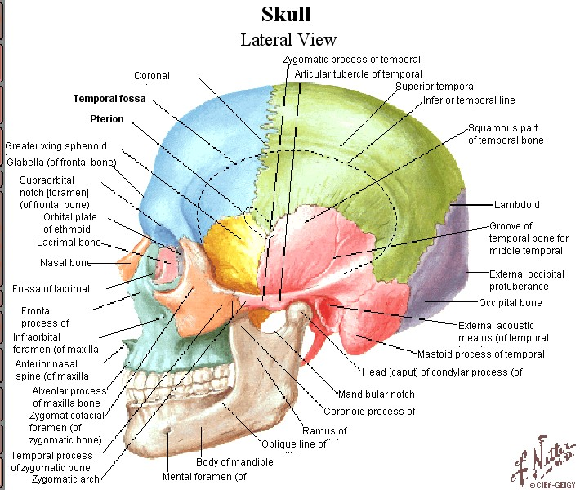

Slide 11
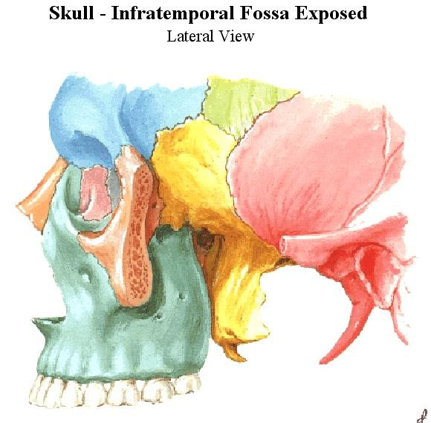

Slide 12
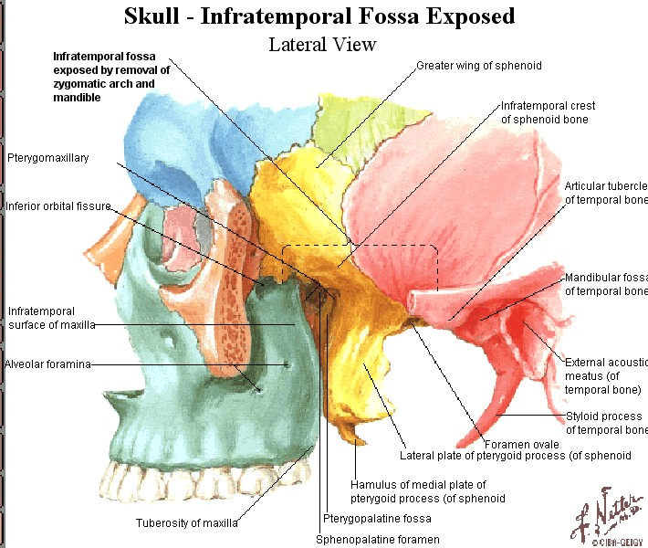

Slide 13
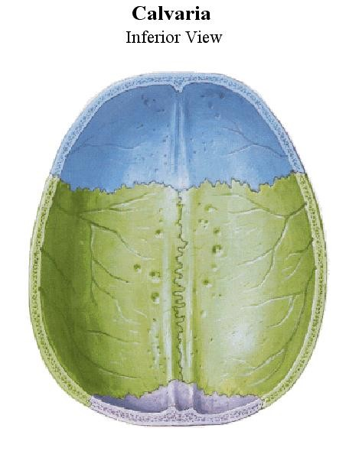

Slide 14
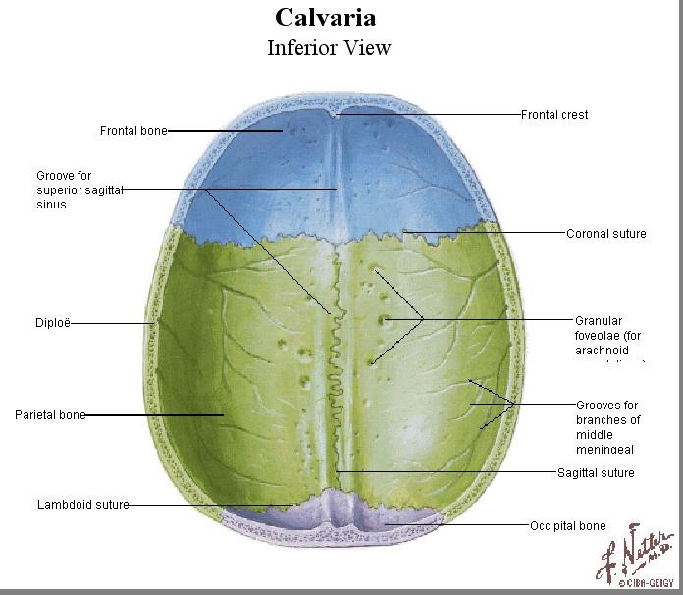

Slide 15
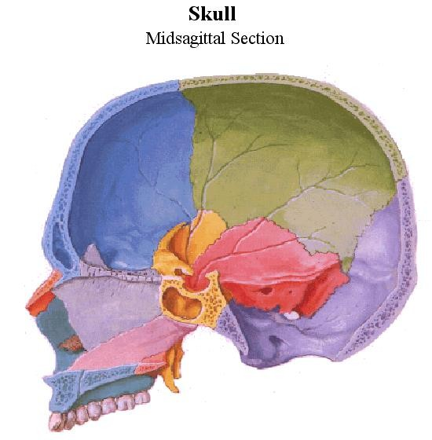

Slide 16
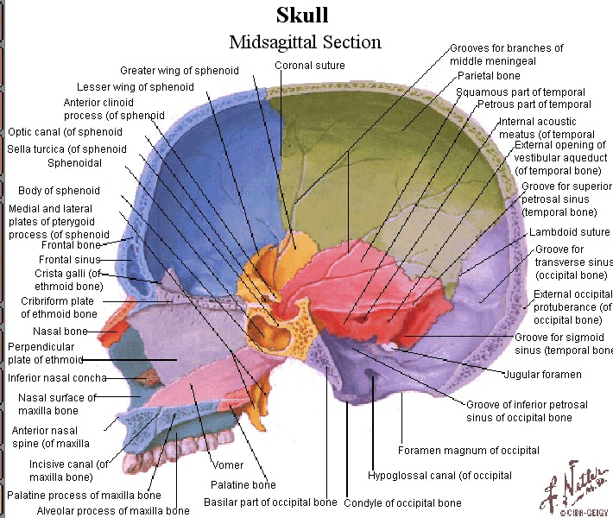

Slide 17
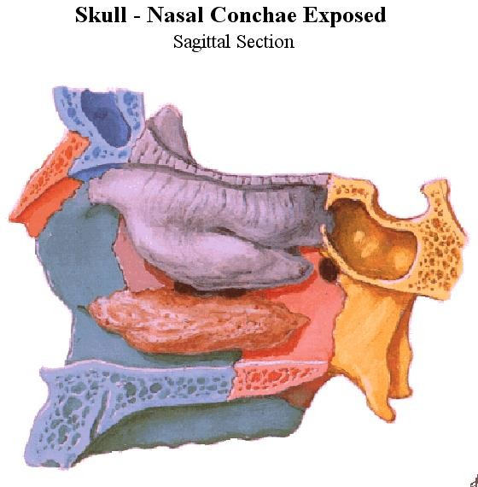
17

Slide 18
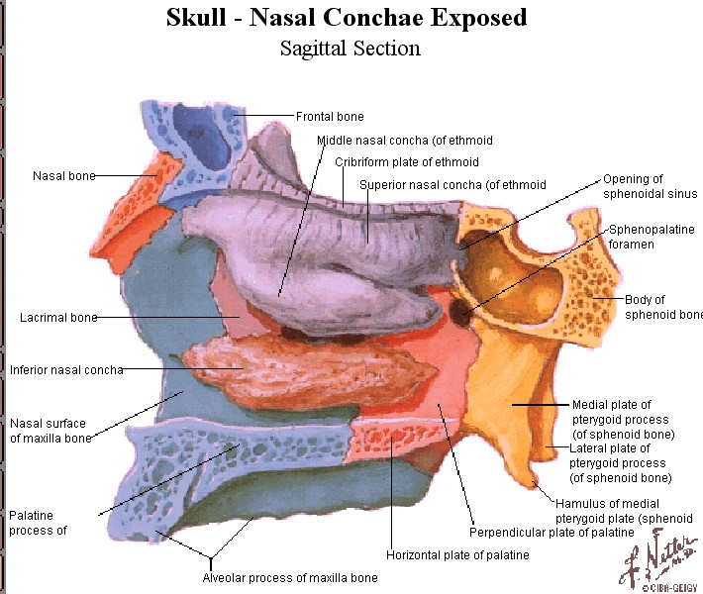

Slide 19
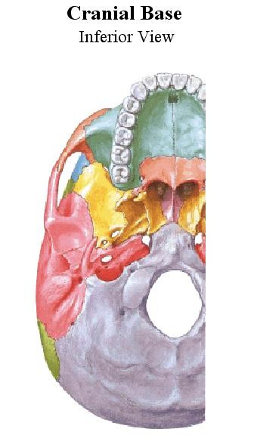
19

Slide 20
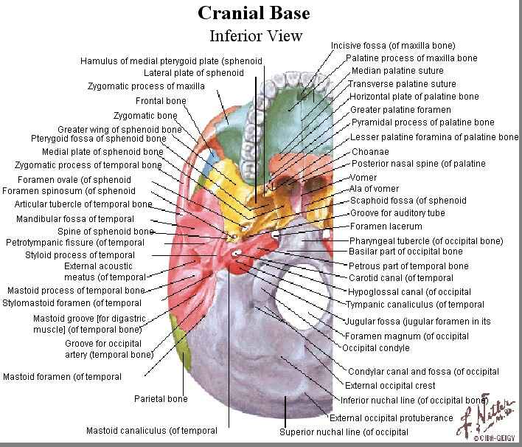

Slide 21
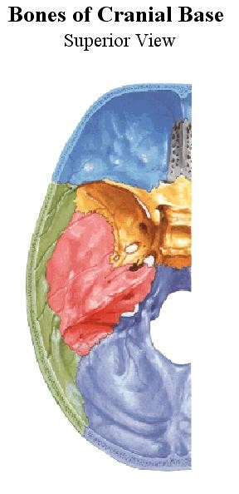
21

Slide 22
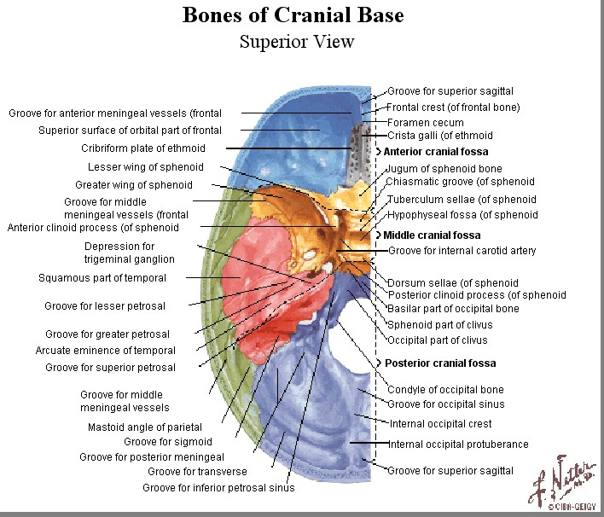

Slide 23
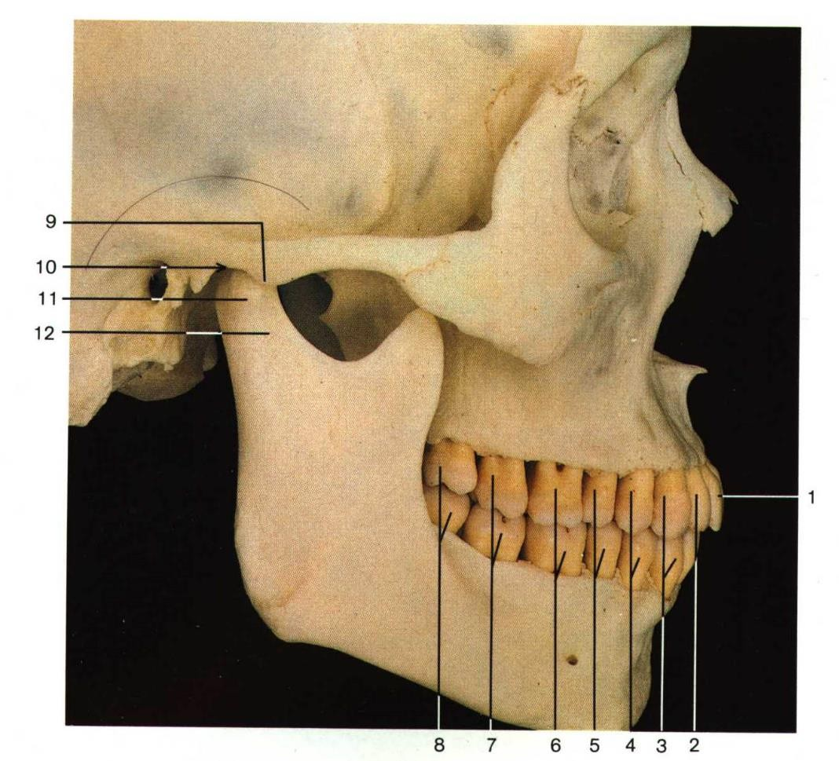

Slide 24
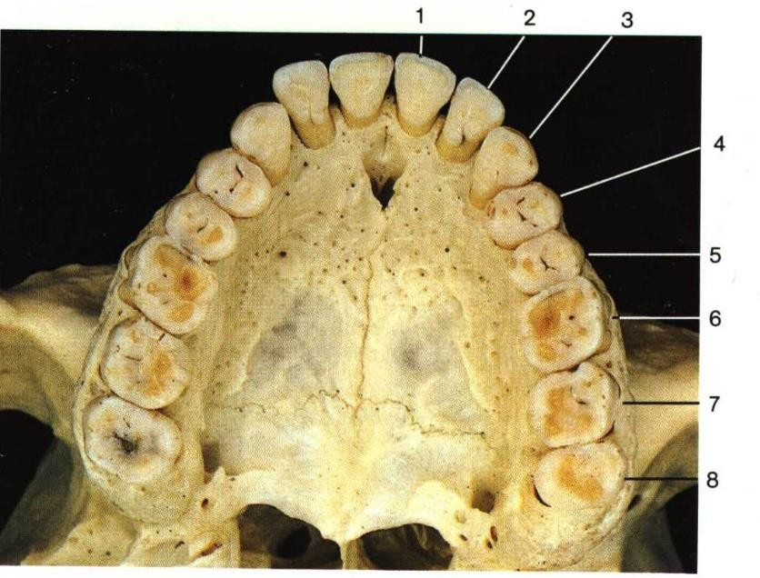

Slide 25
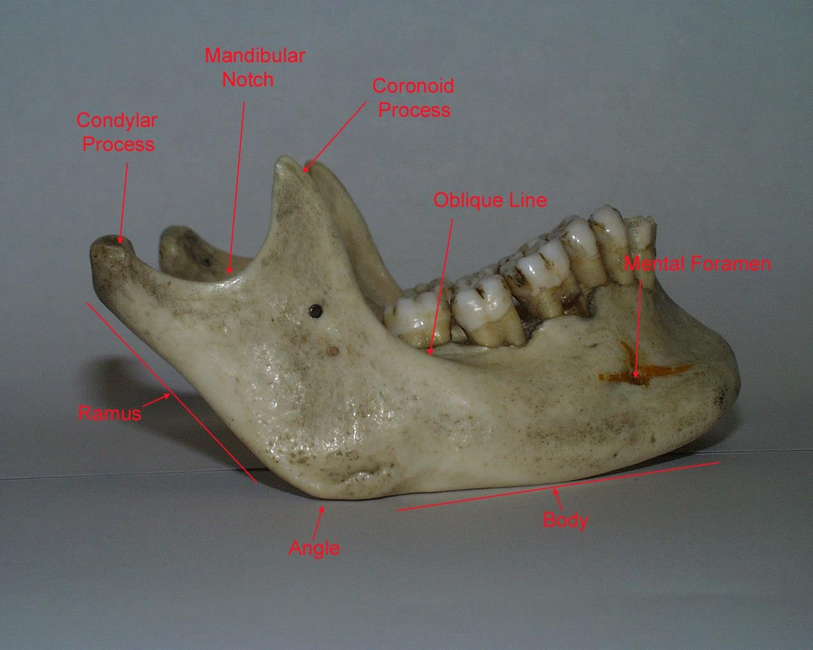

Slide 26
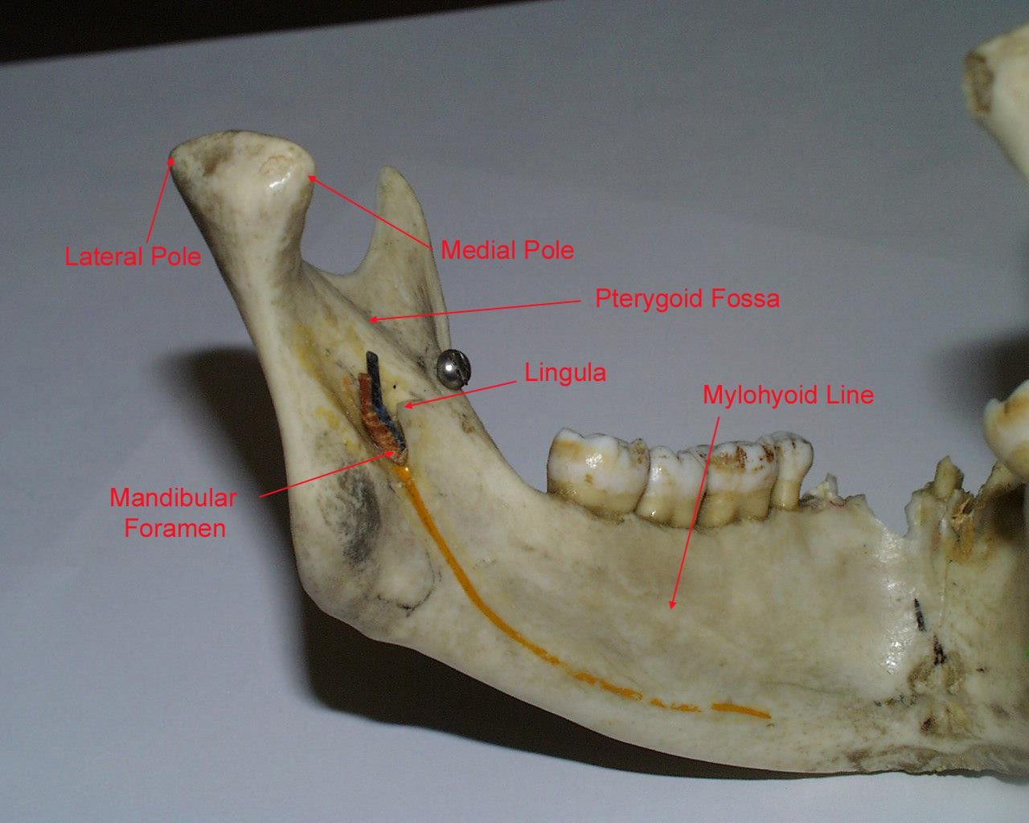

Slide 27
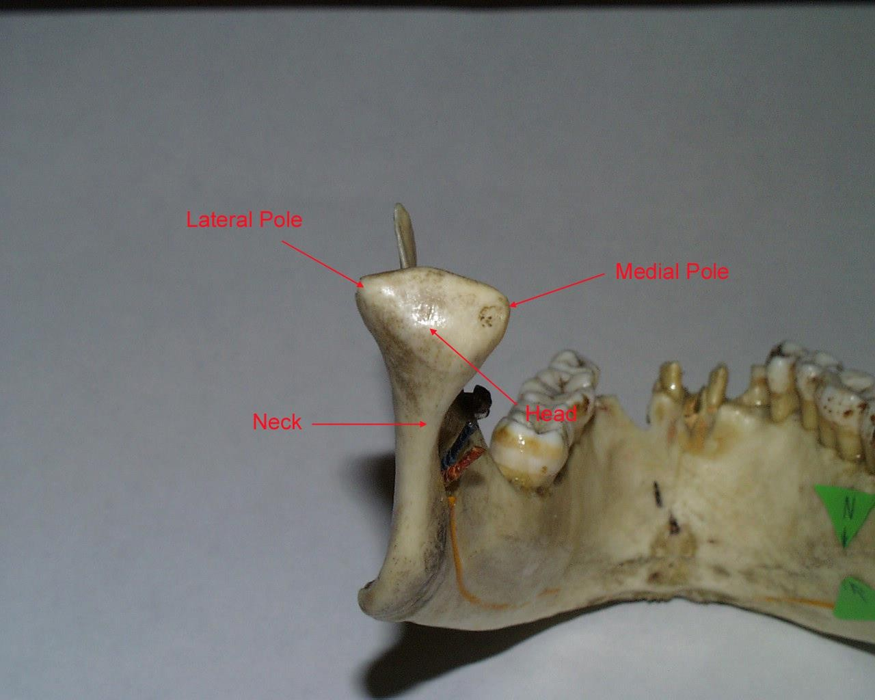

Slide 28
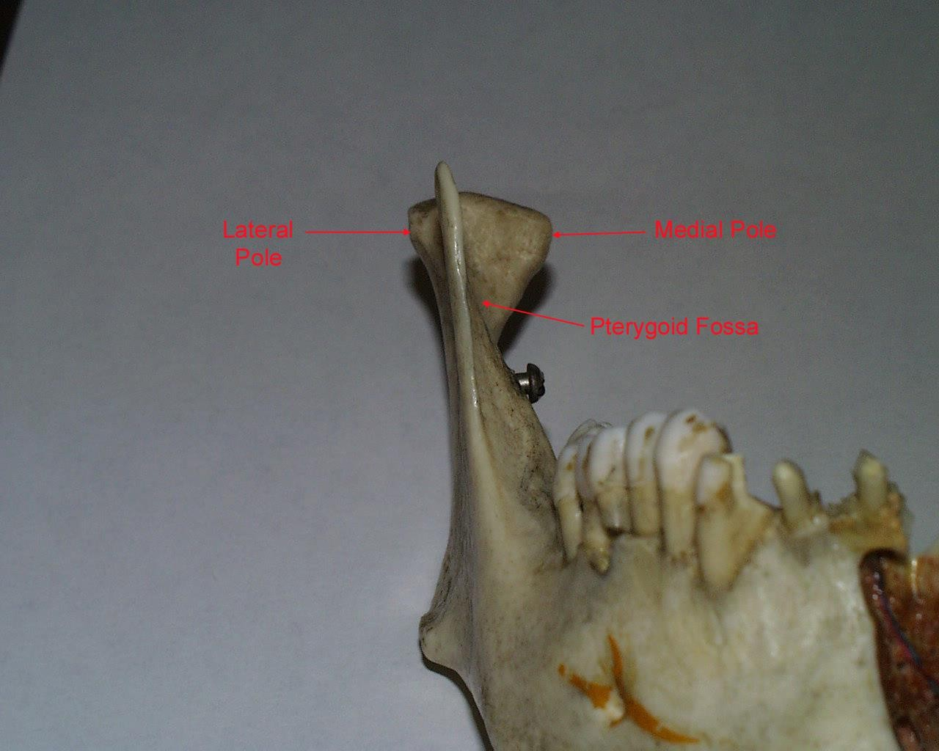

Slide 29
Foramina of the skull

Slide 30
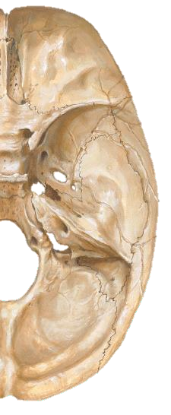
Anterior Cranial Fossa
Foramina in the cribriform plate of the ethmoid:
Olfactory nerve filaments
Anterior ethmoidal nerve and vessels
Foramen cecum (red arrow)
Between the frontal crest of the frontal bone and the ethmoid in front of the crista galli
Emissary vein (between nose and superior sagittal sinus).

Slide 31
Middle Cranial Fossa ..1/4
Optic canal: in the body of sphenoid and the 2 roots of the lesser wing (blue arrow):
Optic nerve
Ophthalmic artery
Superior Orbital fissure: in the sphenoid between the body and the greater and lesser wings, with a fragment of the frontal bone at the lateral extremity (red arrow):
CN III, CN IV, CN VI,
Lacrimal, frontal, and nasociliary nerves
Filaments from the internal carotid plexus (sympathetic)
Orbital branch of the middle meningeal artery
Recurrent branch of the lacrimal artery
Superior ophthalmic vein

Slide 32
Middle Cranial Fossa ..2/4
Foramen rotundum: in the greater wing of the sphenoid (blue arrow):
Maxillary nerve (CN V3)
Foramen ovale: in the greater wing of the sphenoid(red arrow):
Mandibular nerve (CN V2)
Lesser petrosal nerve
Accessory meningeal artery
Emissary veins (from the cavernous sinus to pterygoid plexus)

Slide 33
Middle Cranial Fossa ..3/4
Foramen spinosum: in the greater wing of the sphenoid (blue arrow):
Middle meningeal vessels
Meningeal branch of the mandibular nerve
Foramen lacerum: between the sphenoid, apex of the temporal and the basilar part of the occipital bones (red arrow):
Internal carotid artery
Greater petrosal nerve
Nerve of pterygoid canal
A meningeal branch of the ascending pharyngeal artery
Emissary veins

Slide 34
Middle Cranial Fossa ..4/4
Hiatus for greater petrosal nerve (red arrow): in the tegmen tympani of the petrous temporal, in front of the arcuate eminence
Hiatus for lesser petrosal nerve (blue arrow): in the tegmen tympani of the petrous temporal 3 mm in front of the greater hiatus

Slide 35
Posterior Cranial Fossa .. 1/4
Internal acoustic meatus(red arrow): in the posterior
surface of the petrous temporal:
CN VII
CN IIIV
Labyrinthine arter
Aqueduct of the vestibule(blue arrow): in the petrous temporal about 1 cm behind the internal acoustic meatus:
Endolymphatic duct and sac
A branch from the meningeal branch of the occipital artery
A vein from the labyrinth and vestibule to the sigmoid sinus

Slide 36
Posterior Cranial Fossa .. 2/4
Jugular foramen(red arrow): between the jugular fossa of the petrous temporal and the occipital bone:
CN IX, CN X, CN IX
Meningeal branch of the vagus nerve
Inferior petrosal sinus
Internal jugular vein
A meningeal branch of the occipital artery
Hypoglossal canal(blue arrow): in the occipital bone above the anterior part of the condyle:
CN XII and its recurrent meningeal branch
A meningeal branch of the ascending pharyngeal artery
Emissary vein

Slide 37
Posterior Cranial Fossa .. 3/ 4
Condylar canal (red arrow): occasionally seen
Emissary vein
A meningeal branch of the occipital artery
Mastoid foramen(blue arrow): in the petrous temporal near the posterior margin of the lower part of the sigmoid groove, passing backwards to open behind the mastoid process:
A meningeal branch of the ascending pharyngeal artery
Emissary vein

Slide 38
Posterior Cranial Fossa .. 4/4
Foramen magnum (red arrow): in the occipital bone:
Apical ligament of the odontoid process of the axis
Medulla oblongata and meninges
Spinal part of the accessory nerves
Tectorial membrane
Meningeal branches of the upper cervical nerves
Vertebral arteries
Anterior spinal artery
Posterior spinal arteries

