Slide 1
Pericardium and Heart

Slide 2
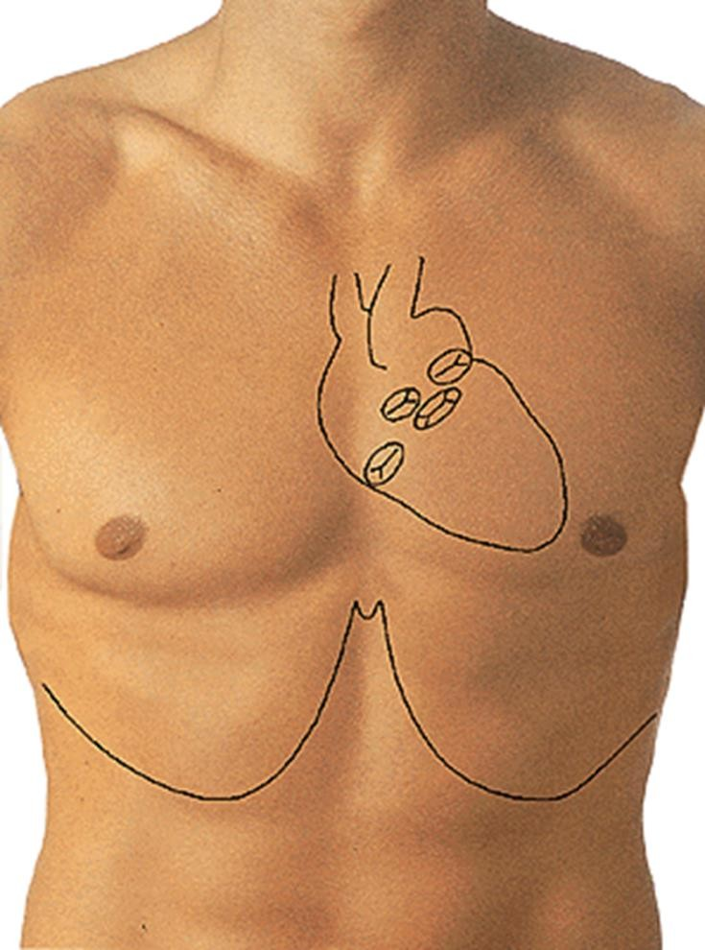

Slide 3
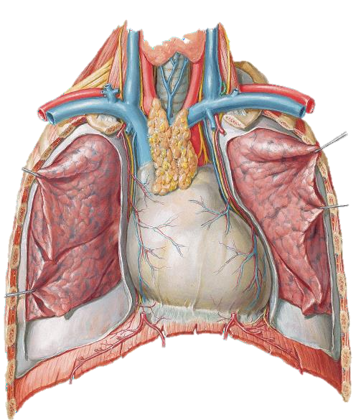
Pericardium
Conical fibroserous sac which contains the heart and the roots of the great vessels in the middle mediastinum.
It is formed of 2 sacs:
Outer fibrous
Inner serous:
Parietal pericardium
Visceral pericardium

Slide 4
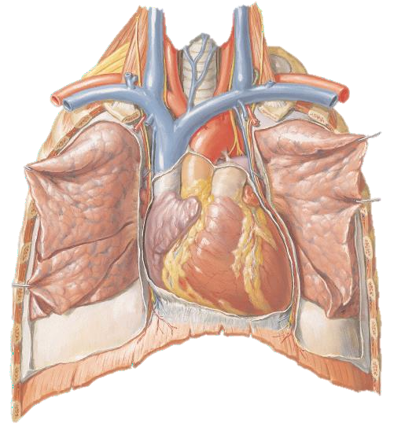
Anteriorly:
Relations of the pericardium
Lung and pleurae separating it from the thymus.
Body of the sternum
Cartilage of 2-6 ribs
On the left side the pericardium is closely related to the lower part of the sternum and the left 4th and 5th costal cartilages.

Slide 5
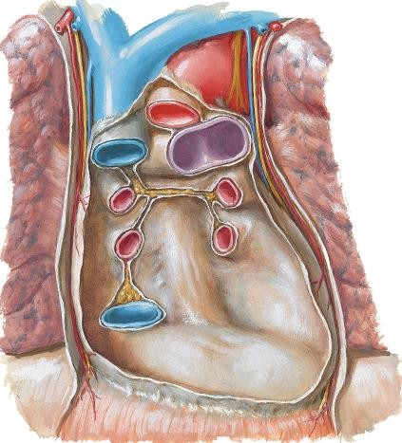
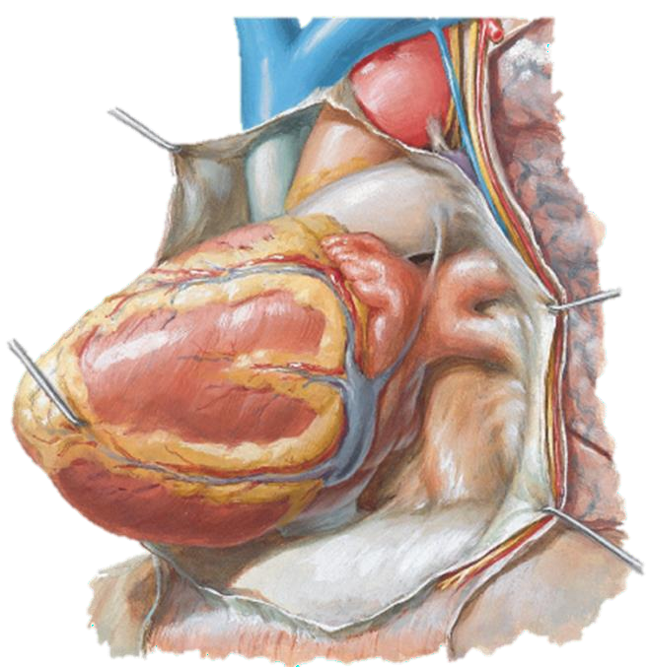
Posteriorly:
Relations of the Pericardium
Bronchi
Oesophagus
Oesophageal plexus
Descending aorta
T5-T8 vertebra
Inferiorly:
Diaphragm
Laterally:
Pleura and mediastinal
surfaces of both lungs
Phrenic nerves and musculophrenic vessels

Slide 6
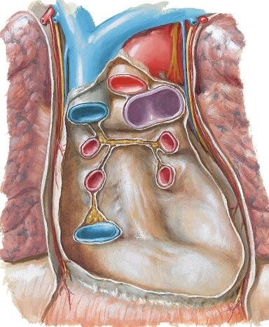
Visceral Pericardium
Formed of two tubes:
1st tube: closes the aorta and pulmonary trunk
2nd tube: closes the S.V.C, I.V. C and the 4 pulmonary veins and shows two sinuses:
Oblique
Transverse

Slide 7
Visceral Pericardium
The Oblique Sinus: lies behind the left atrium and the pericardium.
The Transverse sinus: lies between the ascending thoracic aorta, pulmonary trunk and the left atrium
.

Slide 8
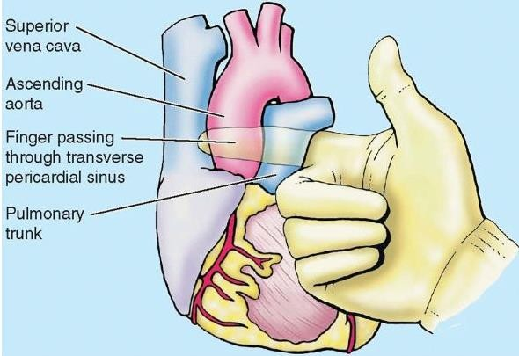

Slide 9
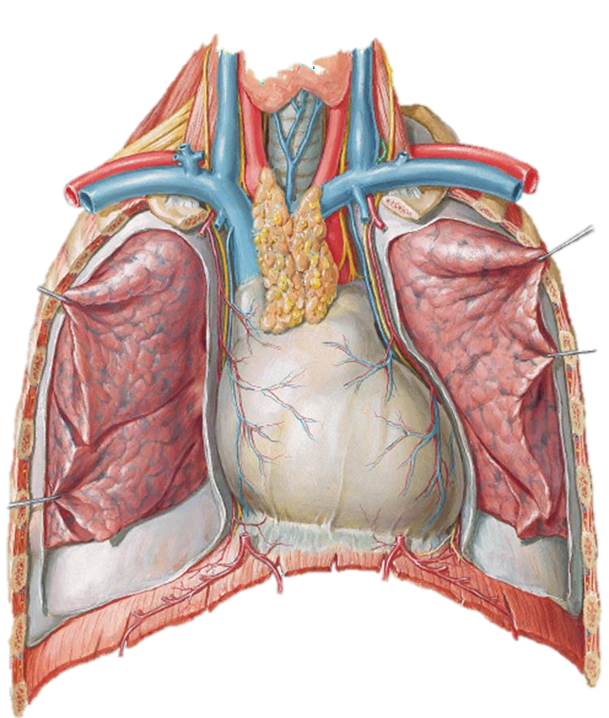
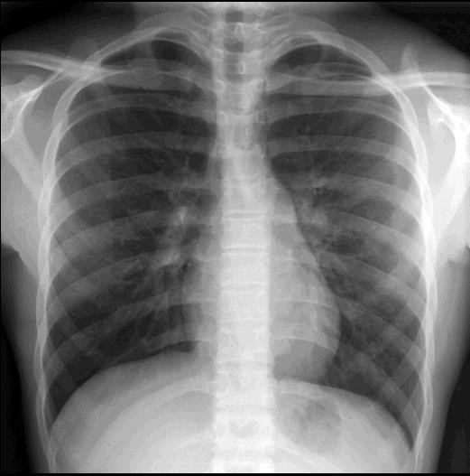
The Heart, General Considerations 1:
The APEX: lies in the 5th intercostal space, slightly medial to the mid clavicular line, 9 cm from the midline. This point is important for auscultating the mitral valve.

Slide 10
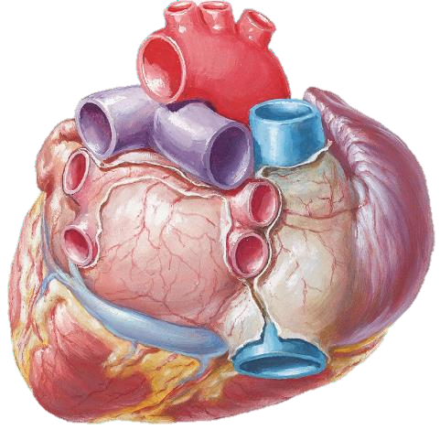
The Heart, General Considerations 2:
The BASE: formed mainly by the left atrium and part of the right atrium

Slide 11
The Heart, General Considerations 3:
The RIGHT BORDER:
formed by the S.V.C, right atrium and I.V.C.

Slide 12
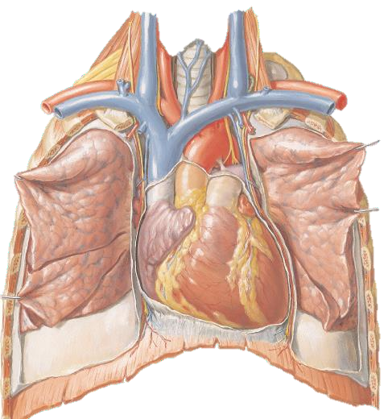
The Heart, General Considerations 4:
The LEFT BORDER:
formed by the left ventricle.

Slide 13
The Heart, General Considerations 5:
The CORONARY SULCUS:
a groove on the external surface of the heart marks the division between the atria and the ventricles.

Slide 14
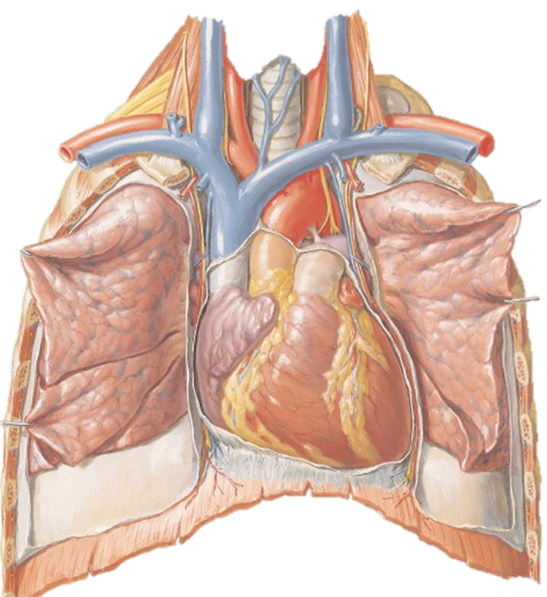
Surfaces of the Heart
Anterior (sternocostal) surface, formed mainly by the right ventricle.
Diaphragmatic (inferior) surface, formed mainly by the left ventricle and partly by the right ventricle; it is related mainly to the central tendon of the diaphragm.
Right pulmonary surface, formed mainly by the right atrium.
Left pulmonary surface, formed mainly by the left ventricle; it forms the cardiac impression in the left lung.

Slide 15
Internal Anatomy of the Heart

Slide 16
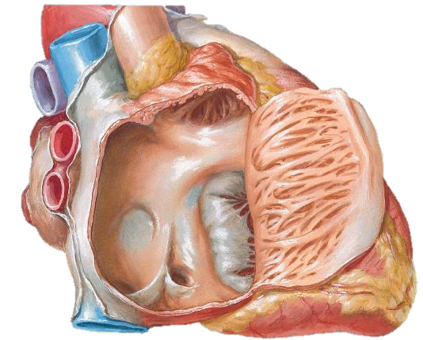
Right Atrium
Larger than the left and has thinner wall.
Its walls are smooth except for the presence of pectinate muscles.
The right auricle covers the beginning of RCA.
Sulcus terminalis separates the smooth and rough parts.
Fossa ovalis represents the position of the foramen ovale in the embryo.

Slide 17
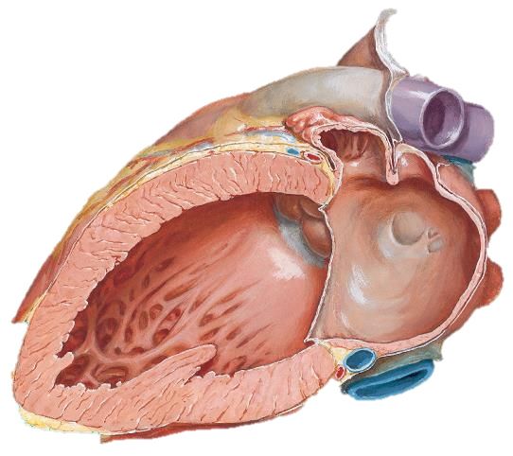
Left Atrium
The most posterior of the 4 chambers.
Its walls are smooth except for few pectinate muscles in the auricle.
Receives the 4 pulmonary veins.

Slide 18
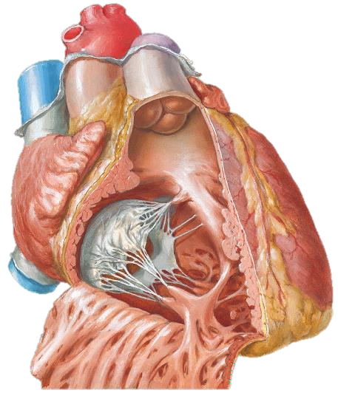
Right Ventricle ..1
Forms the largest part of the anterior surface of the heart, a small part of the diaphragmatic surface, and almost the entire inferior border of the heart
Conus Arteriosusu
Superiorly it tapers into an arterial cone, the conus arteriosus (infundibulum), which leads into the pulmonary trunk.
The interior of the right ventricle has irregular muscular elevations (trabeculae carneae).
A thick muscular ridge, the supraventricular crest, separates the ridged muscular wall of the inflow part of the chamber from the smooth wall of the conus arteriosus, or outflow part.
The inflow part of the ventricle receives blood from the right atrium through the right AV (tricuspid) orifice, located posterior to the body of the sternum at the level of the 4th and 5th intercostal spaces.
The right AV orifice is surrounded by one of the fibrous rings of the fibrous skeleton of the heart.

Slide 19
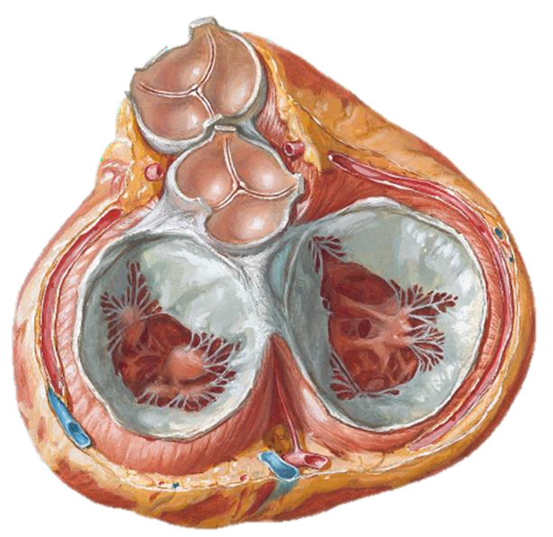
Right Ventricle ..2
The right AV orifice is surrounded by one of the fibrous rings of the fibrous skeleton of the heart.
The fibrous ring keeps the caliber of the orifice constant (large enough to admit the tips of three fingers).
Chordae tendineae attach to the free edges and ventricular surfaces of the anterior, posterior, and septal cusps, much like the cords attaching to a parachute.
The tendinous cords arise from the apices of papillary muscles, which are conical muscular projections with bases attached to the ventricular wall.

Slide 20
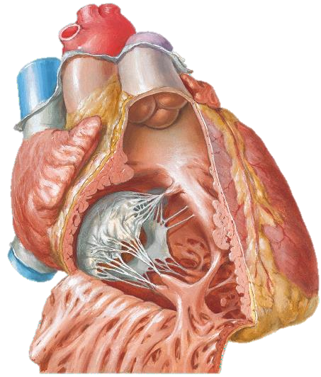
Right Ventricle ..3
Three papillary muscles in the right ventricle correspond to the cusps of the tricuspid valve
Anterior papillary muscle, the largest and most prominent of the three,
Posterior papillary muscle, smaller than the anterior muscle, may consist of several parts
Septal papillary muscle arises from the interventricular septum, and its tendinous cords attach to the anterior and septal cusps of the tricuspid valve.

Slide 21
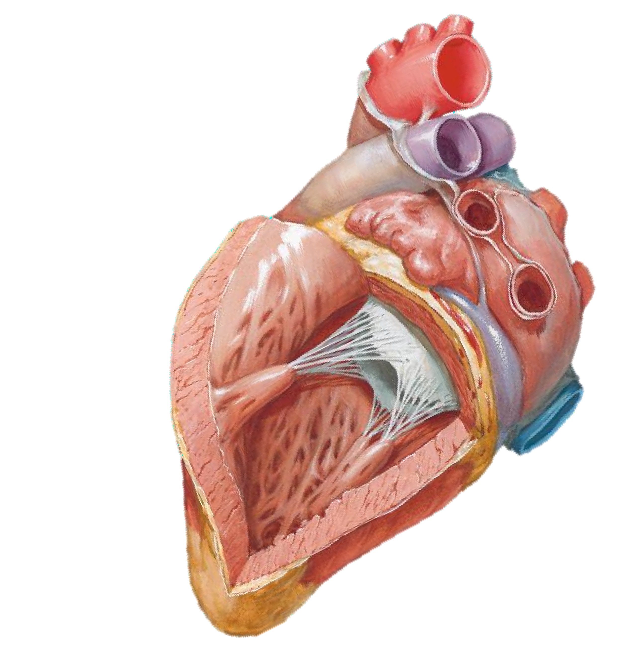
Left Ventricle ..1
Forms the apex of the heart, nearly all its left (pulmonary) surface and border, and most of the diaphragmatic surface
Its wall is thicker than that of the right ventricle
The interior of the left ventricle has:
Walls that are mostly covered with a mesh of trabeculae carneae that are finer and more numerous than those of the right ventricle.

Slide 22
Left Ventricle ..2
The cavity that is longer than that of the right ventricle.
Anterior and posterior papillary muscles that are larger
than those in the right ventricle.
A smooth-walled, non-muscular, superoanterior outflow part, the aortic vestibule, leading to the aortic orifice and aortic valve.
A double-leaflet mitral valve that guards the left AV orifice.
An aortic orifice that lies in its right posterosuperior part and is surrounded by a fibrous ring to which the right posterior, and left cusps of the aortic valve are attached; the ascending aorta begins at the aortic orifice.

Slide 23
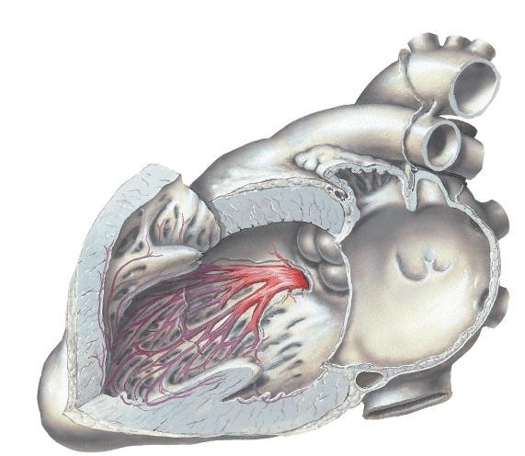
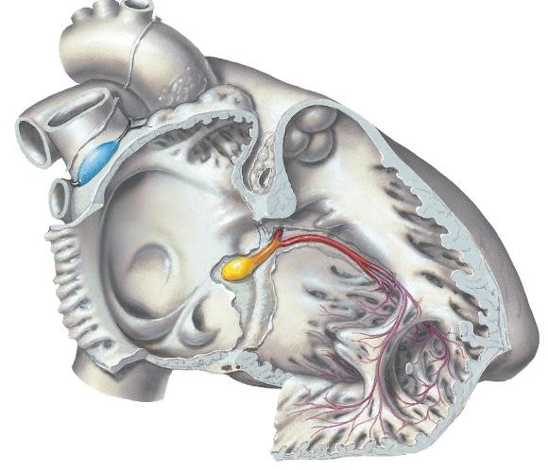
CONDUCTING SYSTEM OF HEART

Slide 24
Blood Supply of the Heart

Slide 25
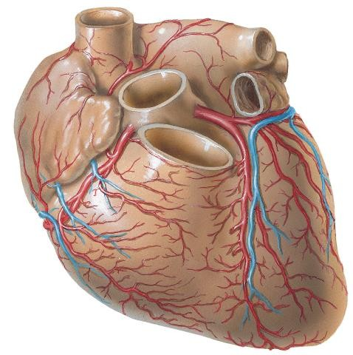
Coronary Arteries
The coronary arteries & their branches form a circle & loop around the heart.
The heart is supplied by two coronary arteries (right & left) which arise from the ascending aorta.
The right coronary artery arises from the anterior aortic sinus, while the left coronary artery arises from the left posterior aortic sinus.

Slide 26
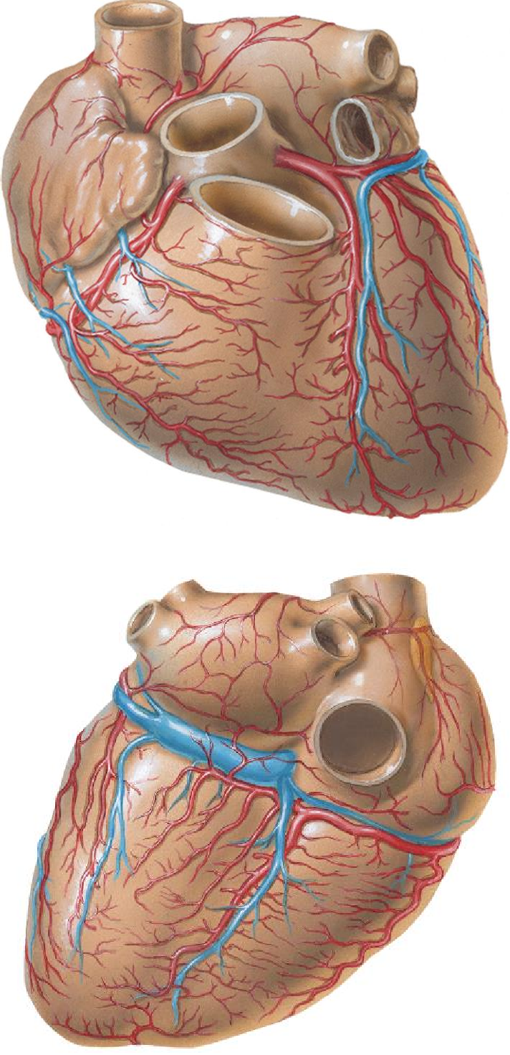
Coronary Arteries ..2
An arterial circle surrounds the heart lying in the A-V groove, from this arterial circle, an arterial loop runs in the anterior & inferior interventricular grooves.
The circle is formed by the RCA & left CX artery, while the loop is formed by the LAD & PDA.
Variability in the origin of the PDA is expressed by the term dominance.
A right dominant coronary circulation is one in which the PDA is a terminal branch of the RCA, & so for the left dominance.
Left dominance occurs more commonly in males.

Slide 27
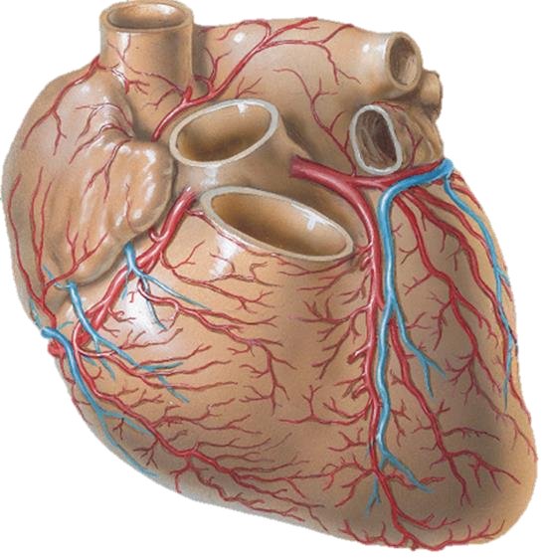
Left Main Coronary Artery
Extends from the ostium in the left sinus of valsalva to its bifurcation into the left anterior descending & left circumflex branches.
Usual length 10-20 mm.
Normally courses between the pulmonary trunk & the left atrial appendage to reach the left A-V groove, occasionally an additional artery originates from the left main & called ramus intermedius & courses parallel to the diagonals.

Slide 28
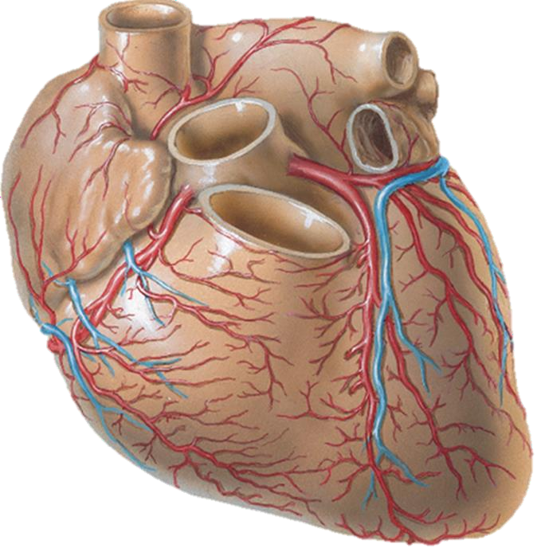
Left Anterior Descending Artery (LAD)
Courses along the anterior interventricular sulcus to the apex of the heart.
In most cases the LAD extends around the apex into the posterior interventricular sulcus supplying the apical portion of both right & left ventricles.
Supplies branches to the right ventricular free wall, to the septum & to the left ventricular free wall.

Slide 29
Circumflex Artery
From the LM coronary artery, with its initial course medial to the base of the left atrial appendage.
Large branch in the proximal segment called atrial circumflex artery, coursing around the left atrium.
The ventricular branches are called Obtuse marginal arteries, supply the obtuse margin of the heart.
In hearts with left dominance or codominance these obtuse marginal arteries supply the inferior surface of the LV.
Variations in the origin & length of the CX are
common.

Slide 30
Right Coronary Artery (RCA)
Usually single artery.
Courses down the right A-V groove.
Branches:
1. Conus artery.
2. Branches to the anterior right ventricular
free wall.
3. Anterior right atrial artery ** this artery commonly gives the SA nodal artery.
4. Lateral right atrial artery ( usually injured
in oblique right atriotomy).
5. Acute marginal artery in the region of the acute margin of the heart, which courses most of the way to the apex of the heart.
6. A-V nodal artery at the crux.

Slide 31
Anastomosis between the Coronary Arteries
Anastomosis exist at the arteriolar level between the terminations of the right & left coronary arteries in the atrioventricular groove & between the interventricular branches & conus branches.
These anastomosis on the surface of the heart are insignificant.

Slide 32
Cardiac Veins ..1
Most of the cardiac veins accompany the coronary arteries.
Most of the cardiac veins end in the coronary sinus, which opens into the right atrium.
The heart is similar to the brain in the manner that the veins are not named similar to the accompanying arteries.

Slide 33
Cardiac Veins ..2
The veins of the heart fall into three
groups:
Venae cordis minimae.
Anterior cardiac veins.
Coronary sinus:
Great cardiac vein
Middle cardiac vein
Small cardiac vein
Post vein of the LV
Oblique vein of the LA

Slide 34
Coronary Sinus
Lies in the posterior part of the AV groove.
Covered by a thin layer of myocardium.
It is a wide-bored vessel, about 3 cm long.
The coronary sinus opening, along with tendon of todaro & the annulus of the septal leaflet of the tricuspid valve form the boundaries of the triangle of Koch. The AV node & proximal part of the bundle of his lie within this triangle.

Slide 35
GREAT CARDIAC VEIN
Begins near the apex, ascends first in the inter-ventricular groove with left anterior descending artery, then at the upper end of the groove, in turns to the left and ends in the left end of the coronary sinus.
Receives in its course a number of left ventricular branches.

Slide 36
MIDDLE CARDIAC VEIN
On the diaphragmatic surface.
Begins at the apex of the heart & passes backwards in the inferior inter- ventricular groove with the post descending artery & ends by joining the middle of the coronary sinus.

Slide 37
SMALL CARDIAC VEIN
Begins near the apex of the heart & runs to the right till the A-V groove where it turns to the left & enters the right end of the coronary sinus.
However it frequently drains directly into the right atrium through its anterior wall, in which case the vein can be said merely to be the lowest anterior cardiac vein.
It accompanies the marginal branch of the right coronary artery.

Slide 38
ANTERIOR CARDIAC VEINS
Series of parallel veins that run across the surface of the right ventricle to open into the right atrium.
They drain independently into the right atrium by dipping into the anterior atrioventricular groove.

Slide 39
VENAE CARDIS MINIMAE
Small veins of all four chambers of the heart that open directly into their respective chambers.
They appear to be most frequent in the right atrium.
Their contribution to the venous return is negligible.

Slide 40
LYMPH DRAINAGE
The lymphatics of the heart drain back along the coronary arteries.
They emerge from the fibrous pericardium along with the aorta and pulmonary trunk & empty into the tracheo-bronchial lymph nodes & mediastinal lymph trunks.

Slide 41
LYMPHATIC DRAINAGE OF THE THORASIC CONTENTS
Three groups of LN:
Brachio cephalic
Post. mediastinal
Tracheo bronchial
These groups enter the thorasic duct or right lymphatic duct.

Slide 42
BRACHIOCEPHALIC LN
In the superior mediastinum anterior to the brachio cephalic veins.
They drain the thyroid gland, thymus, heart, pericardium & lateral diaphragmatic nodes, their efferents unite with those of the tracheo bronchial nodes to form the right & left broncho mediastinal nodes.

Slide 43
POSTERIOR MEDIASTINAL NODES
Behind the pericardium, near the esophagus & the descending thorasic aorta
Their afferents are from:
Oesophagus
Posterior pericardium
Diaphragm
Lateral & posterior diaphragmatic nodes
Sometimes the left lobe of the liver
They drain chiefly to the thorasic duct, but some join the tracheo-bronchial nodes.

Slide 44
TRACHEO-BRONCHIAL NODES
Paratracheal → infront & to the sides of the trachea.
Sup. Tracheo bronchial → at the angle between the trachea & bronchi.
Inferior tracheo bronchial nodes → in the angle between the bronchi.
Hilar L.N → at the Hilum.
Pulmonar or intralobar → in the substance.

Slide 45
LYMPHATIC DRAINAGE OF THE HEART
Cardiac lymphatic vessels form sub- endocardial , myocardia & sub epicardial plexus ( 1+2 → drain to 3).
Efferents from the sub epicardial plexus form left & right cardiac collecting trunks.
2-3 left collecting trunks ascend with the LAD, they are joined by a large vessel from the diaphragmatic surface of the LV (which ascends with the PDA).

Slide 46
CONT………..
The vessels formed by the union of these two vessels ascends between the pulmonary trunk & left atrium, usually ending in an inferior tracheo-bronchial node.
The right trunk receives afferents from the right atrium & right boarder & diaphragmatic surfaces of the right ventricle → ascends anterior to the ascending aorta to end in the brachia-cephalic node \ usually the left.

