Slide 1
Pleura & Lungs

Slide 2
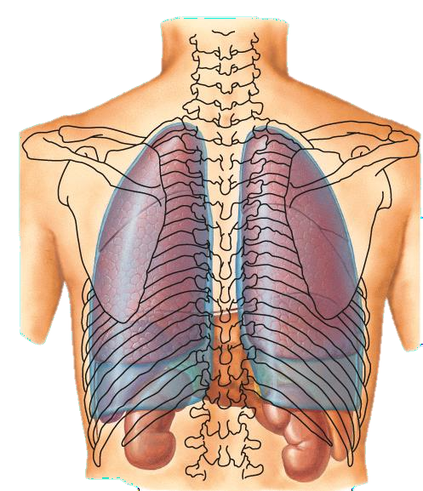
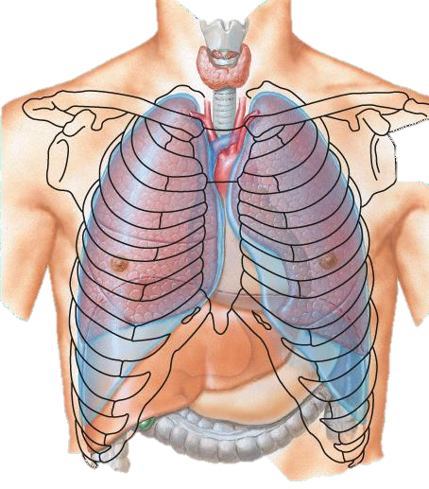
2
4
6
6
8
Surface Anatomy of the Pleura

Slide 3
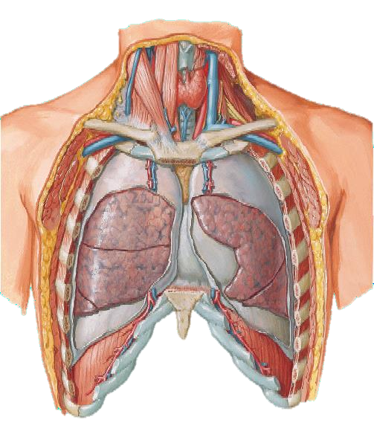
Surface Anatomy of the Pleura
Apex (of each lung): lies one inch above the medial 1/3 of the clavicle.
Right pleura:
The anterior margin extends vertically from sternoclavicular joint to 6th costal cartilage.
Inferior margin : passes round chest wall, on the 8th rib in midclavicular line, 10th rib in mid- axillary line and finally reaching to the last thoracic spine.
Posterior margin : along the vertebral column from the apex to the inferior margin.
Left pleura:
The anterior margin extends from sternoclavicular joint to the level of 4th costal cartilage, then deviates for about 1 inch to left at 6th costal cartilage to form cardiac notch.

Slide 4
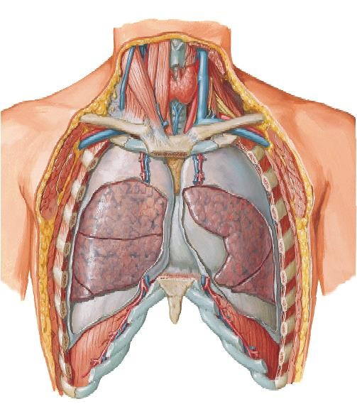
Surface Anatomy of the Lungs
Apex, anterior border and posterior border correspond nearly to the lines of pleura but are slightly away from the median plane.
Inferior margin:
as the pleura but more horizontal and
finally reaching to the 10th thoracic spine.
Oblique fissure:
represented by a line extending from 3rd thoracic spine, obliquely ending at 6th costal cartilage.
Transverse fissure only in right lung: represented by a line extending from 4th right costal cartilage to meet the oblique fissure.

Slide 5
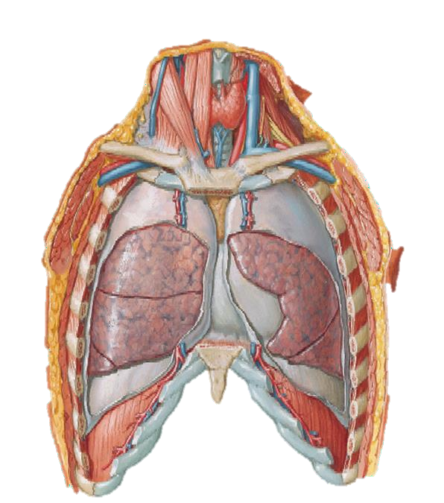
The Pleura
It is a closed serous sac which surrounds the lung and invaginated from its medial side by the root of lung.
It has 2 – layers:
parietal pleura which lines the thoracic cavity.
visceral pleura which surrounds the lung, separated by a pleural cavity.
Pleural cavity:
Contains 5-10 ml. of serous fluid which lubricates both surfaces and allows the lungs to move free during respiration.

Slide 6
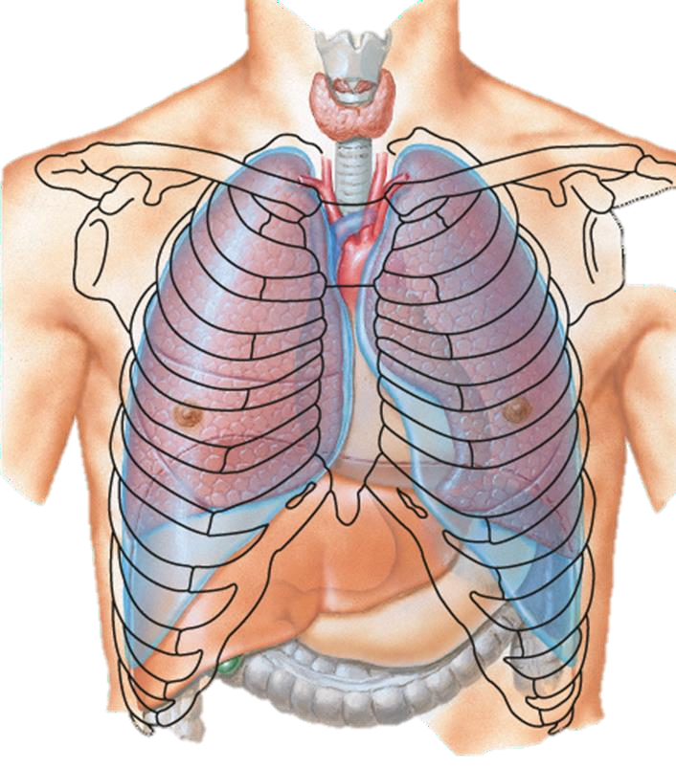
Parts of Parietal Pleura
Cervical pleura:
It is part of parietal pleura which protrudes up into the root of the neck.
Costal pleura:
It lines inner surface of ribs, costal cartilages, intercostal muscles and back of the sternum. Innervated by intercostal nerves.
Diaphragmatic pleura:
It covers upper surface of the diaphragm. Innervated medially by the phrenic nerve, and peripherally by the lower 6 intercostal nerves.
Mediastinal pleura: It covers mediastinal surface of the lung. Innervated by the phrenic nerve.

Slide 7
Visceral Pleura
Firmly covers outer surfaces of the lung and extends into its fissures.
The 2- layers (mediastinal parietal pleura & visceral pleura) are continuous with each other to form a tubular sheath (pleural cuff) that surrounding root of lung (vessels, nerves & bronchi) in the hilum of the lung.
On the lower surface of root of the lung, pleural cuff hangs down as a fold called pulmonary ligament.
Innervated by sympathetic fibres from
pulmonary plexus.

Slide 8
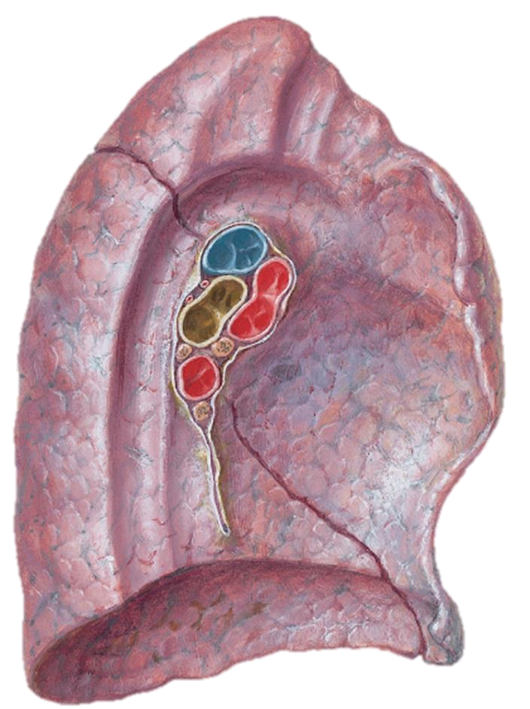
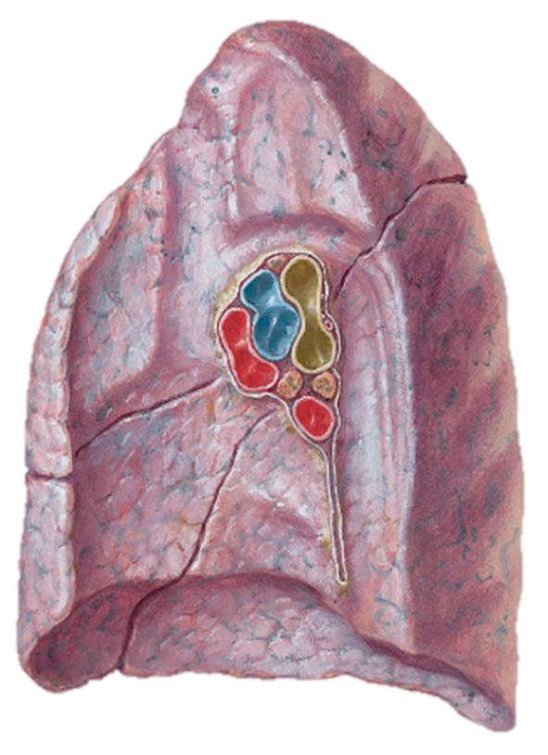
Lungs .. General ..1/3
Anterior border : is sharp, thin and overlaps the heart.
Anterior border of left lung presents a cardiac notch at its lower end + thin projection called the lingula below the cardiac notch.
Posterior border : is rounded, thick and lies beside the vertebral column

Slide 9
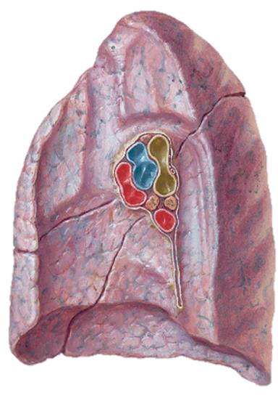
Lungs .. General ..2/3
The lung is conical in shape.
It has an apex, a base and 2 surfaces.
The costal surface of each lung borders the ribs
(front and back).
On the medial (mediastinal) surface, the bronchi, blood vessels, and lymphatic vessels enter the lung at the hilum.
Apex: projects into root of the neck (one inch above the medial 1/3 of the clavicle) and it is covered by cervical pleura.
Base: (inferior= diaphragmatic surface) is concave and rests on the diaphragm.

Slide 10
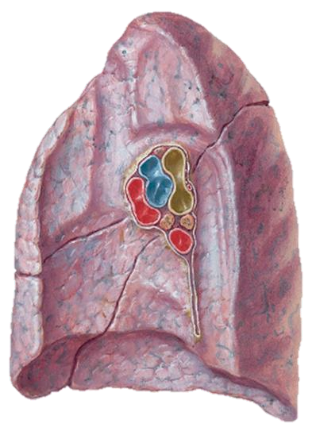
Lungs .. General ..2/3
Costal surface:
Convex.
Covered by costal pleura which separates lung from: ribs, costal cartilages & intercostal muscles.
Medial surface: It is divided into 2 parts:
Anterior (mediastinal) part:
Contains a hilum in the middle (it is a depression in which bronchi, vessels, & nerves forming the root of lung).
Posterior (vertebral) part:
It is related to: bodies of thoracic vertebrae, intervertebral discs, posterior intercostal vessels & sympathetic trunk.

Slide 11
Right Lung
Larger & shorter than left lung.
Divided by 2 fissures (oblique & horizontal) into 3 lobes (upper, middle and lower lobes).

Slide 12
Mediastinal Surface of the Right Lung
Azygos vein and its arch (posterior and
over the root of the lung).
Vagus nerve posterior to the root.
Esophagus above and posterior to the root.
Phrenic nerve anterior to the root.
Cardiac impression: related to right atrium.
Below hilum and in front of pulmonary ligament: Groove for I.V.C.

Slide 13
Root of the Right Lung
2 bronchi lie posterior.
Pulmonary artery is superior
2 Pulmonary veins are inferior and anterior.

Slide 14
Left Lung
Divided by one oblique fissure into -2 lobes, Upper and lower.
There is No horizontal fissure.
It has a cardiac notch at lower part of its anterior border.

Slide 15
Mediastinal Surface of the Left Lung
Descending aorta posterior to the root.
Arch of the aorta above the root. Vagus nerve posterior to the root. Groove for left common carotid artery. Groove for left subclavian artery.
Phrenic nerve anterior to the root.
Cardiac impression : related to left
ventricle.

Slide 16
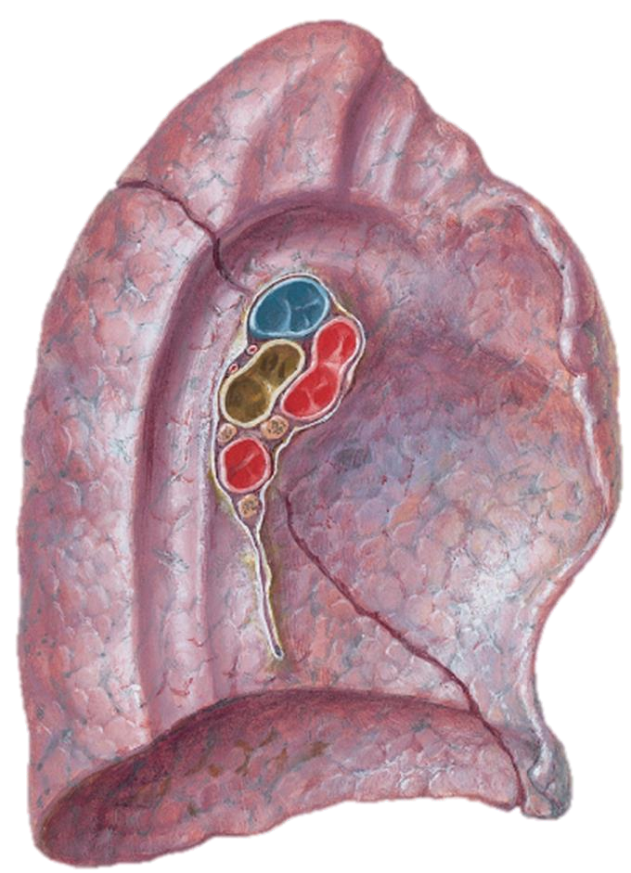
Root of the Left Lung
One bronchus lies posterior
Pulmonary artery is superior
2 Pulmonary veins are inferior and anterior.

Slide 17
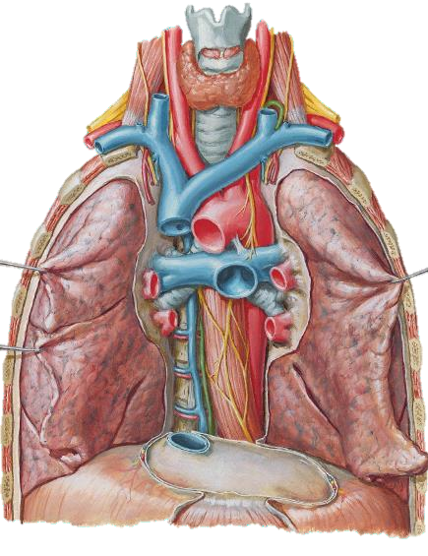
Blood Supply of the Lungs
Bronchial arteries (branches of descending thoracic aorta)….. supply oxygenated blood to bronchi , lung tissue & visceral pleura.
Bronchial veins: drain into azygos &
hemiazygos veins.
Pulmonary artery carries
non-oxygenated blood from right ventricle to the lung alveoli.
2 pulmonary veins from each lung : carry oxygenated blood to the left atrium.

Slide 18
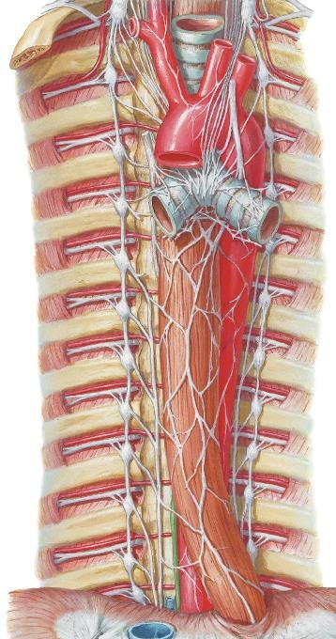
Nerve Supply of the Lung
Pulmonary plexus :at the root of lung. It s formed of sympathetic & parasympathetic fibres.
1- Sympathetic: from sympathetic trunk they are broncho-dilators and vasoconstrictors.
2- Parasympathetic: from the Vagus nerve. They are broncho-constrictors and secretomotor to bronchial glands and vasodilators.

Slide 19
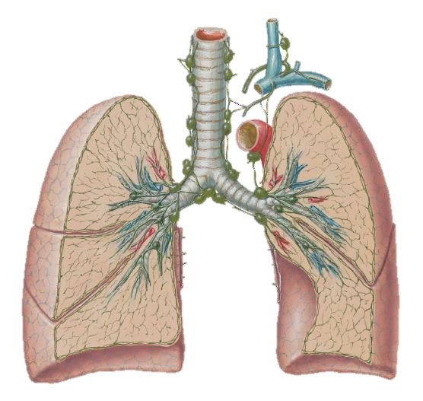
Lymph Drainage of the Lung
There are 2 lymphatic
plexuses
Superficial plexus (subpleural): lies under the visceral pleura and
drains to bronchopulmonary nodes in
the hilum of lung.
Deep plexus:
Lies along the bronchial tree & pulmonary blood vessels and drain into the pulmonary nodes within the lung substance. Then into bronchopulmonary nodes in the hilum of lung. Then into the
tracheo-bronchial nodes at the bifurcation of trachea, and finally into broncho-mediastinal lymph trunks to end in thoracic duct (left) or in right lymphatic duct (right).

Slide 20
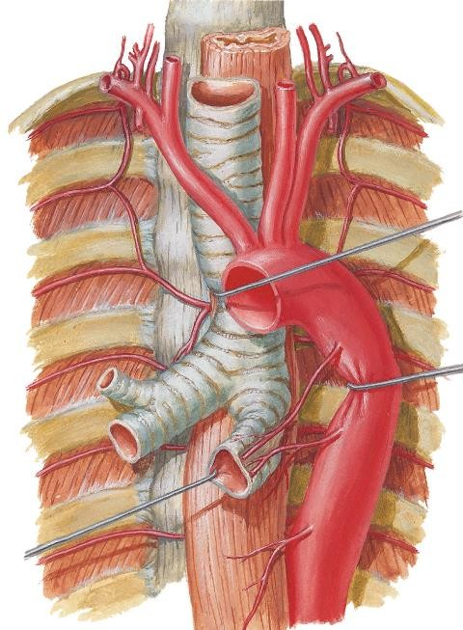
Bronchi
The trachea divides into 2 main bronchi:
Right main bronchus:
divides before entering the hilum, it gives off superior lobar (secondary) bronchus.
On entering hilum, it divides into
middle & inferior lobar bronchi.
Left main bronchus:
it divides after entering the lung into superior & inferior lobar bronchi.
Within the lung each bronchus divides into number of branches.

Slide 21
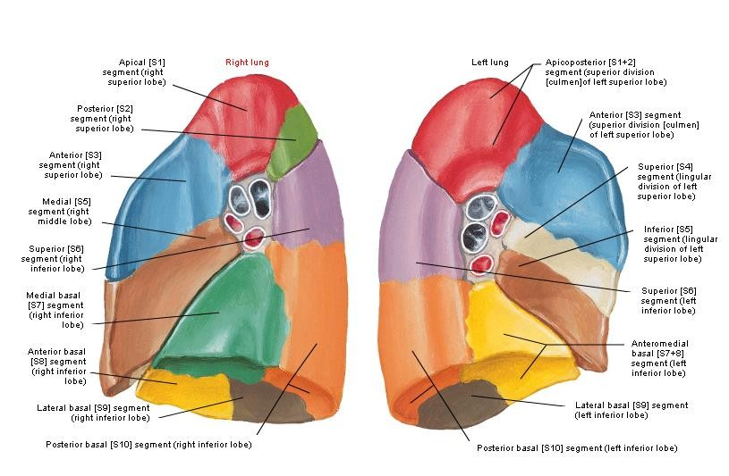
Bronchopulmonary Segments
They are the anatomic, functional, and
surgical units of the lungs.
Each lobar (secondary) bronchus gives off segmental (tertiary) bronchi.
Each segmental bronchus divides repeatedly into bronchioles.
Bronchioles divide into terminal bronchioles, which show delicate outpouchings ‘the respiratory bronchioles’.

Slide 22
Bronchopulmonary Segments
The respiratory bronchioles end by branching into alveolar ducts, which lead into alveolar sacs.
The alveolar sacs consist of several alveoli, each alveolus is surrounded by a network of blood capillaries for gas exchange.

Slide 23
Bronchopulmonary Segments
It is pyramidal in shaped, its apex lies toward the root, while its base lies on the lung surface.
It is surrounded by connective tissue septa.
It has a segmental bronchus, a segmental artery, lymph vessels, and autonomic nerves.
The segmental vein lies in the inter- segmental C.T. septa between the segments.
A diseased segment can be removed surgically, because it is a structural unit..

Slide 24
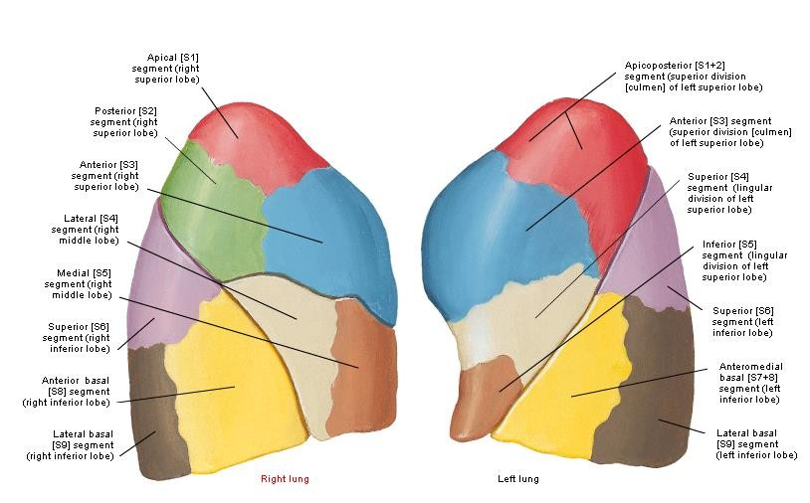

Slide 25
